Slide 1
A Look at the U.S. Military-Industrial Complex through Visual Art

Slide 2
Today’s Lesson
We will:
view and analyze a political cartoon, visual art, and primary source documents;
consider the U.S. military-industrial complex;
learn about the work of artist Gamaliel Rodríguez.
Gamaliel Rodríguez, Figure 1830 (2018)

Slide 3
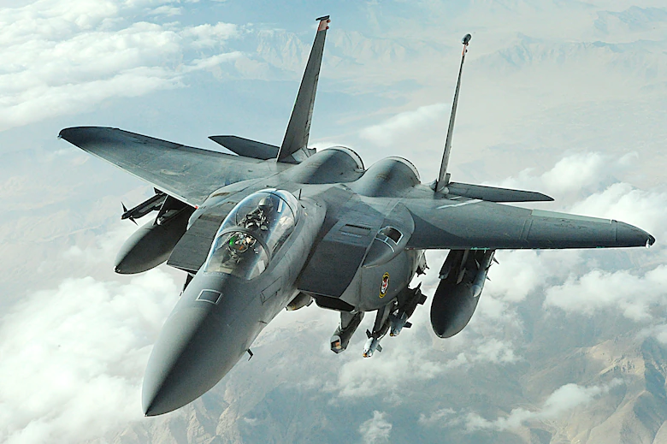
The Rise of the U.S. Military Industrial Complex:
A Cold War Strategy

Slide 4
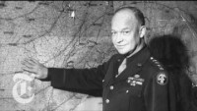
What is the military-industrial complex?
Notes:
Questions:
Who do you recognize in the video?
What can you infer is meant by the military industrial complex?
When did the idea of the military industrial complex begin?
Does it continue today?

Slide 5
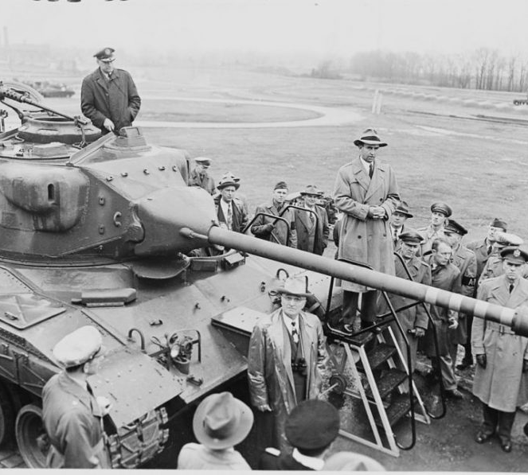
The Rise of the Military Industrial Complex During the Cold War
“The military–industrial complex describes the relationship between a nation’s military and the defense industry that supplies it, seen together as a vested interest which influences public policies. A driving factor behind this relationship between the government and defense-minded corporations is that both sides benefit—one side from obtaining war weapons, and the other from being paid to supply them.”
President Harry Truman with a T41 (tank) prototype.
Notes:
1. Why did the Cold War provide the ideal political environment for the emergence of the U.S. military industrial complex?
2. What are some positives and negatives of the mutually beneficial relationship between the U.S. government and defense industry?
Image from: https://www.warhistoryonline.com/instant-articles/9-american-cold-war-tanks.html
Quote from: https://en.wikipedia.org/wiki/Military%E2%80%93industrial_complex

Slide 6
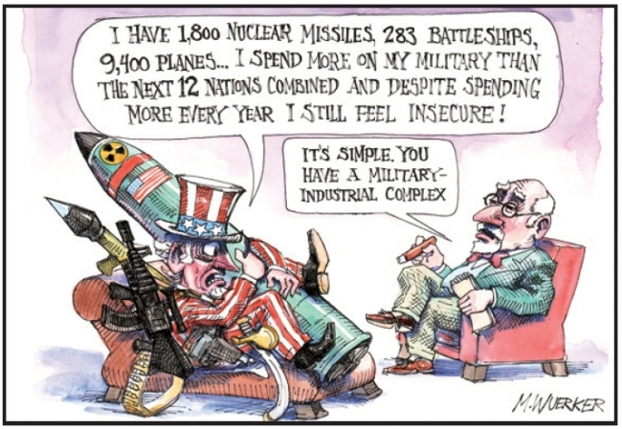
Notes:
1. What do you see in this image?
Who are the main characters in the cartoon? What are they doing?
Read the speech bubbles. In your own words, what are the characters saying?
What do you perceive is the message in this political cartoon?

Slide 7
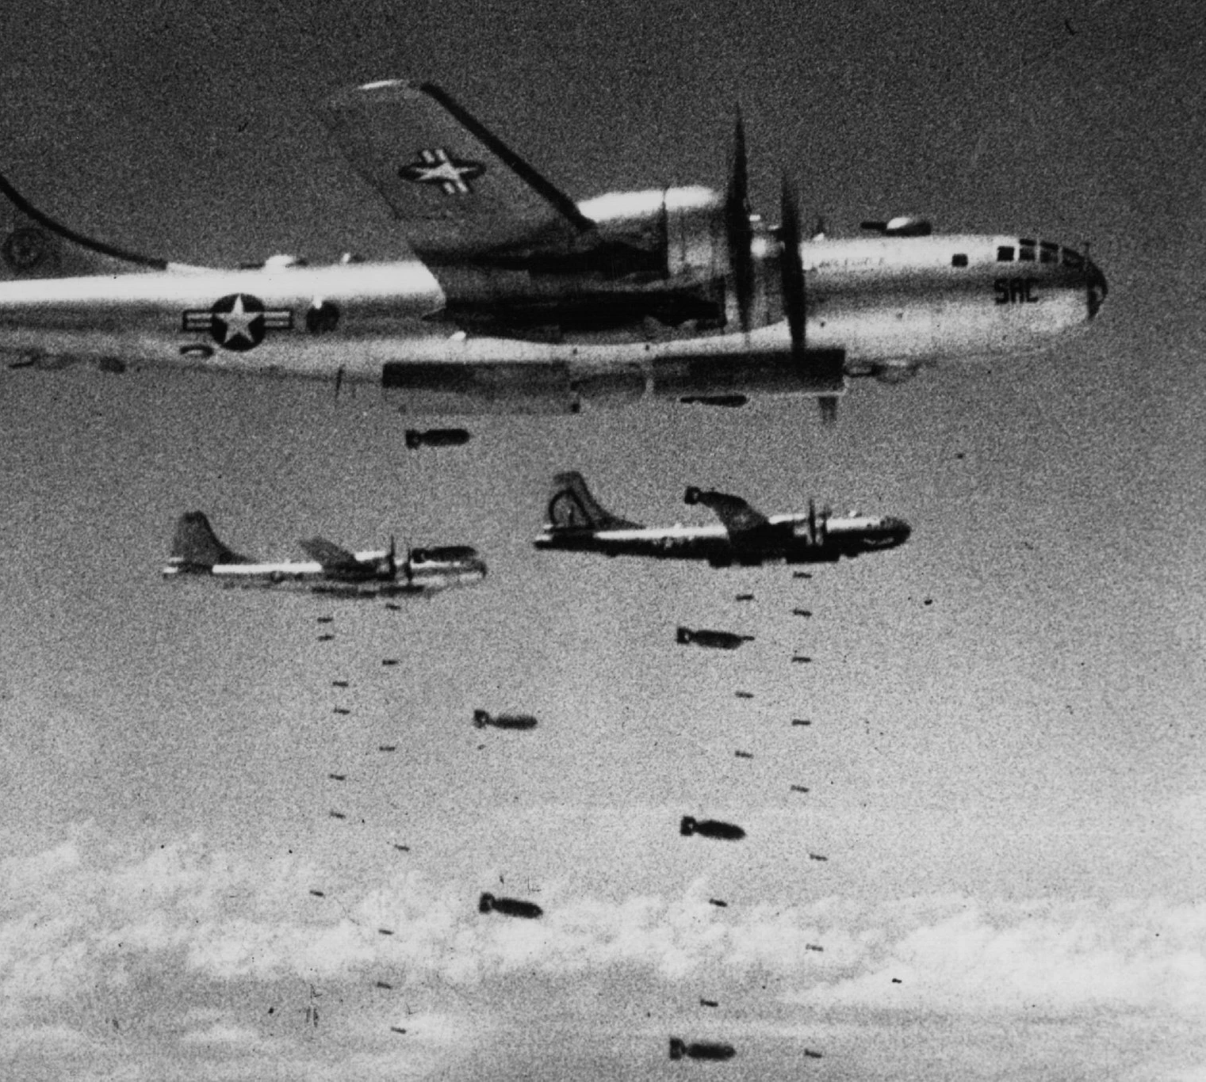
Why did the military-industrial complex emerge?
Post-WWII military expansion
Korean War (1950-1953)
Cold War between the U.S. and the Soviet Union
  National policy: Readiness (preparedness) for war
American B-29 Superfortress Bombers
dropping their payloads during the Korean War.
Notes:
Image from: https://www.nytimes.com/2018/04/25/world/asia/korean-war-.html

Slide 8
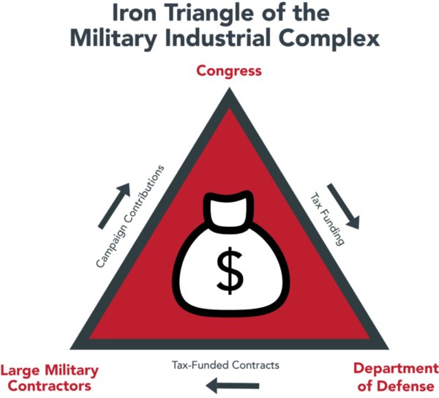
Let’s Consider:
Can artwork be made as a result of, or in response to, the military-industrial complex?
What could that look like?
Notes:
Graphic source: https://www.4sighthealth.com/eisenhowers-prophecy-the-healthcare-industrial-complex/

Slide 9
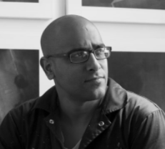
Gamaliel Rodríguez (Artist)
Enlisted in the U.S. Army (2 yrs)
Artwork focuses on militarization
“It is not my desire to criticize any country, or praise it. My work is not political. I present an image, and I let people draw their own conclusions. What I am fascinated by is the subject of power and its consequences”. - Gamaliel Rodríguez, 2013

Slide 10
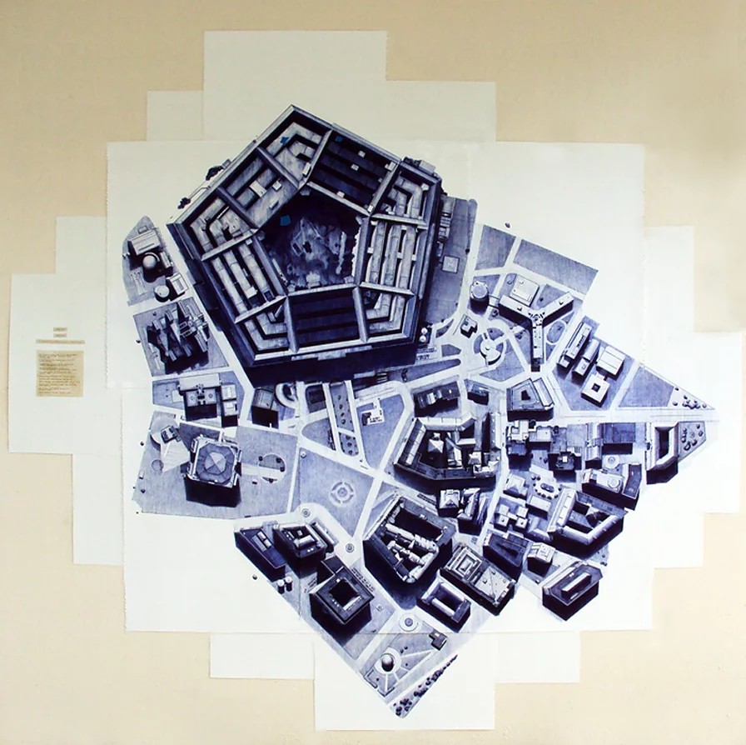
What do you see in this image?
Why do you think the artist titled this painting Smartville?
What does the main building represent to you?
Rodriguez, G. (2010). Smartville, Issues series.

Slide 11
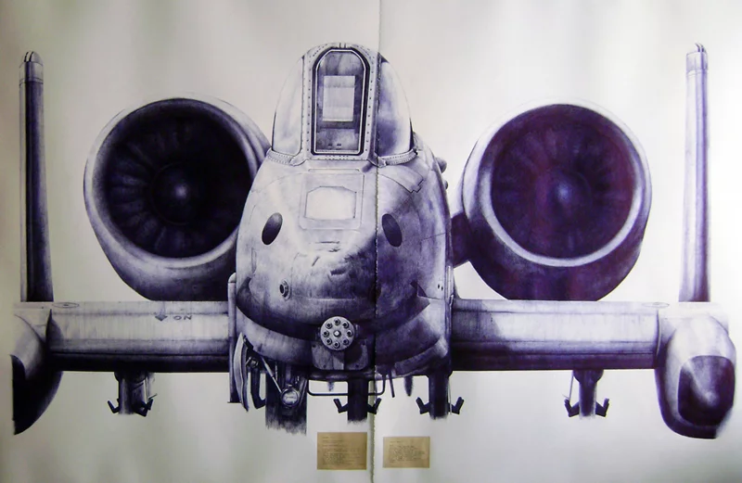
What do you see in this image?
Why do you think the artist titled this painting There is more serious things to talk about?
What does this image represent to you?
Rodriguez, G. (2010). There is more serious things to talk about, Issues series.

Slide 12
Figure 1827 (2018)
Figure 1851 (2021)
Notes:
Gamaliel Rodríguez works with pencil, ink, acrylic and ballpoint pen to produce aerial views of artificial industrial, military, and civilian structures in Puerto Rico and US territories. Memories are manipulated into dystopian, apocalyptic drawings that imagine the collapse of global infrastructure into ruin.

Slide 13
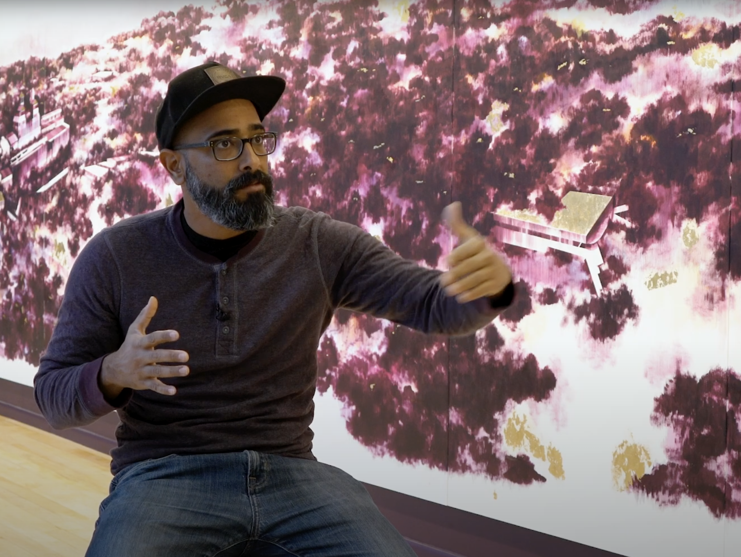
Consider this quote by the artist
“My work is not political.”
Do you agree? Why or why not?

