Slide 1
“On the Bones of the Oppressors”:
Race, Racism, and the
Civil Rights Movement
Notes:
This presentation and lesson is based on the USF CAM exhibition Still Here: The Griffith J. Davis Photographs and Archives in Context (January 22 – March 6, 2021). It includes works by this pioneering photographer, photojournalist and senior US Foreign Service Officer Griffith J. Davis as well as works by contemporary Black artists Emory Douglas and Hank Willis Thomas.

Slide 2
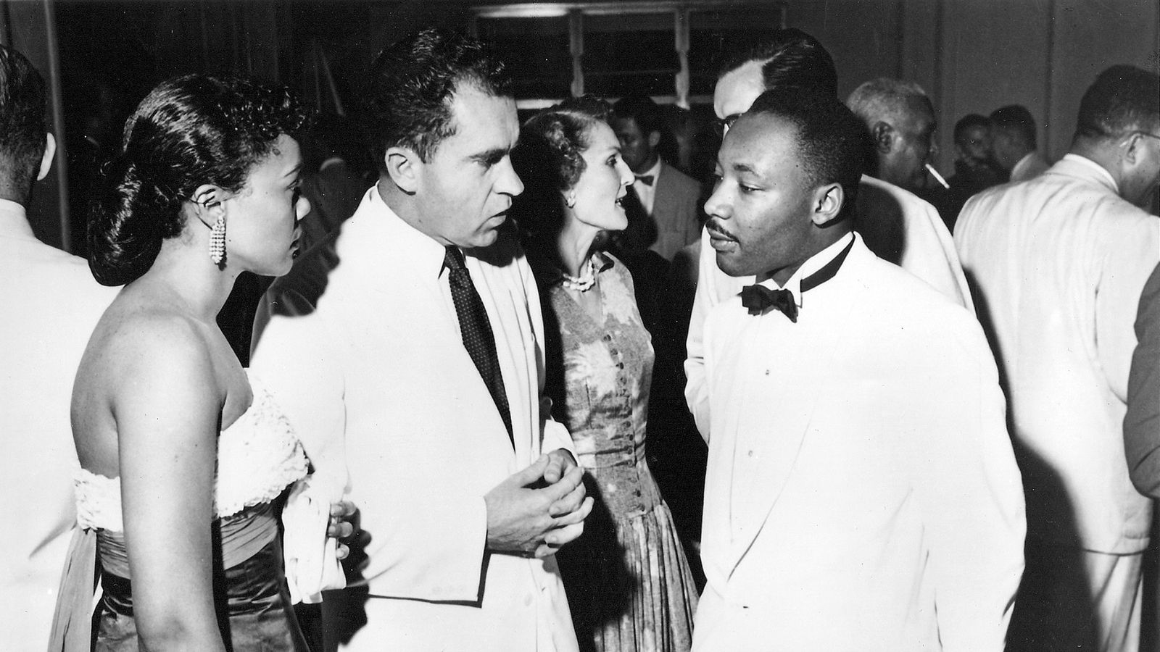
Notes:
Show the photo and allow students 1-2 minutes to study the image. Then ask:
Are there any individuals in the photograph you can identify?
Where do you think this is taking place?
When do you think this photo was taken?
What do you think the people in the photo are talking about?
Later, the photographer who took this photo said: “It was ironic to me that Montgomery, Ala., and Washington, D.C., had to meet at Accra, outside the United States.” What do you think he meant by that?
How does how the black and white photography deliver information differently from that of colored photography?

Slide 3
1st meeting of U.S. Vice President Richard Nixon and Martin Luther King, Jr., Ghana, 1957
Detail of photo by Griffith J. Davis
Notes:
First meeting of U.S. Vice President Richard Nixon and Martin Luther King Jr. and their two wives — Patricia Nixon and Coretta Scott King — during Independence Day celebrations in Accra, Ghana, on March 6, 1957, on the tails of the end of the Montgomery, Ala., bus boycott. It was the first trip to Africa for all of them. [Detail of photo by Griffith J. Davis on assignment as U.S. Foreign Service Officer by U.S. Information Service (USIS). Copyright and courtesy of Griffith J. Davis Photographs & Archives.]
Source: https://www.tampabay.com/arts-entertainment/arts/visual-arts/2020/01/17/this-photo-of-mlk-and-richard-nixon-was-once-taboo-now-see-it-in-tampa/

Slide 4
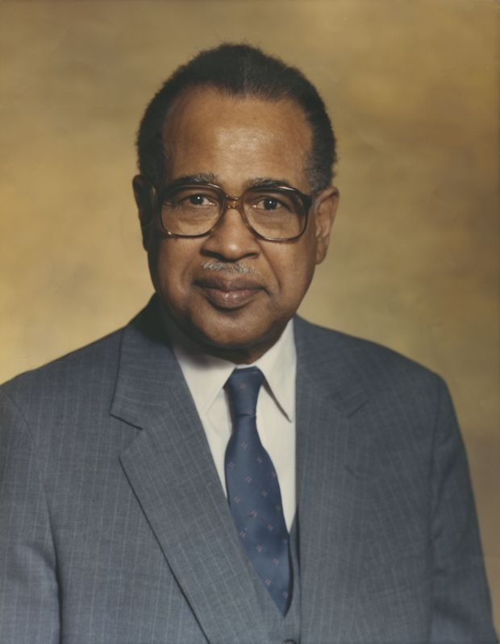
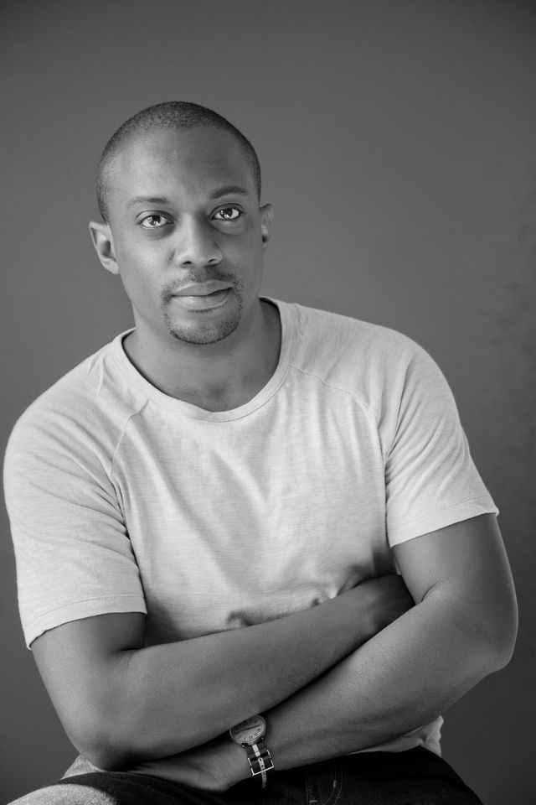
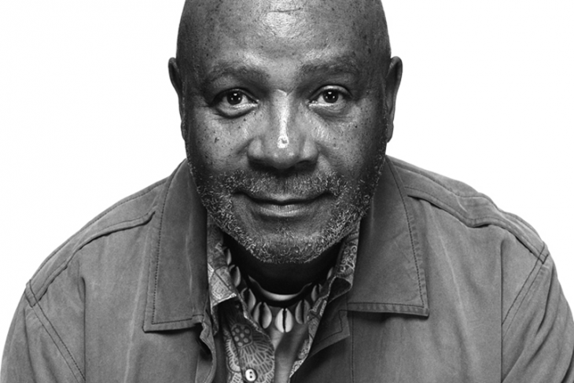
Griffith J. Davis, Emory Douglas, & Hank Willis Thomas
Notes:
Sources of images:
https://www.tampabay.com/opinion/2020/01/17/how-my-dad-captured-this-famous-photo-of-martin-luther-king-jr-column/
https://www.cityartsmagazine.com/art-revolution/
https://www.theartnewspaper.com/interview/hank-willis-thomas-public-art-is-propaganda-frankly

Slide 5
Independent Reading
Read the article “How my dad captured this famous photo of Martin Luther King, Jr” (Tampa Bay Times, January 17, 2020)
Highlight key terms and events as you read
Answer the questions on the sheet provided
We will discuss as a class

Slide 6
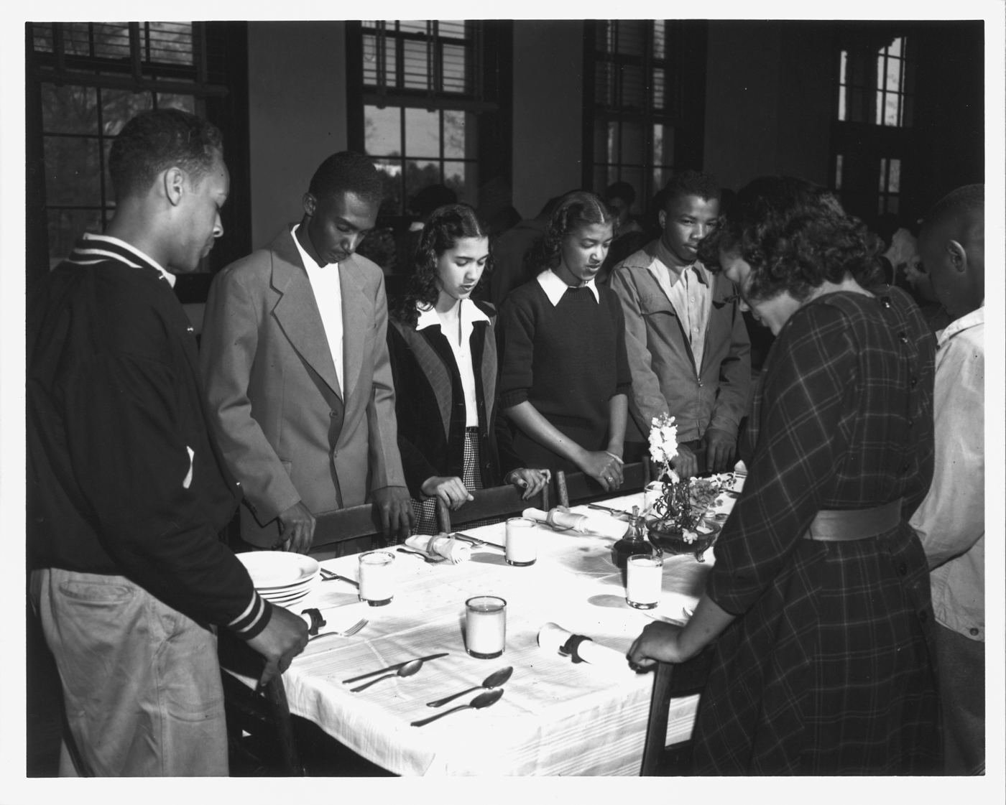
Griffith J. Davis: Brief biography
Born 1923 in Atlanta, GA
Attended Morehouse College same time as MLK, Jr; graduated 1947
Studied journalism at Columbia University; M.A. in 1949
Began career as a photojournalist
Joined the U.S. Foreign Service; posted to Africa
Chronicled Black culture through photography and diplomacy
Notes:
Davis’ breakthrough was a 1947 story for Ebony magazine about life at Palmer Memorial Institute in Sedalia, North Carolina. Founded in 1902 by Charlotte Hawkins Brown, the school was the nation’s only Black boarding school and prepared its students for college. Griffith’s sister attended the school.
Image source: https://share.america.gov/griff-davis-life-in-photography-and-diplomacy/

Slide 7
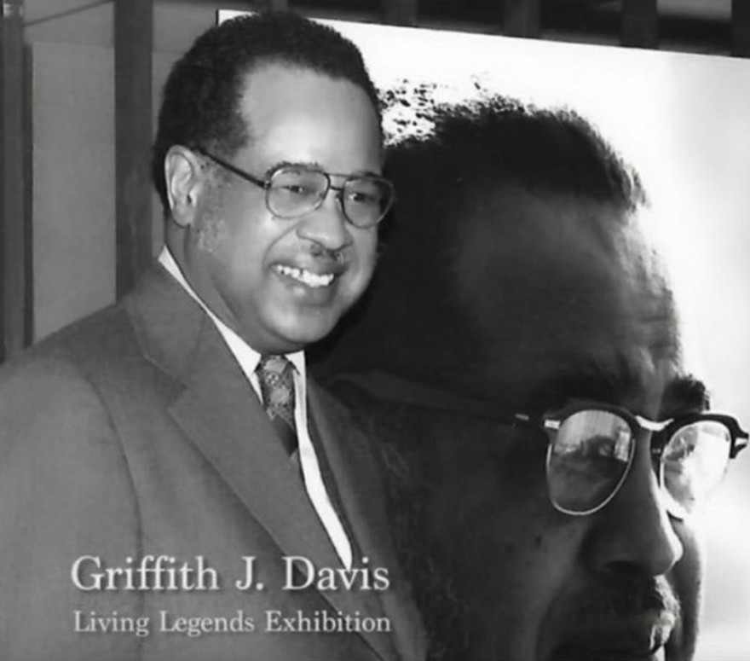
Griffith J. Davis: Selected works
Notes:
Image source: https://wusfnews.wusf.usf.edu/local-state/2020-10-13/photojournalist-griffith-j-davis-honored-with-lifetime-achievement-award

Slide 8
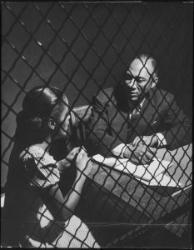
Euclid Taylor interviewing a client, 1948
Notes:
Euclid Taylor was a prominent attorney in Chicago’s black community. For a crime story for Ebony in 1948, Davis photographed Taylor interviewing a client in prison.

Slide 9
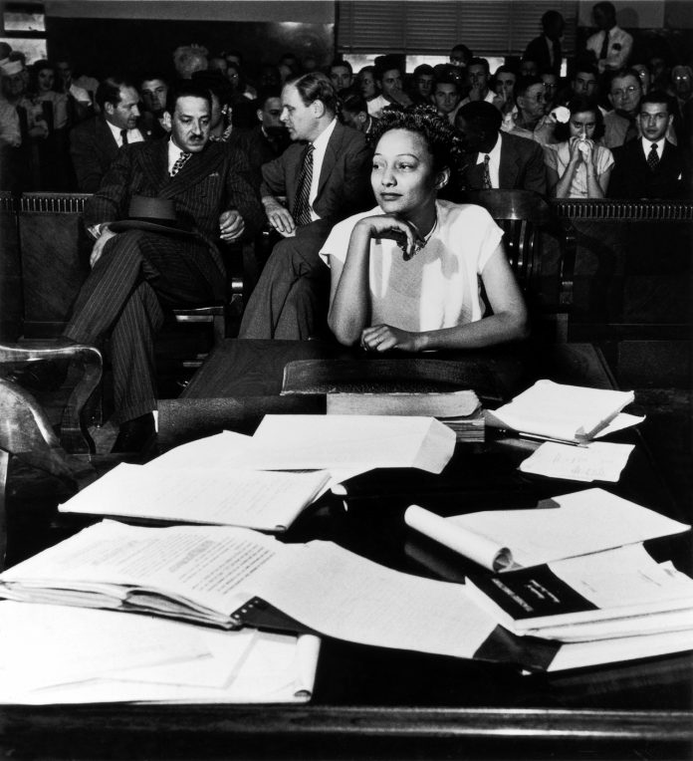
Ada Lois Sipuel vs. University of Oklahoma Law School (1948)
Notes:
Ada Lois Sipuel and Thurgood Marshall (left rear) at Supreme Court during “Ada Lois Sipuel vs. University of Oklahoma Law School”
Griff Davis photographed future Supreme Court justice Thurgood Marshall (rear, left) representing Ada Lois Sipuel (front) against the University of Oklahoma School of Law in a 1948 discrimination suit. (© Griff Davis)

Slide 10
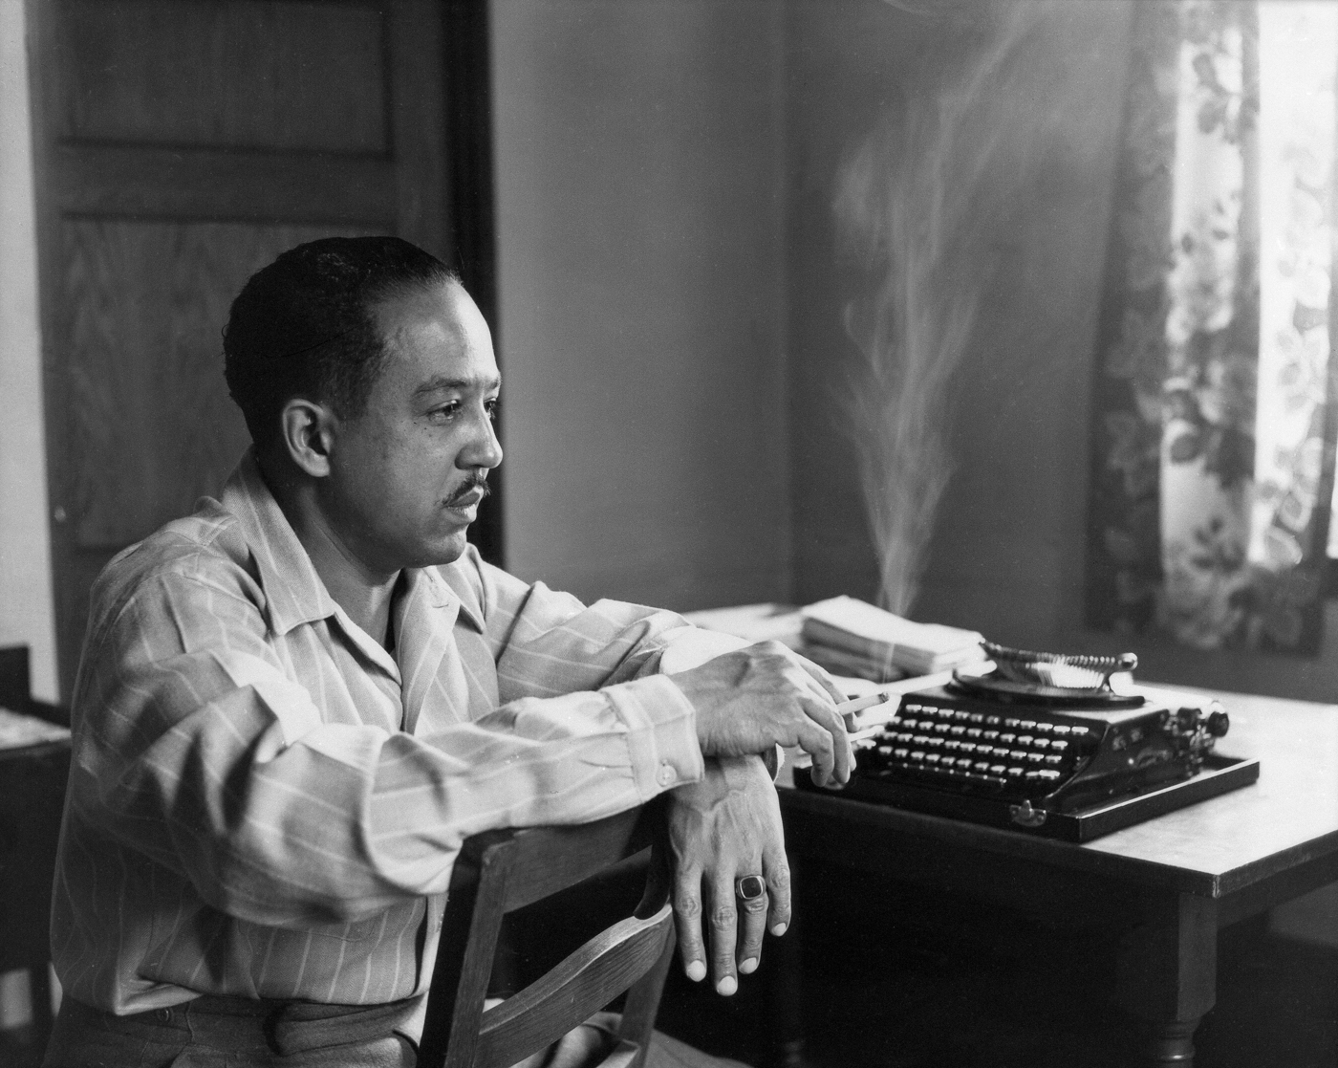
Langston Hughes
Notes:
The celebrated poet Langston Hughes was a friend and mentor to Davis, befriending him in 1946 when Hughes was a visiting professor at Morehouse. While Davis studied journalism at Columbia University, he rented a room in Hughes’ home in Harlem. It was here that Davis took this photo of Hughes sitting in front of his typewriter, which later graced the cover of Hughes’ book of short stories titled The Ways of White Folks.
Image source: https://share.america.gov/griff-davis-life-in-photography-and-diplomacy/

Slide 11
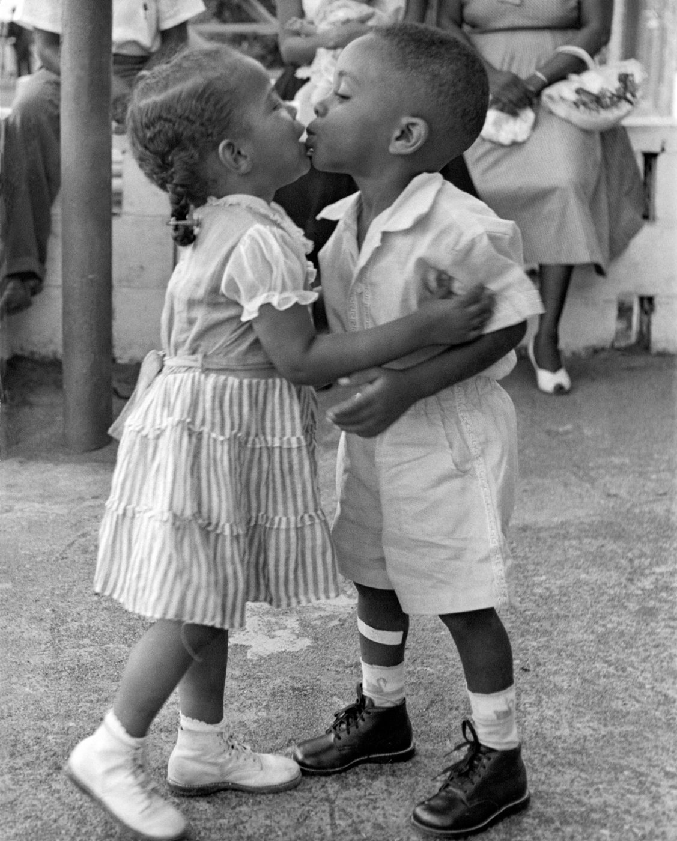
“The International Kiss” (1956)
Notes:
Davis was posted to Africa. In 1956, Davis’ daughter, Dorothy, gives Wiki Padmore, the son of Liberia’s ambassador to the U.S. (George Arthur Padmore), a farewell kiss as the boy prepares to leave Liberia to join his father in Washington. The photo was captioned “International Kiss” when it appeared in a Liberia newspaper at the time.
Image source: https://share.america.gov/griff-davis-life-in-photography-and-diplomacy/

Slide 12
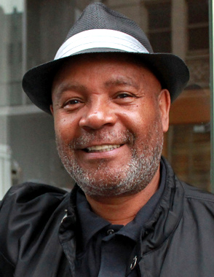
Emory Douglas: Selected works
Notes:
Image source: https://socialistworker.org/2015/05/13/we-always-had-solidarity

Slide 13
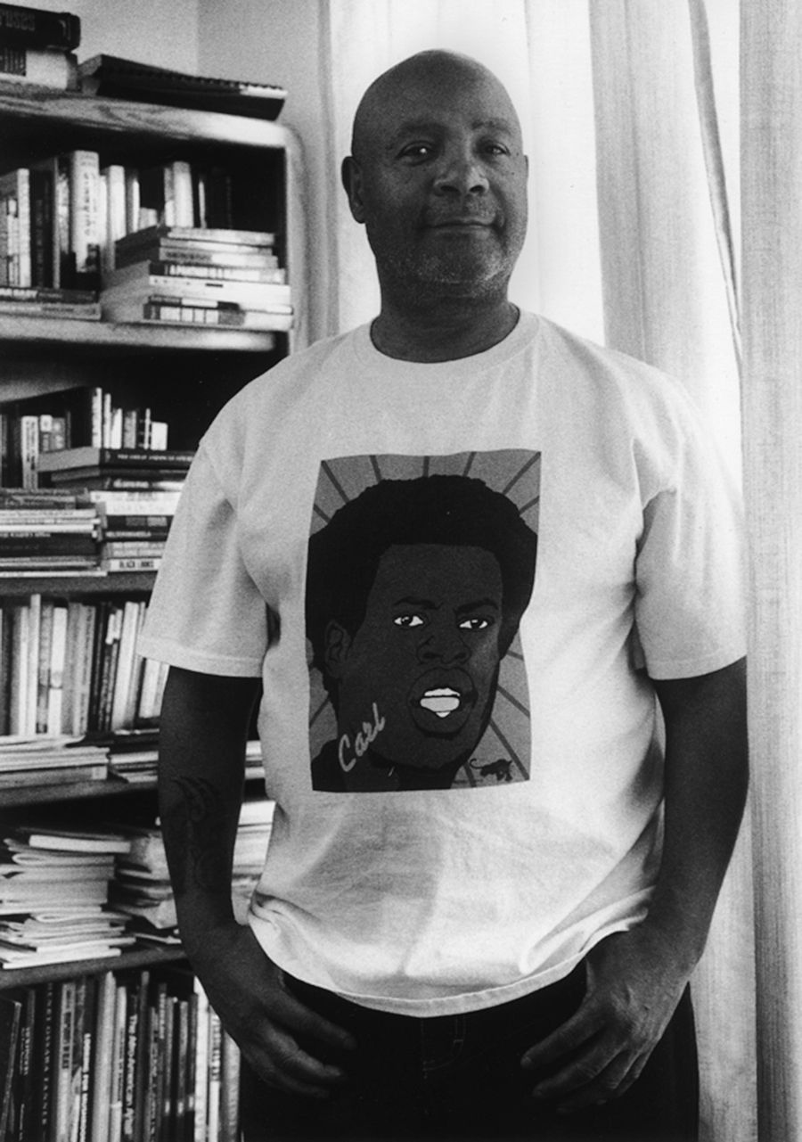
Emory Douglas: Brief biography
Born 1943 in Michigan
Incarcerated as a youth; worked in prison’s print shop
studied commercial art at San Francisco City College
Minister of Culture, Black Panther Party, 1967 - 1980s
Art director, designer, and main illustrator for The Black Panther (weekly newspaper)
Notes:
Image source: https://journalstar.com/entertainment/visual-art/l-kent-wolgamott-emory-douglas-design-social-justice-art-event-of-2015/article_f832a7a9-4809-5332-9702-948466c7a01a.html

Slide 14
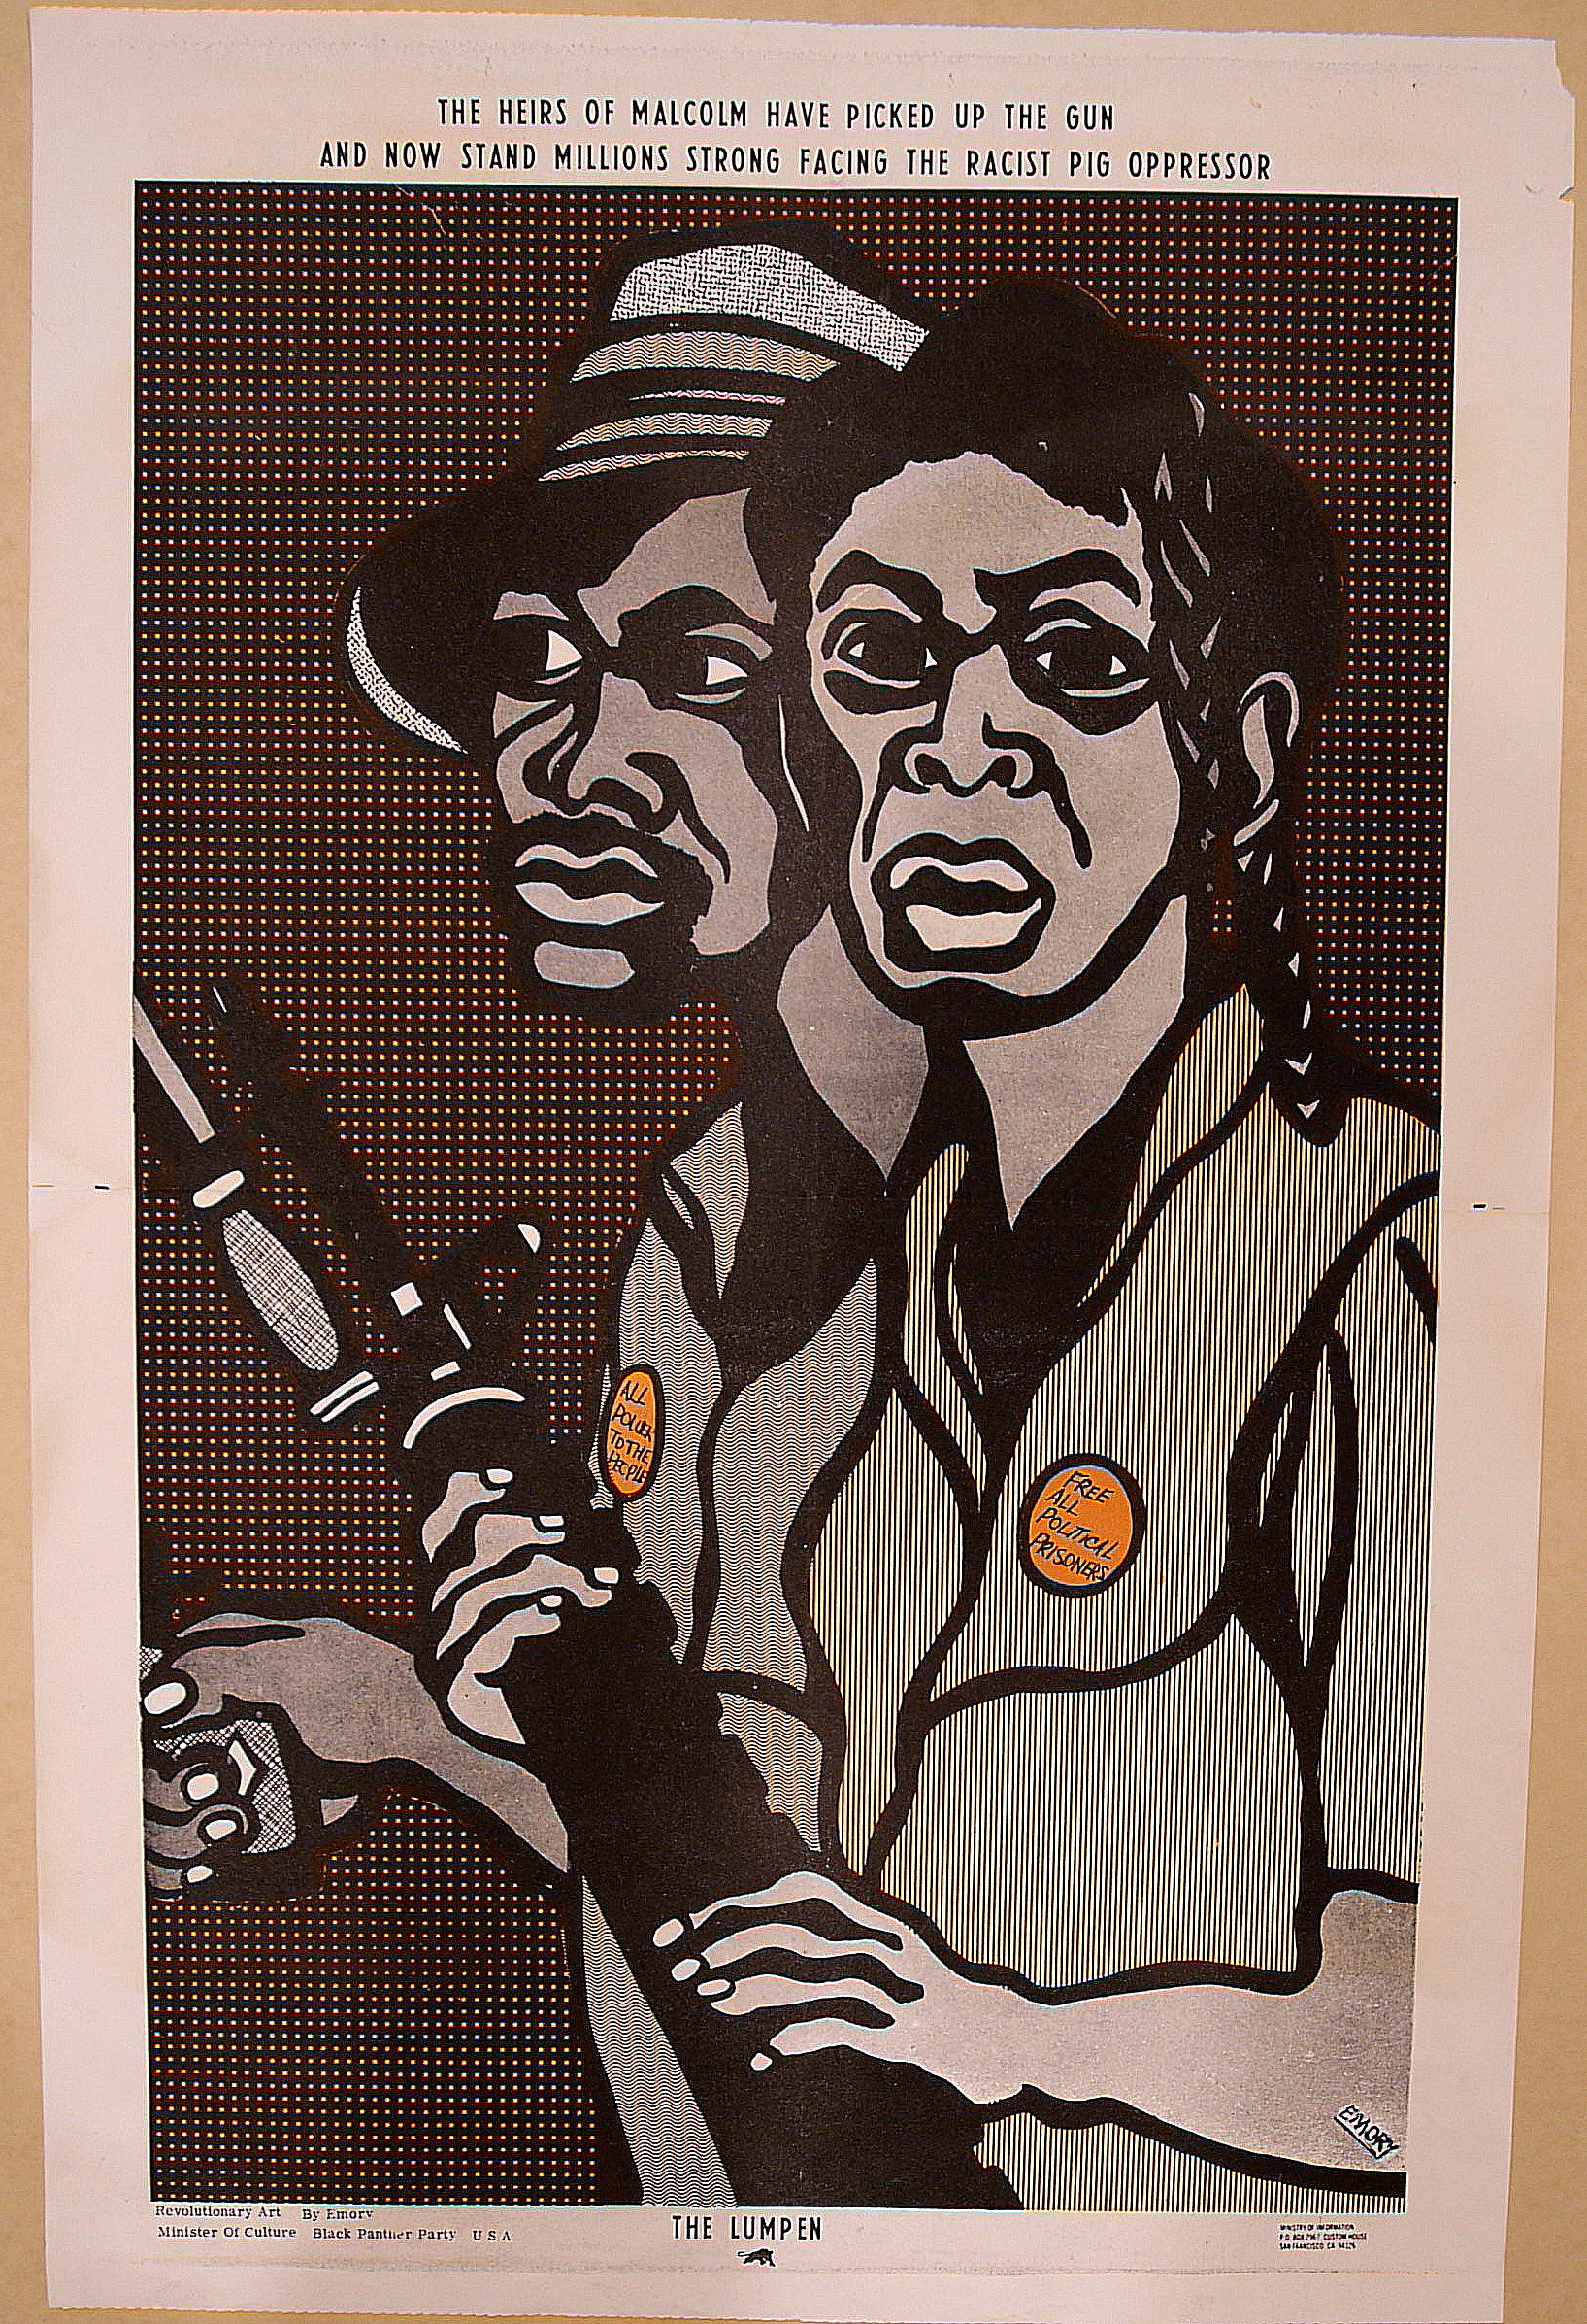
“The heirs of Malcolm have picked up the gun...“
Emory Douglas (1968)
Notes:
Source: https://aap68.yale.edu/black-panther-party-poster-heirs-malcolm-have-picked-gun
Black Panther Party poster: “The Heirs of Malcolm Have Picked Up the Gun…”
This poster was designed by Emory Douglas, Minister of Culture for the Black Panther Party. The bottom right corner bears the address for the Party’s Ministry of Information, demonstrating the importance of the organized dissemination of educational and visual materials in advancing the BPP’s aims. The poster also demonstrates the iconic and unified aesthetic of Douglas-designed material. The BPP slogans “All Power to the People” and “Free All Political Prisoners” appear on buttons worn by the two figures, while text appears above the image: “The heirs of Malcolm have picked up the gun and now stand millions strong facing the racist pig oppressor.”

Slide 15
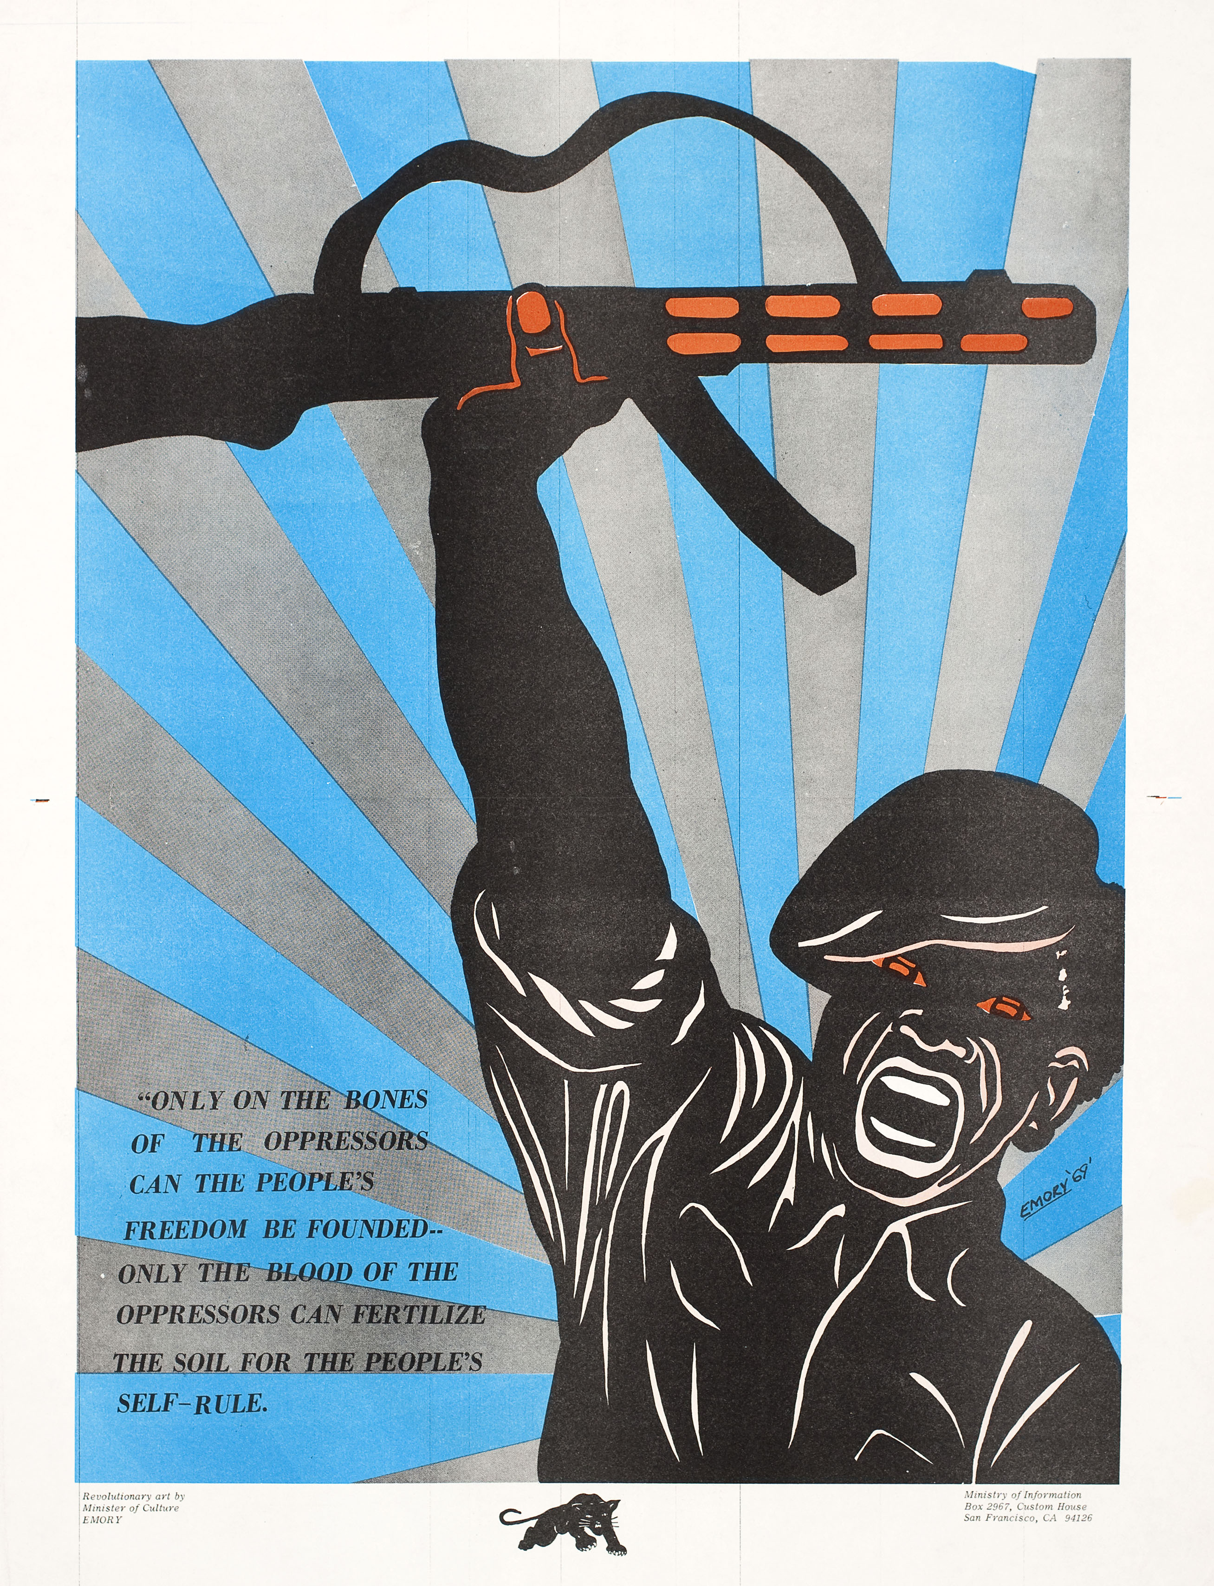
"Only on the bones of the oppressors...“
Emory Douglas (1969)
Notes:
"Only on the bones of the oppressors...". 1969. Emory Douglas, artist. Poster. Collection of Oakland Museum of California, All of Us or None Archive. Gift of the Rossman Family.
Source: http://collections.museumca.org/?q=collection-item/2010542917-0
Emory Douglas
Untitled (On the Bones of the Oppressors)
poster
work on paper
1969
OFFSET LITHOGRAPH
PAPER
20.00 in HIGH x 13.50 in WIDE (50.80 cm HIGH x 34.29 cm WIDE)
All Of Us Or None Archive. Gift of the Rossman Family.
2010.54.2917

Slide 16
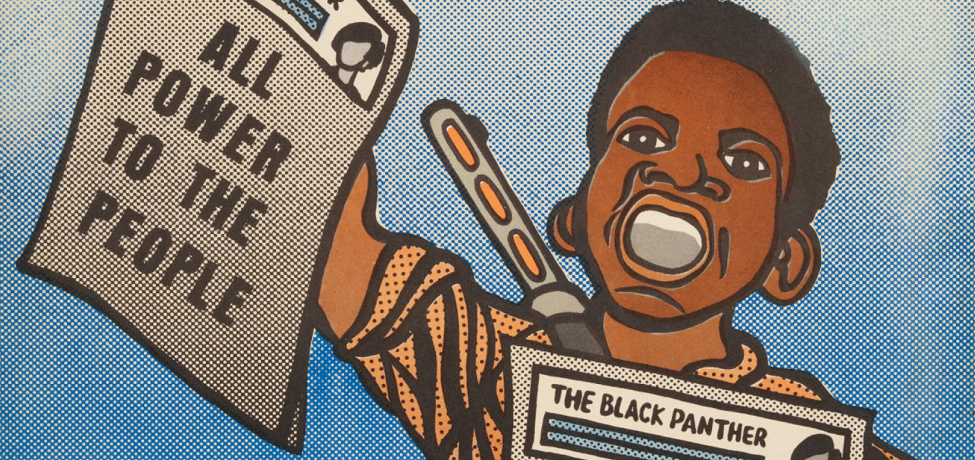
“Paper Boy Black Panther”
Emory Douglas (1968)
Notes:
Image source: https://wibailoutpeople.org/2018/09/24/uw-milwaukee-october-24-2018-artists-now-guest-lecture-series-emory-douglas/

Slide 17
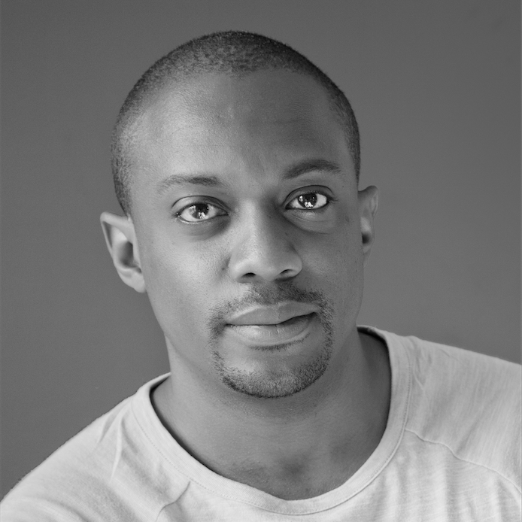
Hank Willis Thomas: Selected works
Notes:
Image source: https://hankwillisthomas.com/BIO/1

Slide 18
Hank Willis Thomas: Brief biography
Born 1976 in New Jersey
Conceptual artist
B.F.A., Photography and Africana Studies, New York University (1998)
M.F.A., Photography and Visual Criticism, California College of the Arts (2004)
Notes:
Image source: https://www.artsy.net/article/editorial-hank-willis-thomas-on-race-the-media
Note:
Conceptual art emphasizes the concept or idea undergirding the work over traditional artistic concerns regarding aesthetics, mediums, materials, and techniques used.

Slide 19
“I’m interested in finding new ways of revealing things that are kind of latent in a given image. I talk about my work as an archaeology in a sense, and I might consider myself a photographic archaeologist, or a visual culture archaeologist. I believe that all the content in my work is really about framing and context, is about calling the viewer to think about how their position affects what they see.”
Hank Willis Thomas
Notes:
Source: https://www.artsy.net/article/editorial-hank-willis-thomas-on-race-the-media
As you view the next images, keep this quote in mind.
Note:
Archaeology is one of the branches of anthropology that seeks to study human activity and history through the recovery and analysis of material culture.

Slide 20
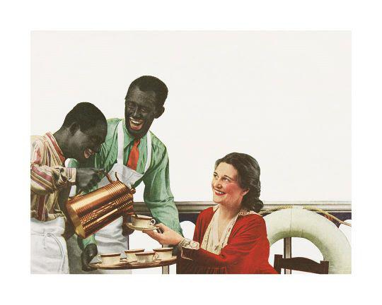
Notes:
Hank Willis Thomas
SN11548.3 – Print
Golly, Mis’ Maria, Folks Jus’ Can’t Help Havin’ a friendly feeling’ for Dis Heah! 1935/2015, 2015

Slide 21
Golly, Mis’ Maria, Folks Jus’ Can’t Help Havin’ a friendly feeling’ for Dis Heah! 1935/2015
Hank Willis Thomas (2015)
Notes:
Hank Willis Thomas
SN11548.3 – Print
Golly, Mis’ Maria, Folks Jus’ Can’t Help Havin’ a friendly feeling’ for Dis Heah! 1935/2015, 2015

Slide 22
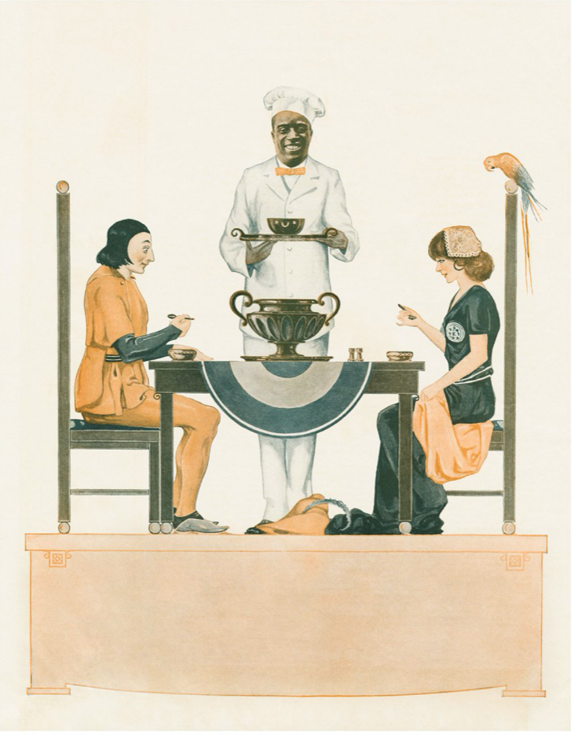
Notes:
Hank Willis Thomas
The Breakfast Belle, 1915/2015, 2015 Sheet: 48 7/8 × 40 in. (124.1 × 101.6 cm) Framed: 50 × 41× 1 3/4 in. (127 × 104.1 × 4.4 cm)

Slide 23
The Breakfast Belle, 1915/2015
Hank Willis Thomas (2015)
Notes:
Hank Willis Thomas
The Breakfast Belle, 1915/2015, 2015 Sheet: 48 7/8 × 40 in. (124.1 × 101.6 cm) Framed: 50 × 41× 1 3/4 in. (127 × 104.1 × 4.4 cm)

Slide 24
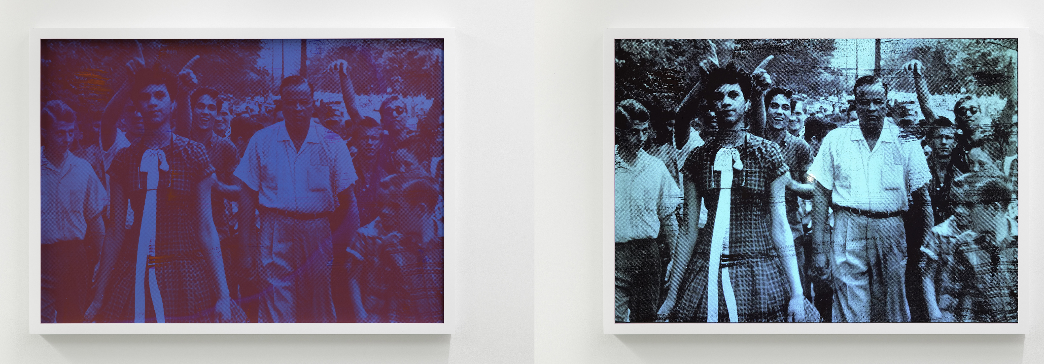
WHAT HAPPENED ON THAT DAY REALLY SET ME ON A PATH (RED AND BLUE)
LEFT IMAGE WITHOUT FLASH, RIGHT WITH FLASH
HANK WILLIS THOMAS (2018)
Notes:
Thomas is also known for his special-effect photographs that require flashes (such as from a camera or phone) in order to see their full contents. Viewed in ordinary light, the photograph What happened on that day really set me on a path (red and blue) (2018) appears to contain oddly-colored shapes. But when illuminated with flash, the work reveals the forms of an African American woman and white protesters, underscoring the invisibility of certain racial histories.
In this work, 15-year-old Dorothy Counts is one of four students integrating Charlotte Mecklenburg Schools. Thomas’ “What happened on that day really set me on a path (red and blue)” chronicles Counts’ first moments at Harding High School.
Source: https://ocula.com/artists/hank-willis-thomas/
Image source: https://garage.vice.com/en_us/article/59jdv5/hank-willis-thomas-jack-shainman-what-we-ask

Slide 25
Hank Willis Thomas and advertising/consumerism
Notes:
See: https://hankwillisthomas.com/WORKS/Photographic/thumbs
https://www.brooklynmuseum.org/exhibitions/unbranded/
https://ocula.com/artists/hank-willis-thomas/
https://www.clevelandart.org/exhibitions/hank-willis-thomas

Slide 26
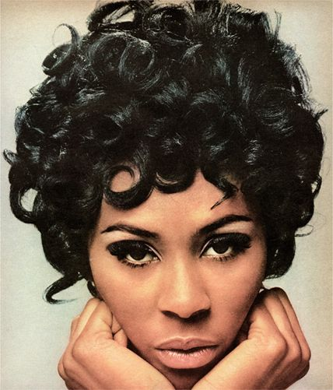
“Relax Me”
Unbranded: Reflections in Black by Corporate America
Hank Willis Thomas (1968/2007)
Notes:
Hank Willis Thomas (American, b. 1976). Why wait another day to be adorable? Tell your beautician “Relax me” 1968/2007. Chromogenic photograph, 34¹⁄₈ x 30 in. (86.7 × 76.2 cm). Brooklyn Museum, Mary Smith Dorward Fund and gift of Robert Smith, by exchange, 2010.18.1
In the series Unbranded: Reflections in Black by Corporate America, Hank Willis Thomas appropriates print advertisements from 1968 to the present that targeted a Black audience or featured Black subjects. From the original ads, taken from popular magazines such as Ebony and Essence, the artist digitally removed all text as well as logos. The remaining figures and scenarios are often both captivating and perplexing, especially in juxtaposition with the sometimes witty and provocative titles given to each image by the artist (which include the original date of the ad followed by the date of the Willis Thomas work).

Slide 27
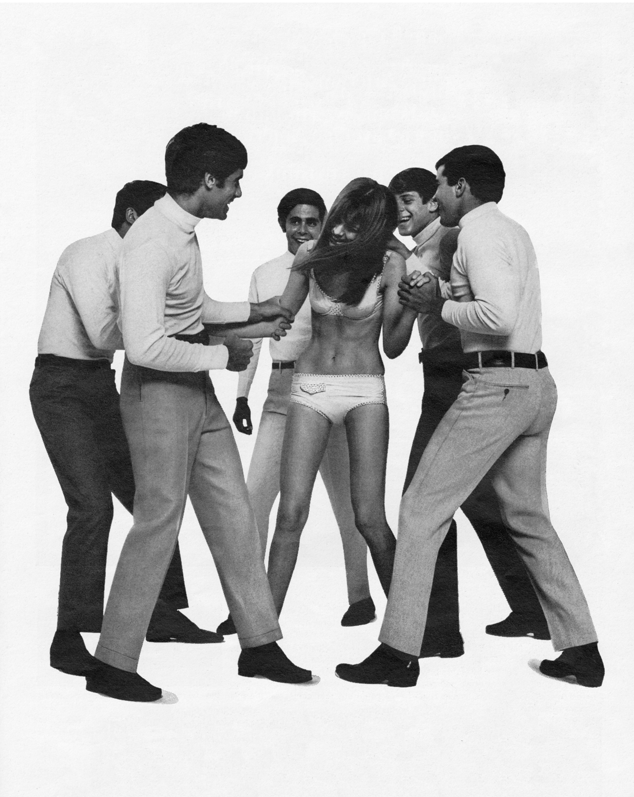
“House Rules!”
Hank Willis Thomas (1967/2015)
Notes:
Willis Thomas also has a series that examines white women and advertising in the U.S.
“House rules!” was originally a 1967 ad for a men’s pants brand that features five men grabbing and laughing at a woman who is only wearing her underwear.
Although today this seemingly violent image would immediately register to viewers as assault, when it came out in 1967, it was perfectly acceptable.

Slide 28
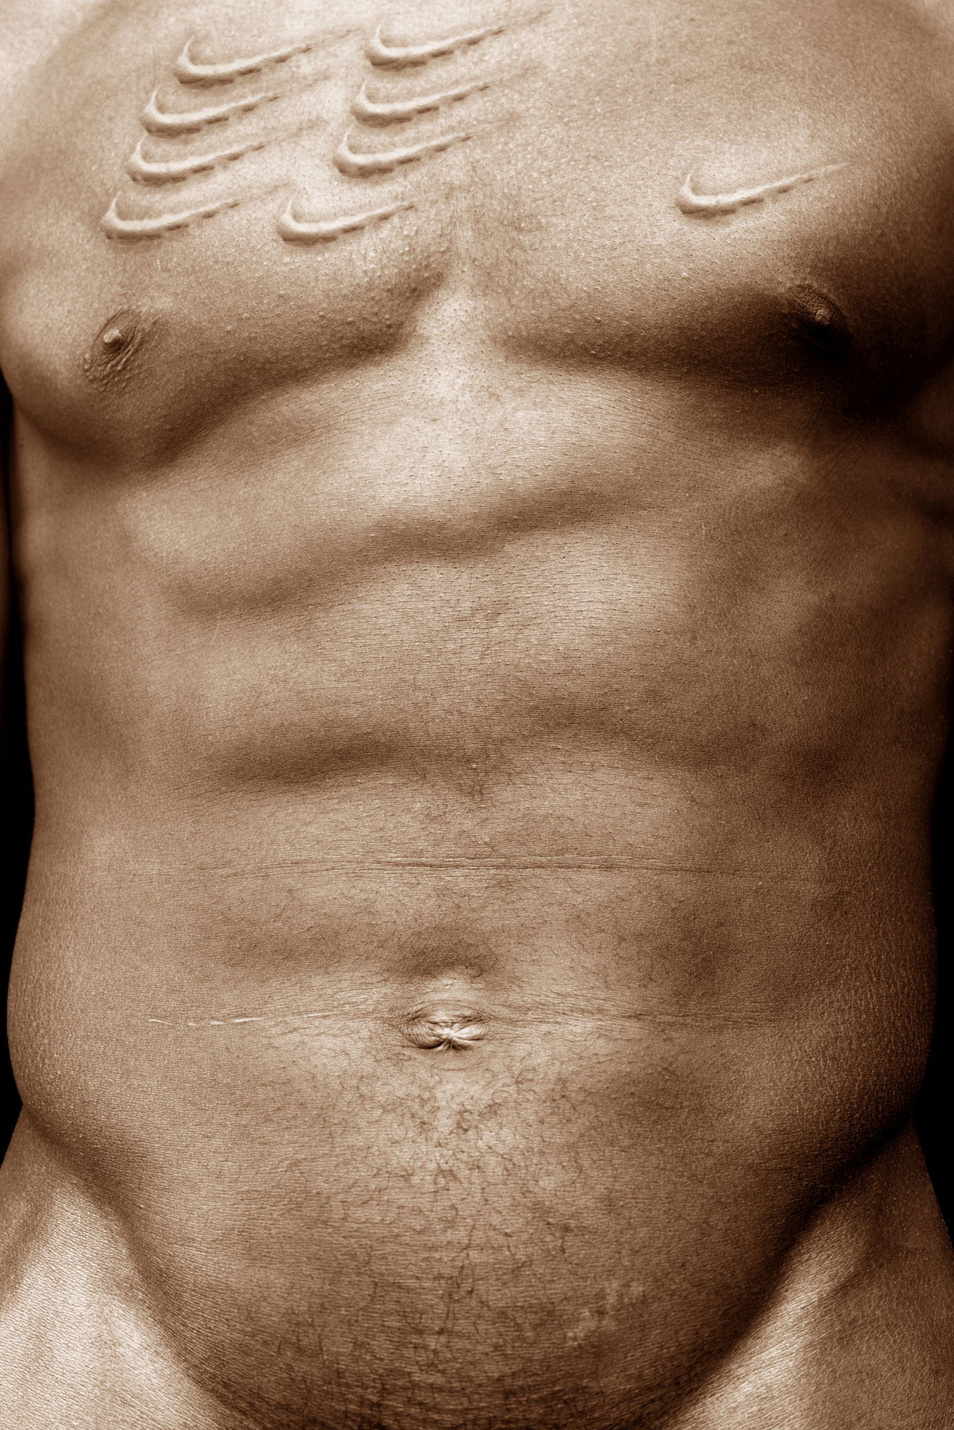
“Scarred Chest”
B®anded/Unbranded
Hank Willis Thomas (2003)
Notes:
By removing the text from advertisements, the exhibit, “Hank Willis Thomas: Branded/Unbranded” examines how marginalized people have been represented by imagery in advertising and what that says about the prejudices ingrained in modern culture.
Thomas’ work is informed by his own experience.
When Thomas was around 5 years old, he became fully aware of his racial identity as an African-American. It was around the same time that he began paying attention to advertisements.
“For me, that’s the moment you start to recognize yourself as part of a larger world,” Thomas says. “You start to learn social codes.” In the early 2000s, he started piecing together the puzzle of branding in relation to personal identity and realizing the influence that marketing tools have on shaping individual identities.
He decided to use art to critique and show the underlying truths of these ads. “Truth is better than fiction, so rather than making images myself, I used actual ads,” he says.
“Scarred Chest” is a manipulated Nike ad in which the athlete’s chest has been physically branded with Nike logos.
This image is particularly potent because, like many athletic brand ads, the model is African-American, and American slaves were often physically branded as a form of punishment for running away throughout America’s slavery era.
In his series B®anded, Thomas investigates the influence of sportswear advertising, the construction of black male identity, and the commodification of black male bodies. Here, the athletically muscled torso of a Black man fills the frame, his chest marred by nine swoop-shaped scars—immediately recognizable as the brand of Nike—that the artist has inserted through digital manipulation. Thomas simultaneously evokes images of the latticework scars left on slaves by the lacerations of an owner’s whip and the historical punishment of branding runaway slaves. In the process, he draws parallels to the corporate brands that adorn the bodies of Black athletes today.

Slide 29
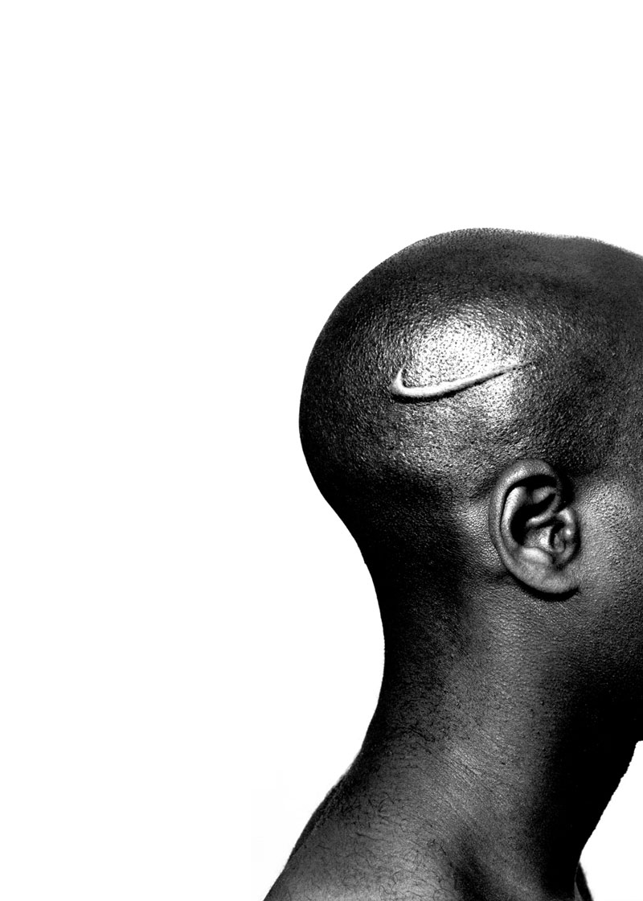
“Branded Head”
B®anded/Unbranded
Hank Willis Thomas (2003)

Slide 30
“I approach photography [and advertising] with skepticism about what’s really the story here, what’s really for sale?”
Hank Willis Thomas
Notes:
Quote source: https://www.artsy.net/article/editorial-hank-willis-thomas-on-race-the-media
Image source: https://www.surfacemag.com/articles/studio-visit-artist-hank-willis-thomas-for-freedoms-super-pac-presidential-election-2016/

Slide 31
What can you find?
Notes:
Image source: http://www.themost10.com/10-most-effective-magazine-ads/

