Slide 1
Rodrigo Valenzuela
“Return of the Real”

Slide 2
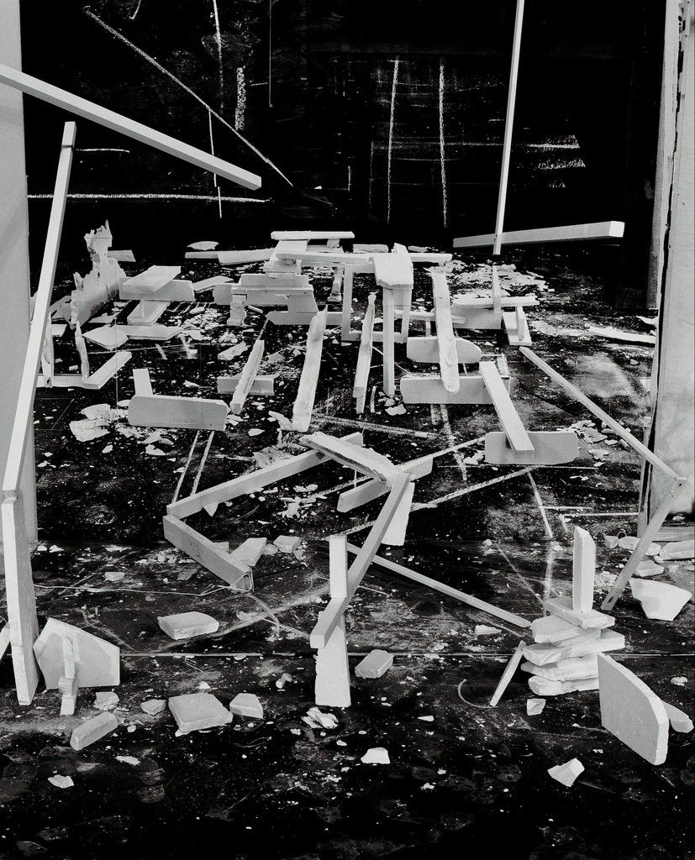
Notes:
Source: https://www.artsy.net/article/artsy-editorial-how-chilean-artist-rodrigo-valenzuela-sheds-light-on-the-immigrant-experience
Allow students a couple of minutes to consider this image. Ask for volunteers to share what they see and what feelings and thoughts the image evokes.

Slide 3
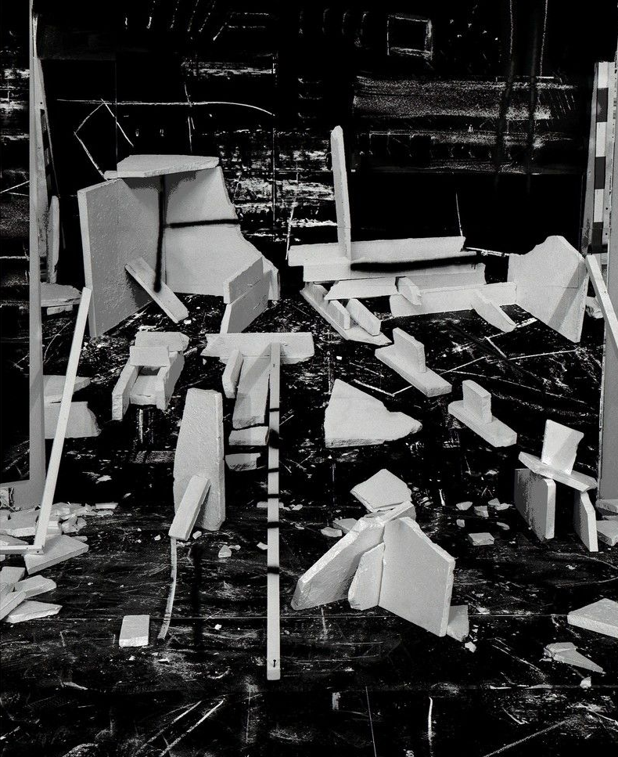
Hedonic Reversal No. 13 Hedonic Reversal No. 12
(2014)
Notes:
Source: https://www.artsy.net/article/artsy-editorial-how-chilean-artist-rodrigo-valenzuela-sheds-light-on-the-immigrant-experience
Explain that the image on the preceding slide is part of a larger work created by Rodrigo Valenzuela, a Chilean artist who now lives and works in Los Angeles, California.
Having formerly worked illegally in construction upon immigrating to the United States by way of Montreal, Valenzuela has focused much of his practice on the undocumented workers whose labor helps erect and maintain metropolitan infrastructure. Knowing this, Valenzuela’s images, and their impetus, are thrown into relief. The displacement the viewer might feel when surrounded by these unfamiliar landscapes of debris seems to echo the alienation sometimes experienced by immigrant laborers.
Tell students that today they will learn about the Chilean artist Rodrigo Valenzuela.

Slide 4
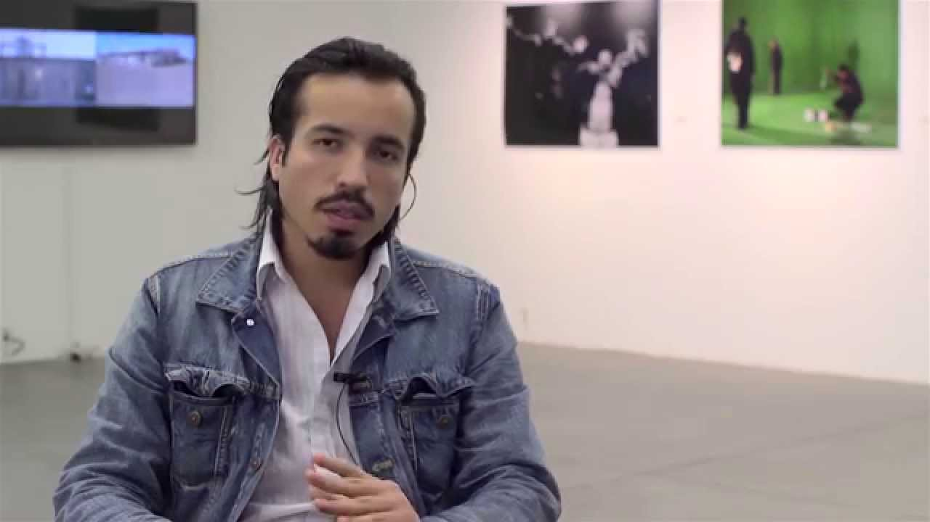
Rodrigo Valenzuela:
Shedding Light on the Human Experience

Slide 5
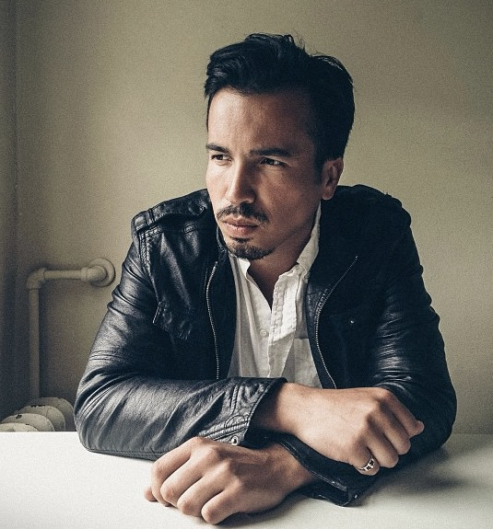
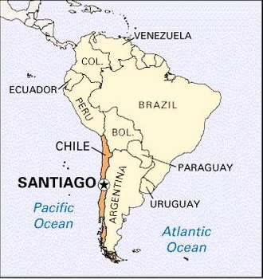
Brief biography
Born in 1982 in Santiago, Chile
Immigrated to the United States at age 21 by way of Montreal
Worked in U.S. as an undocumented construction laborer and janitorial worker
Notes:
Valenzuela’s father was a mailman; his grandfather was a carpenter. Both were members of their unions. As such, Valenzuela credits this background with his identification with the working class.
Source of photo: https://teiartinbuildings.com/collaborators/rodrigo_Valenzuela
Source of map: https://www.britannica.com/place/Santiago-Chile

Slide 6
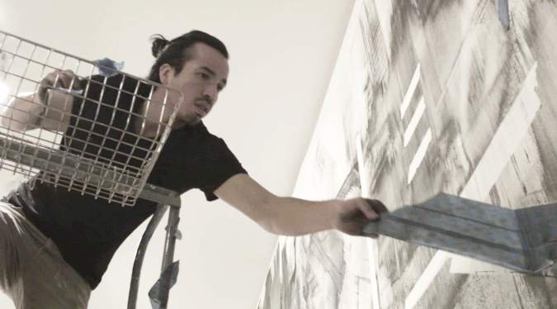
Education
B.F.A. in art history and photography, University of Chile in Santiago
B.A. in philosophy from Evergreen State College, Olympia, WA
M.F.A. in Photomedia, University of Washington, Seattle
Now a Professor at UCLA and permanent US resident
Notes:
http://blogs.evergreen.edu/artistlectureseries/blog/2018/08/17/week-4-rodrigo-valenzuela-wendesday-october-17th-1130-1pm-in-lecture-hall-1/

Slide 7
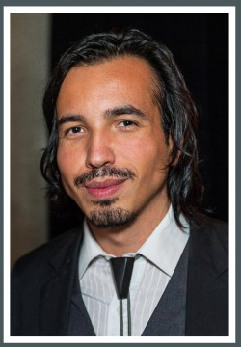
Valenzuela’s art work
Points out tensions between the individual and community
Addresses issues and experiences common to working-class people living in the United States
Much of his work centers on the lives of undocumented immigrants and workers
Pays special attention to recent immigrants and Latinx people
Notes:
Source: https://klowdenmann.com/artist-press/rodrigo-valenzuela-at-new-museum/
Valenzuela addresses issues and experiences common to working-class people living in the United States, paying special attention to recent immigrants and those of Latinx heritage.

Slide 8
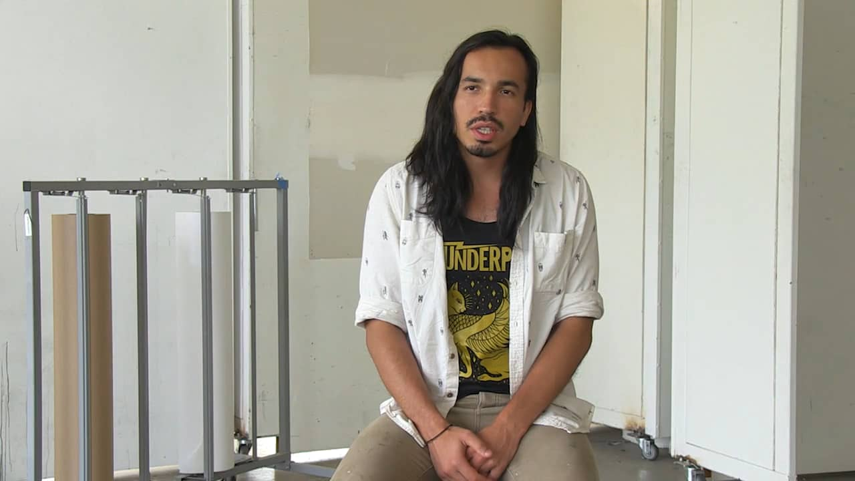
Techniques
“lens-based work”
Installation
Photography
Film
Notes:
http://art.ucsc.edu/news_events/visiting-artist-lecture-%C2%A0-rodrigo-Valenzuela
Valenzuela (2019) considers his work to be “lens-based” – that is, the camera is central to his approach and artistic process.

Slide 9
Installations

Slide 10
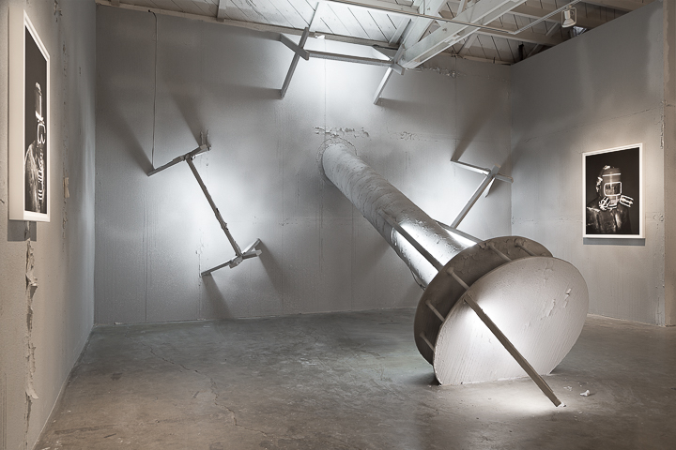
General Song (2018)
Notes:
Source: https://artillerymag.com/rodrigo-valenzuela/
Named after Pablo Neruda’s epic poem (Canto General, an encyclopedic poetic history of the New World told from a Latin American perspective), Rodrigo Valenzuela’s own “General Song” harmonizes with its Lantinx perspective.

Slide 11
Rodrigo Valenzuela. Barricade No. 3 (2017)
archival pigment print mounted on Dibond, 55 x 45 inches
Notes:
Source: http://www.laurencemillergallery.com/artists/rodrigo-valenzuela
In his series Barricades, the work alludes to the structures erected by both oppressors and the oppressed amidst acts of civil disobedience.

Slide 12
Barricade No. 3 (2017)
archival pigment print mounted on Dibond, 55 x 45 inches
Notes:
Source: http://www.laurencemillergallery.com/artists/rodrigo-valenzuela
Valenzuela speaks of travelling across the US by car and paying witness to the parts of the landscape that we look away from, the discarded parts of the American Dream that line the roadside mile after mile. In this sense, while his methods may differ, his aim is an heir to traditions like the Photo League* that sought to use the camera to bring focus to parts of contemporary life and social issues that we might otherwise choose to disregard. These works have a flinty discipline in their execution and feel equally connected to the early history of photography and contemporary art, as well as the politics of our day.
*The Photo League was a cooperative of photographers in New York who banded together around a range of common social and creative causes. The League was active from 1936 to 1951 and included among its members some of the most noted American photographers of the mid-20th century.

Slide 13
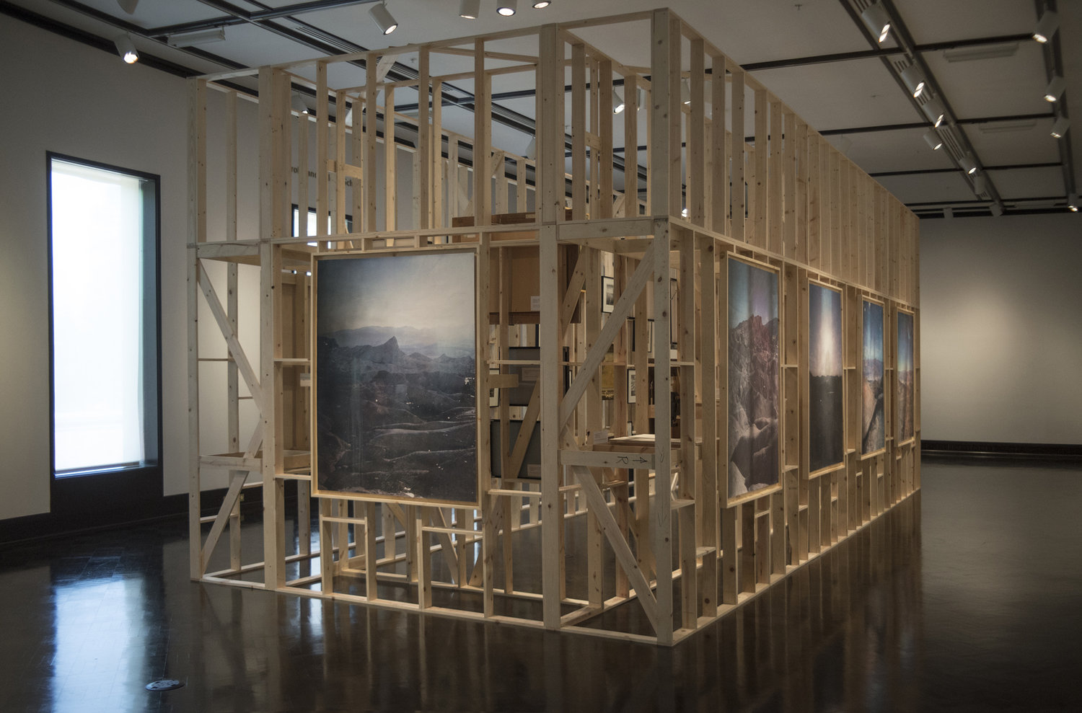
Work in Its Place (2018)
Notes:
Jordan Schnitzer Museum of Art. (2018). Work in Its Place. Eugene, OR: Author. https://jsma.uoregon.edu/RodrigoValenzuela
The JSMA invited Valenzuela to use its collection as working material. He selected images of bucolic landscapes, quintessential Americana, manual labor, and the overwhelming magnificence of vast expanses in nature, sometimes referred to as the sublime. All of these works come out of a predominantly white, male, Eurocentric tradition in the visual arts. Valenzuela and the curator arranged these works on the inside of a wooden structure, which he calls “an enclosed tower.” Explaining his intent for creating a barrier around art and information, he states, “I want to create a piece that makes direct reference, metaphorically and physically, to the access that we are provided in education and within institutions to be part of hegemonic discourses.”

Slide 14
PHOTOGRAPHY

Slide 15
Hedonic Reversal No. 13 Hedonic Reversal No. 12
(2014)
Notes:
Source: https://www.artsy.net/article/artsy-editorial-how-chilean-artist-rodrigo-valenzuela-sheds-light-on-the-immigrant-experience
The monochrome prints on view show strange arrangements of building materials, specifically Styrofoam and plaster, that resemble the rubble of an ancient—or perhaps future—city. Prior to their outing at envoy, the works were shown at the Frye Art Museum in Seattle as part of Valenzuela’s first solo museum show, “Future Ruins.” There, they hung amidst a large-scale, site-specific installation that resembled a construction site, replete with scaffolding. On the clean, white walls of envoy, on the other hand, Valenzuela’s black-and-white fields of detritus, which are resolutely absent of human figures, feel alien.
From https://www.artforum.com/picks/rodrigo-valenzuela-50618: The term “hedonic reversal” refers to a psychological phenomenon in which one actively pursues pain and sadness. In Valenzuela’s work, it speaks to both first-world workaholism and the entrapment of low-wage survival.

Slide 16
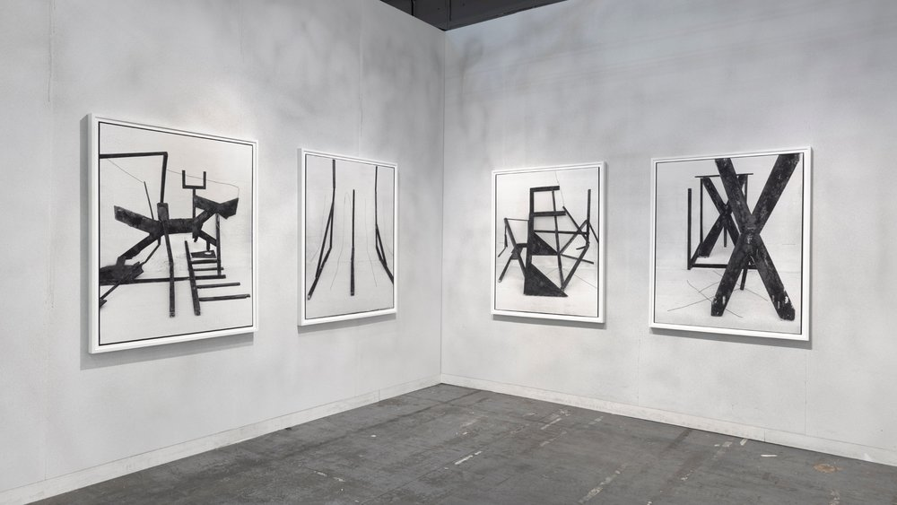
American-type
The Armory Show, New York (March 2019)

Slide 17
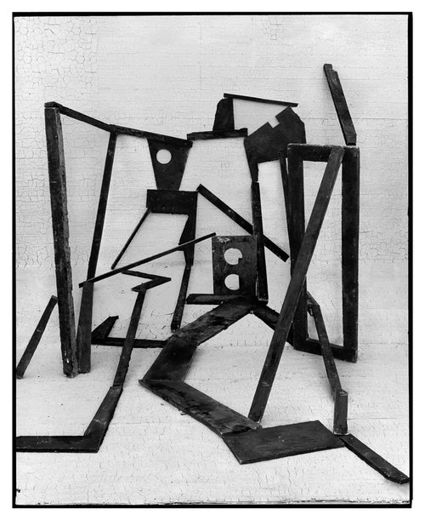
American-type, No. 9
(2018) archival pigment print
55 X 45 inches
Notes:
Source: http://www.laurencemillergallery.com/artists/rodrigo-valenzuela
Rodrigo Valenzuela’s photographs depict immersive whitewashed tableaus that he constructs from commonly cast-off items. These assemblages are evocative of the kind of transitional spaces in modern living associated with both building construction and urban decline…The materials and labor involved in these sculptural works harken back to the construction work that the artist initially performed as a recent US immigrant while also attending art school and navigating the process to become a US resident

Slide 18
film

Slide 19
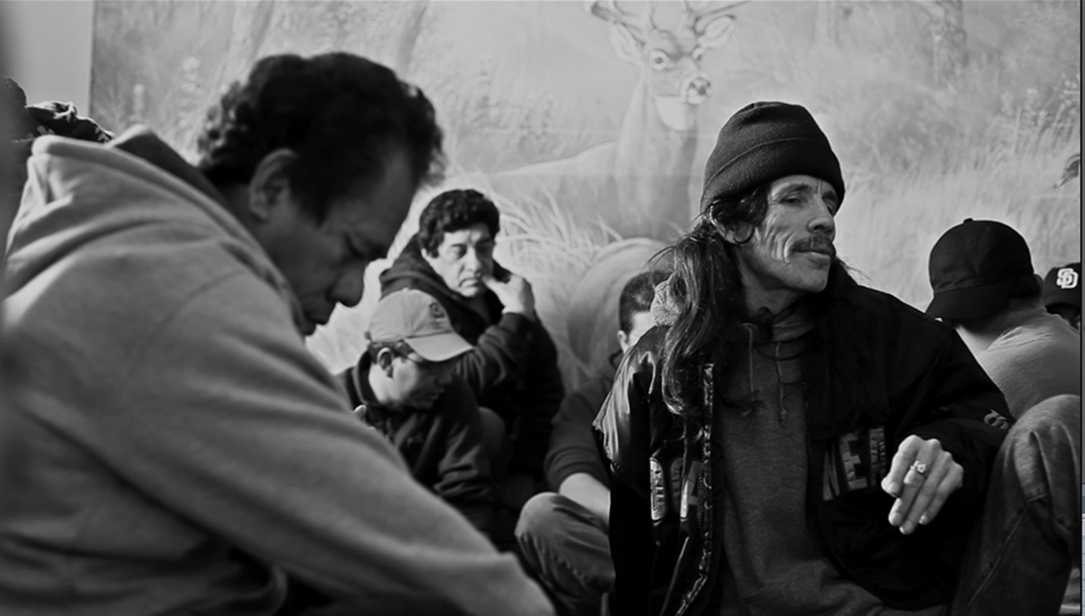
Diamond Box (2013)
Notes:
Source: https://www.newmuseum.org/exhibitions/view/screens-series-rodrigo-valenzuela
In Diamond Box (2013), Valenzuela trains his camera on a group of Latino men whom he approached in the parking lot of a Home Depot, where they had gathered in search of temporary work. In an intimate yet austere setting, the men take turns recounting their stories of migration; the camera, however, never reveals the speaker, instead attending to the faces of the apparent listeners. This narrative technique—in fact achieved by editing together multiple scenes of single speakers—allows the artist to narrate his own story of migration as a kind of filmic autobiography. He tells the stories of others, and their fragmented experiences double as testimony for his own.
HD Video (4 min, 16 seconds) available at: http://www.rodrigovalenzuela.com/diamond-box

Slide 20
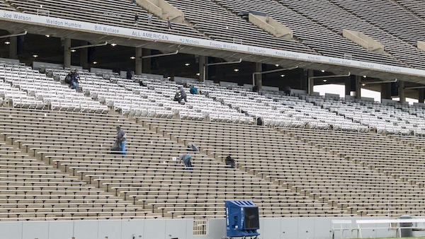
El Sisifo (2015)
Notes:
Source:
El Sisifo (2015) isa three-channel video projection. This piece lends a view into the act of work itself—a Sisyphean task according to Valenzuela, in which the laborer is hired to build walls, clean floors, and eventually tear the whole thing down in the name of urban redevelopment.
El Sisifo features documentation of the crew responsible for cleaning Rice University Stadium in Houston. On one wall, we view the full scope of the arena as a lone worker quietly sweeps the stands; on another, we see hands loading bag after bag of garbage into a trash bin; and on a third, we watch a coach-like figure as he scrawls unintelligible plays onto a chalkboard. Cacophonous audio plays in tandem with the piece, locker-room pep talks interwoven with unnerving instrumental sounds. The result is an ineffectual drone that feels endless and bleak. The motions are repetitive, and the outcome mundane—so much so, the cleanliness of the stadium goes completely unacknowledged by the hordes of spectators as they take their seats.

Slide 21
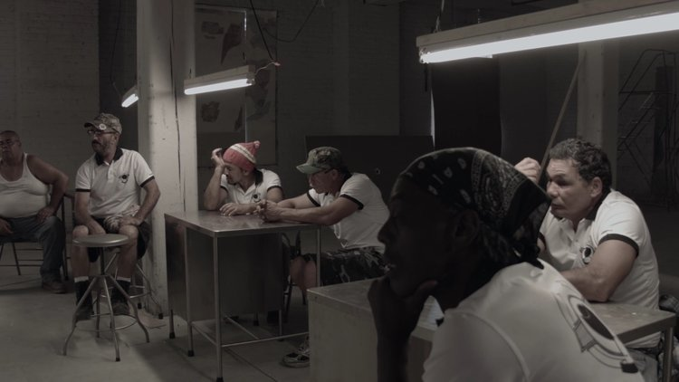
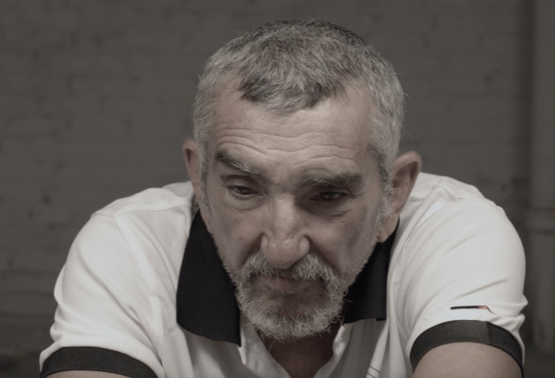
Prole (2015)
Notes:
Source: https://www.newmuseum.org/exhibitions/view/screens-series-rodrigo-Valenzuela
Rodrigo Valenzuela, Prole, 2015. HD digital video, sound, color; 8:47 min
In Prole (2015), Valenzuela focuses on a different group of men: Latino workers who have gathered to play soccer in an empty warehouse. Their uniforms are emblazoned with a union logo, and they eventually abandon their match to take up discussions of labor: how they view their work ethic, how they present themselves as workers to their American bosses, and what they feel is at stake in organizing as a union. Debate emerges within their conversation, highlighting how American culture’s emphasis on self-reliance and individualism conflicts with initiatives that foreground collectivism and the common good.

Slide 22
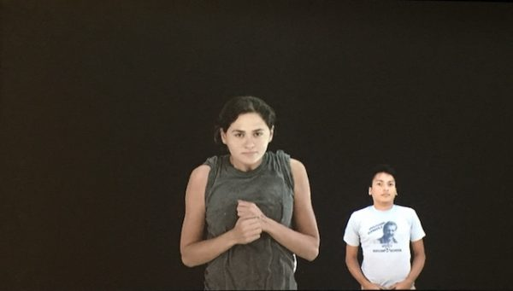
The Unwaged (2017)
Notes:
Source: https://glasstire.com/2018/04/20/rodrigo-valenzuela-at-art-league-houston/
The Unwaged opens with about ten mostly (if not all) Latinx twenty-somethings. Like a staggered, petrified battalion, they stand uncomfortably erect and trembling. As the camera zooms in and pans across each individual, we feel deeply the breadth of their micro-expressions: startled, exhausted, frozen, determined.
What is it that’s making these men and women stand so stiffly in place? We don’t know, and Valenzuela won’t tell us. But judging by the thin, clinging material of the t-shirts of two of the women and occasional blowing hair, it appears as though they’re being blasted with some kind of wind machine. Whatever it is, it’s enough to make them appear to struggle to stay still — at least comfortably so. More importantly, however, is Valenzuela’s (probable) mandate that all the actors remain stoic. It is this stoicism that allows for barely visible grimaces to register as silent screams.

Slide 23
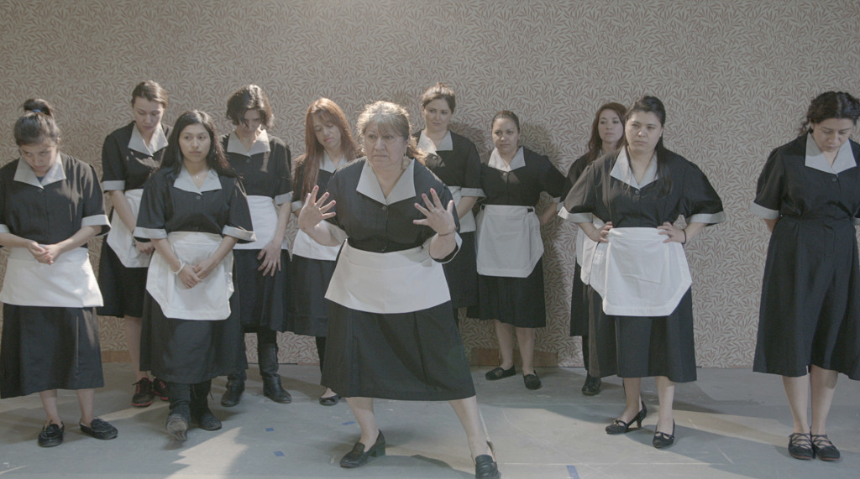
Maria TV (2014)
Notes:
HD Video: 17 min. 15 sec (http://www.rodrigovalenzuela.com/maria-tv)
Matching real-life female immigrants with an acting coach, Valenzuela has the women play the roles of nannies and maids, reenacting lines from soap operas interspersed with revelations from their own personal experiences.
Valenzuela explains that their inexperienced acting highlighted the ridiculousness of the racist and classist dialogue.

Slide 24
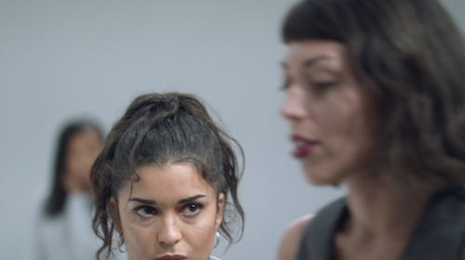
Tertiary (2018)
Notes:
Source: https://www.newmuseum.org/exhibitions/view/screens-series-rodrigo-Valenzuela
With a title that alludes to nonspeaking roles, Valenzuela’s Tertiary (2018) depicts a group of aspiring actors while calling attention to the all-too-common practice in the film and television industries of populating scenes with people of color but relegating them to roles as extras. As the artist has noted, the artifice of “diversity” in casting is worsened by another form of discrimination: the facial recognition technology on most digital cameras has been calibrated for white-skinned faces and thus struggles to properly capture the faces of those with darker skin. In the narration that unfolds in Tertiary, these issues give way to broader reflections on recognition, visibility, and belonging in civic society and popular media.
Tertiary, 2018, HD digital video, 2 minutes 29 seconds

Slide 25
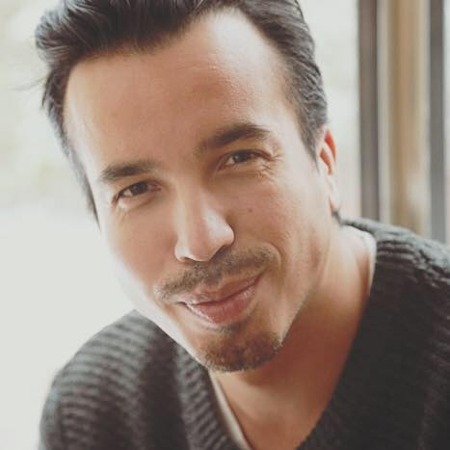
“The films are one way of looking at yourself, finding a way to aestheticize that story. Ultimately, it’s about engaging with other people, realizing that your story isn’t so unique as to have a connection with someone else.”
Rodrigo Valenzuela
Notes:
Image source: https://www.cityartsmagazine.com/rodrigo-valenzuela-opens-closed-quarters/

