Slide 1
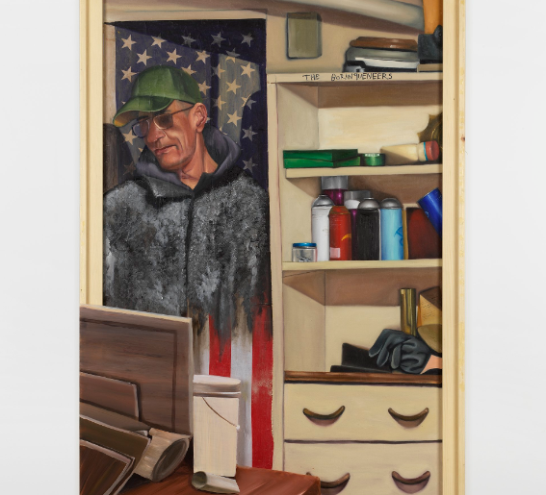
See-Think-Wonder
What do you see?
What do you think is going on?
What does it make you wonder?
Notes:
Have this slide projected on the board. Have students analyze the image using the See-Think-Wonder strategy. (You may also print the slide out as a handout for students)
Solicit student responses to the See-Think-Wonder strategy using the image above.

Slide 2
I never got to ask you 'why Borinqueneers?’ (2021) by Danielle De Jesus
Oil on linen, plexiglass
72 x 48 inches
Notes:
Image source: https://www.latinxproject.nyu.edu/intervenxions/shellyne-rodriguez-and-danielle-de-jesus-siempre-en-la-calle-review
Photo by Dario Lasagni. Courtesy of Calderón, New York
Explain to students that this image captures the work of Danielle De Jesus, today’s featured socially conscious artist. In this image, De Jesus depicts her former neighbor, Carmelo, who she suspected to be a veteran of the Korean War (1950-1953) of the 65th Infantry Regiment, also referred to as “The Borinqueneers.” De Jesus believed Carmelo was a victim of corporate greed, gentrification, and government neglect and represents De Jesus’ attempts to elevate the lived experiences of those often on the margins of society.
Explain to students that this lesson will explore the artworks of Danielle De Jesus, a Latinx socially conscious artist featured in the X Factor: Latinx Artists and the Reconquest of the Everyday exhibition of USF's Contemporary Art Museum.

Slide 3
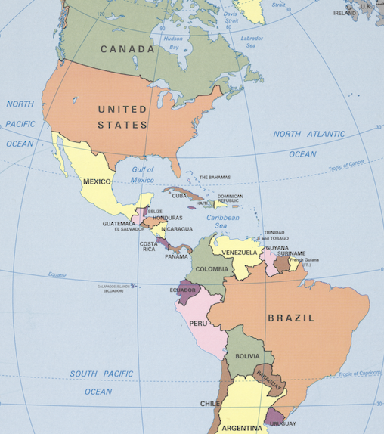


X Factor: Latinx Artists and the Reconquest of the Everyday
Notes:
Image Source: https://www.loc.gov/resource/g3290.ct003188/?r=-0.045,0.242,1.208,0.699,0

Slide 4

What’s in a Name?
What (or who) do you think of when you hear the terms “Hispanic,” “Latino/a,” or “Latinx”?
What countries come to mind when you hear the term “Latin America”?
Notes:
Entertain student responses. Explain to students that this lesson explores Latin American cultures through socially conscious art (SCA), focusing on the works of Puerto Rican painter & photographer Danielle De Jesus.
Image source: https://www.linkedin.com/pulse/latino-latinx-latine-hispanic-fentons-guidance-how/

Slide 5
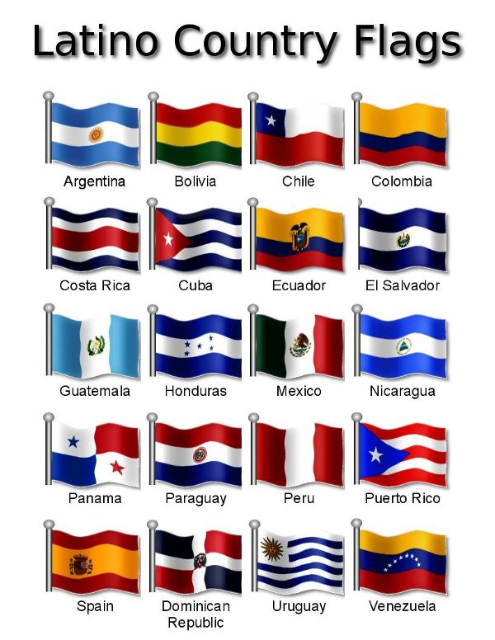
“Latinx” peoples in the U.S.
gender-neutral, pan-ethnic term used in the U.S. for people of Latin American heritage
includes people with roots in over 20 countries in the Americas and Caribbean
used by many individuals and communities with multiple identities in the U.S.
used interchangeably with “Latino/a” and “Hispanic”
more than 65 million Latinx people in the U.S. (20% of the total population)
largest ethnic minority in the U.S.
Notes:
As of July 1, 2023, there were 65.2 million Hispanic or Latino people in the United States, making up 19.5% of the total population. This makes the Hispanic or Latino population the largest racial or ethnic minority in the country.

Slide 6
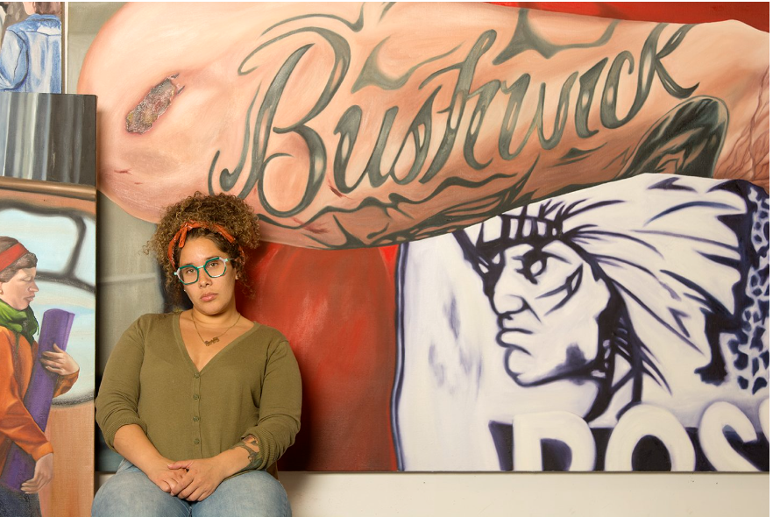
Danielle
De Jesus
Notes:
Image source: https://danielledejesus.com/about-1

Slide 7
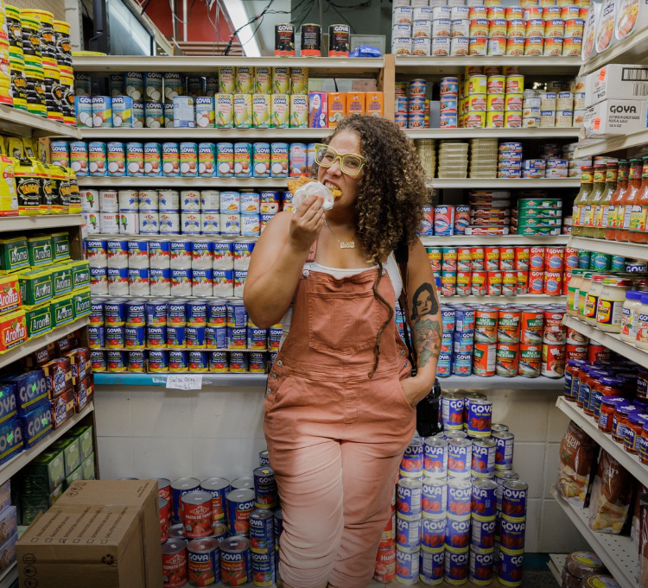
Danielle De Jesus
b. 1987
Nuyorican painter & photographer
Born & raised in Bushwick, Brooklyn
Education:
  BFA Fashion Institute of Technology (2019)
  MFA from Yale School of Art (2021)
She uses art to "create textured stories of everyday life and resilience.”
Recipient of the following awards or grants:
  Oscar Williams and Gene Derwood award for poets and painters (2022)
  Critical Practice Research Grant, Yale University (2020)
Notes:
Image source: https://www.momaps1.org/en/post/173-danielle-de-jesus
About the Artist
Detailed notes:
De Jesus often uses her artwork to elevate accounts of the forgotten, marginalized, or “displaced residents” of Bushwick, Brooklyn (https://www.latinxproject.nyu.edu/intervenxions/shellyne-rodriguez-and-danielle-de-jesus-siempre-en-la-calle-review; https://danielledejesus.com/about-1)
De Jesus uses her experiences growing up to “document her home neighborhood while creating narratives that uplift the lives and stories of the multi diverse residents she grew up with” (https://danielledejesus.com/about-1).
Her works often center on People of Color in her native Bushwick, Brooklyn, in doing so, she attempts to have audiences rethink images and “politics of representation involving the largely low-income people of color depicted in her paintings.” (https://danielledejesus.com/about-1).

Slide 8
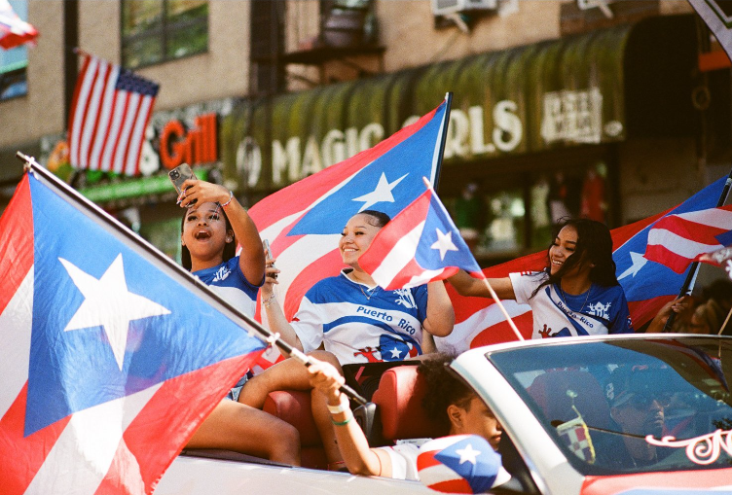
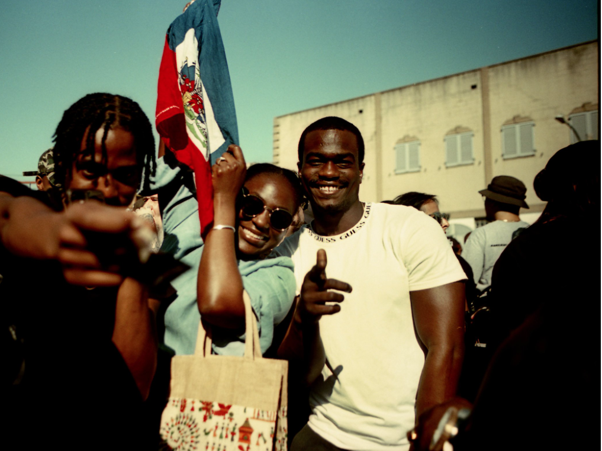
Approach & Media
Painter and photographer
Multimedia objects (e.g., dollar bills)
Common household objects (e.g., often-used products, lace tablecloths)
Notes:
Image source: https://danielledejesus.com/photographs/lrk0qvap68vwsk7x2fdin7b44ou9zw
Image source: https://danielledejesus.com/photographs/t8rnkw8j675vxrbkd5dh5diynzyu2m

Slide 9
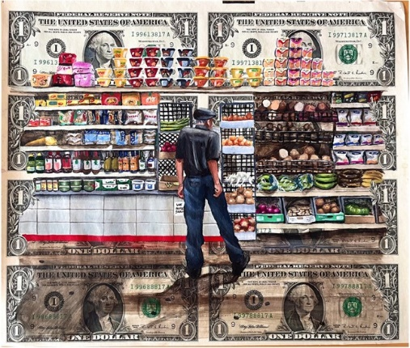
Moore street Marqueta, 2024 by Danielle
De Jesus
Acrylic on U.S currency
Approx 8.5 x 12.5 inches
Notes:
Ask: What objects are unfamiliar to you? How might De Jesus' use of these objects in this artwork help us to understand life in her Brooklyn community and communities around our country and world?
Image source: X Factor: Latinx Artists and the Reconquest of the Everyday, USF Contemporary Art Museum

Slide 10
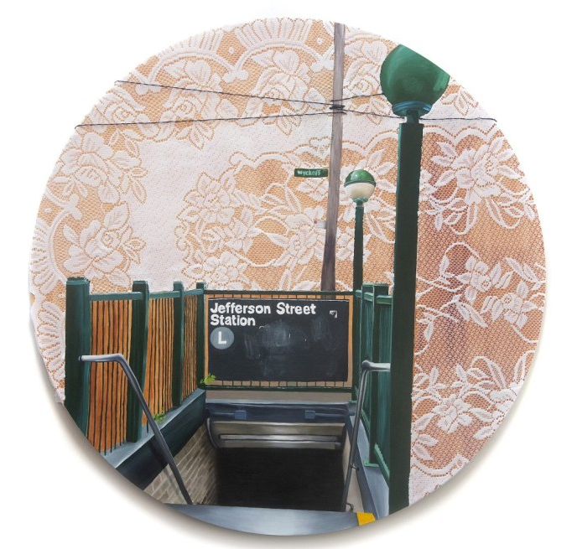
This was my stop, 2023 by Danielle
De Jesus
Oil, fabric tablecloth and string on wood panel
48 x 48 inches
Notes:
Ask: If given the chance to visit Brooklyn, NY, what would be the first place you visit and why?
Image source: X Factor: Latinx Artists and the Reconquest of the Everyday, USF Contemporary Art Museum

Slide 11
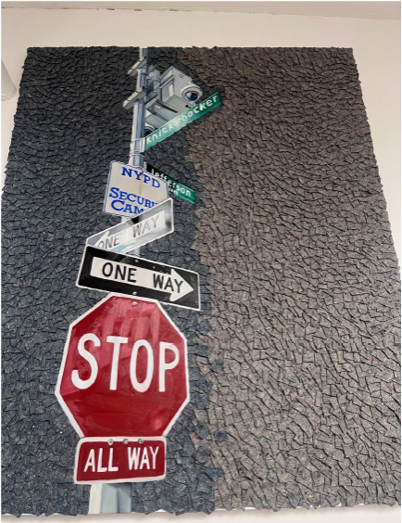
My Block, 2023 by Danielle
De Jesus
Oil and felt moving blanket
48 x 40 inches
Notes:
Ask: If you had an opportunity to talk with De Jesus about this artwork, what would you ask her and why?
Image source: X Factor: Latinx Artists and the Reconquest of the Everyday, USF Contemporary Art Museum

Slide 12
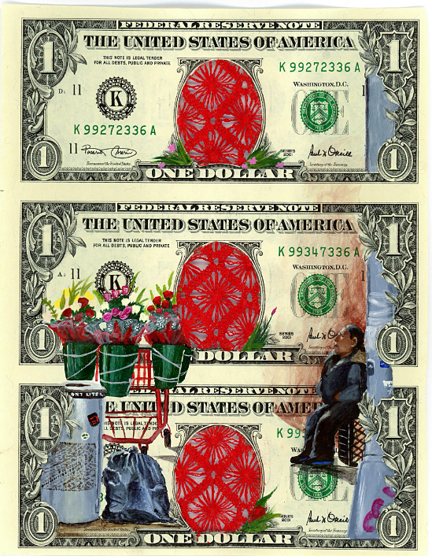
Respect the bouquet lady, 2023
Acrylic on U.S. currency and tablecloth fabric
8 x 6 inches
Notes:
Ask:
What insights does this piece offer us about life in Bushwick, Brooklyn?
Why might De Jesus have chosen to incorporate art into U.S. currency rather than that of another country?
What/who is missing from this artwork? What/who is centered in this artwork? Why might those decisions have been chosen by the artist?
Image source: https://danielledejesus.com/1l6bleppjdz3bng1erovw3e5j5zs9t

Slide 13
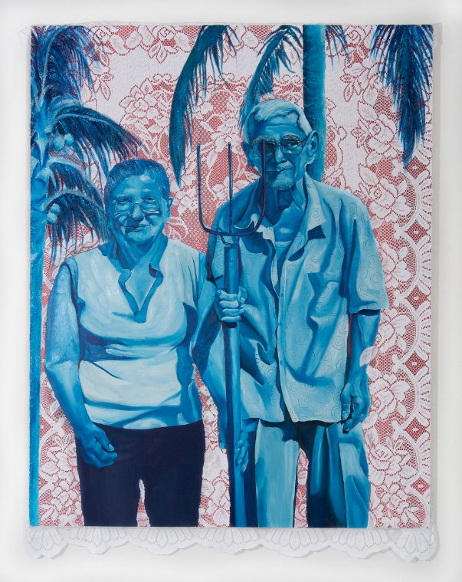
Google Yo no me quito, 2010
Oil on wood panel fabric tablecloth and acrylic
48x60 inches
Notes:
Ask: In what ways is De Jesus’ commitment to unearth and elevate the accounts of ordinary people evident in this artwork?
Image source: https://danielledejesus.com/2022/3/4/2022/3/4/dybtcl3vwi0il67qh9urekgeps4ssl

Slide 14
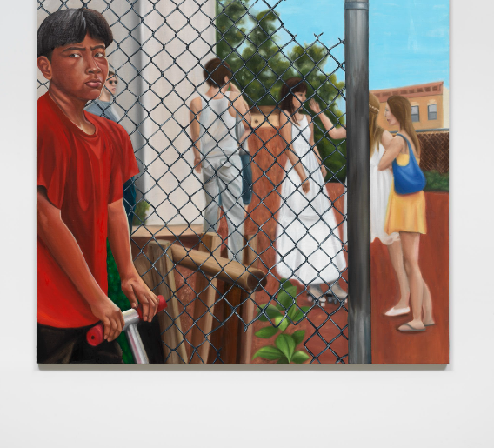
The boy on the scooter, 2021
Oil on linen
68x68 inches
Notes:
Ask: What does this image remind you of, and why?
Image source: https://danielledejesus.com/1l6bleppjdz3bng1erovw3e5j5zs9t

Slide 15
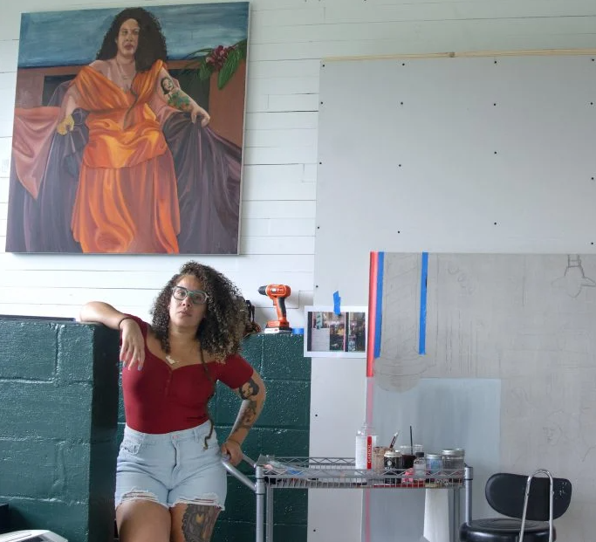
“A trait that I most admire in a work is how a story is told. I enjoy a painting that says something without uttering a word. A painting that teaches me about something.”
-Danielle De Jesus, 2022
Notes:
When asked, “What trait do you most admire in a work of art?” De Jesus replied with the above
Image & Quote Source: https://news.artnet.com/art-world/studio-visit-danielle-de-jesus-2148759

Slide 16
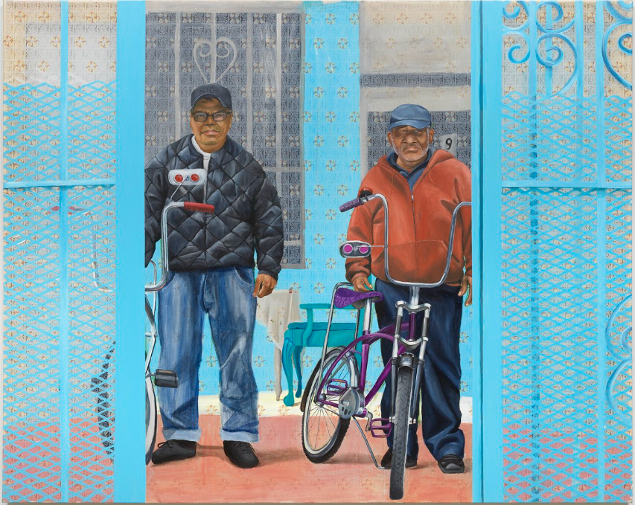
“A picture is worth a thousand words.”
In what ways does De Jesus’ work exemplify this sentiment?
Two men and their blue gate, 2021
8 x 6 inches
Acrylic on vinyl tablecloth
48x60 inches
Notes:
Share the oft-cited proverb, “A picture is worth a thousand words” (often attributed to Fred R. Barnard)
on the board for your students. Prompt them to reflect on the following, “In what ways does De Jesus’ work exemplify this sentiment?”
Provide students with sticky notes to share their reflections on a poster you provide for the class. This activity can alternatively be facilitated using the digital learning platform Padlet (https://padlet.com/). Share student responses.
Image source: https://danielledejesus.com/works-on-vinyl/two-men-and-their-blue-gate

Slide 17
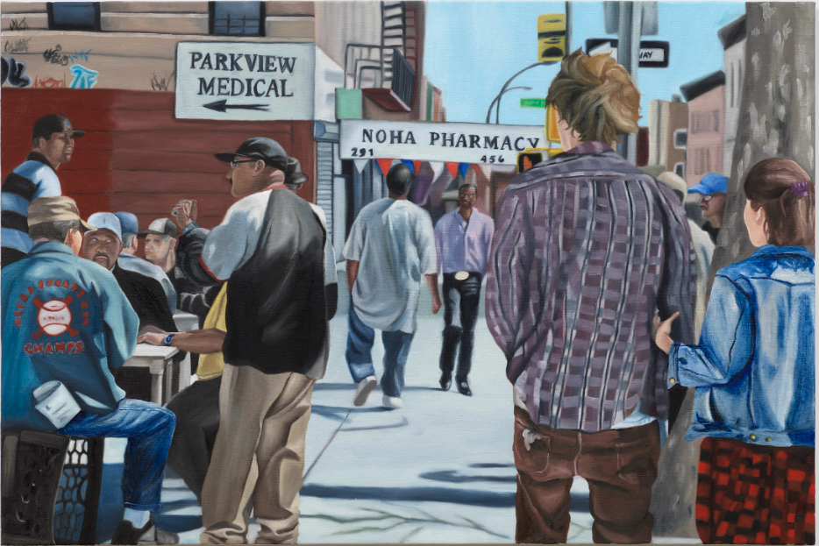
Artwork Design Project
Drawing on the work of Danielle De Jesus, you will use your artistic & research skills to design an artwork that addresses a social issue in our society.
Knickerbocker Park
Oil on linen
32x48 Inches
Notes:
Image source: https://danielledejesus.com/ki2hzc3zmukb0t96psptrljgvwof91

