Slide 1
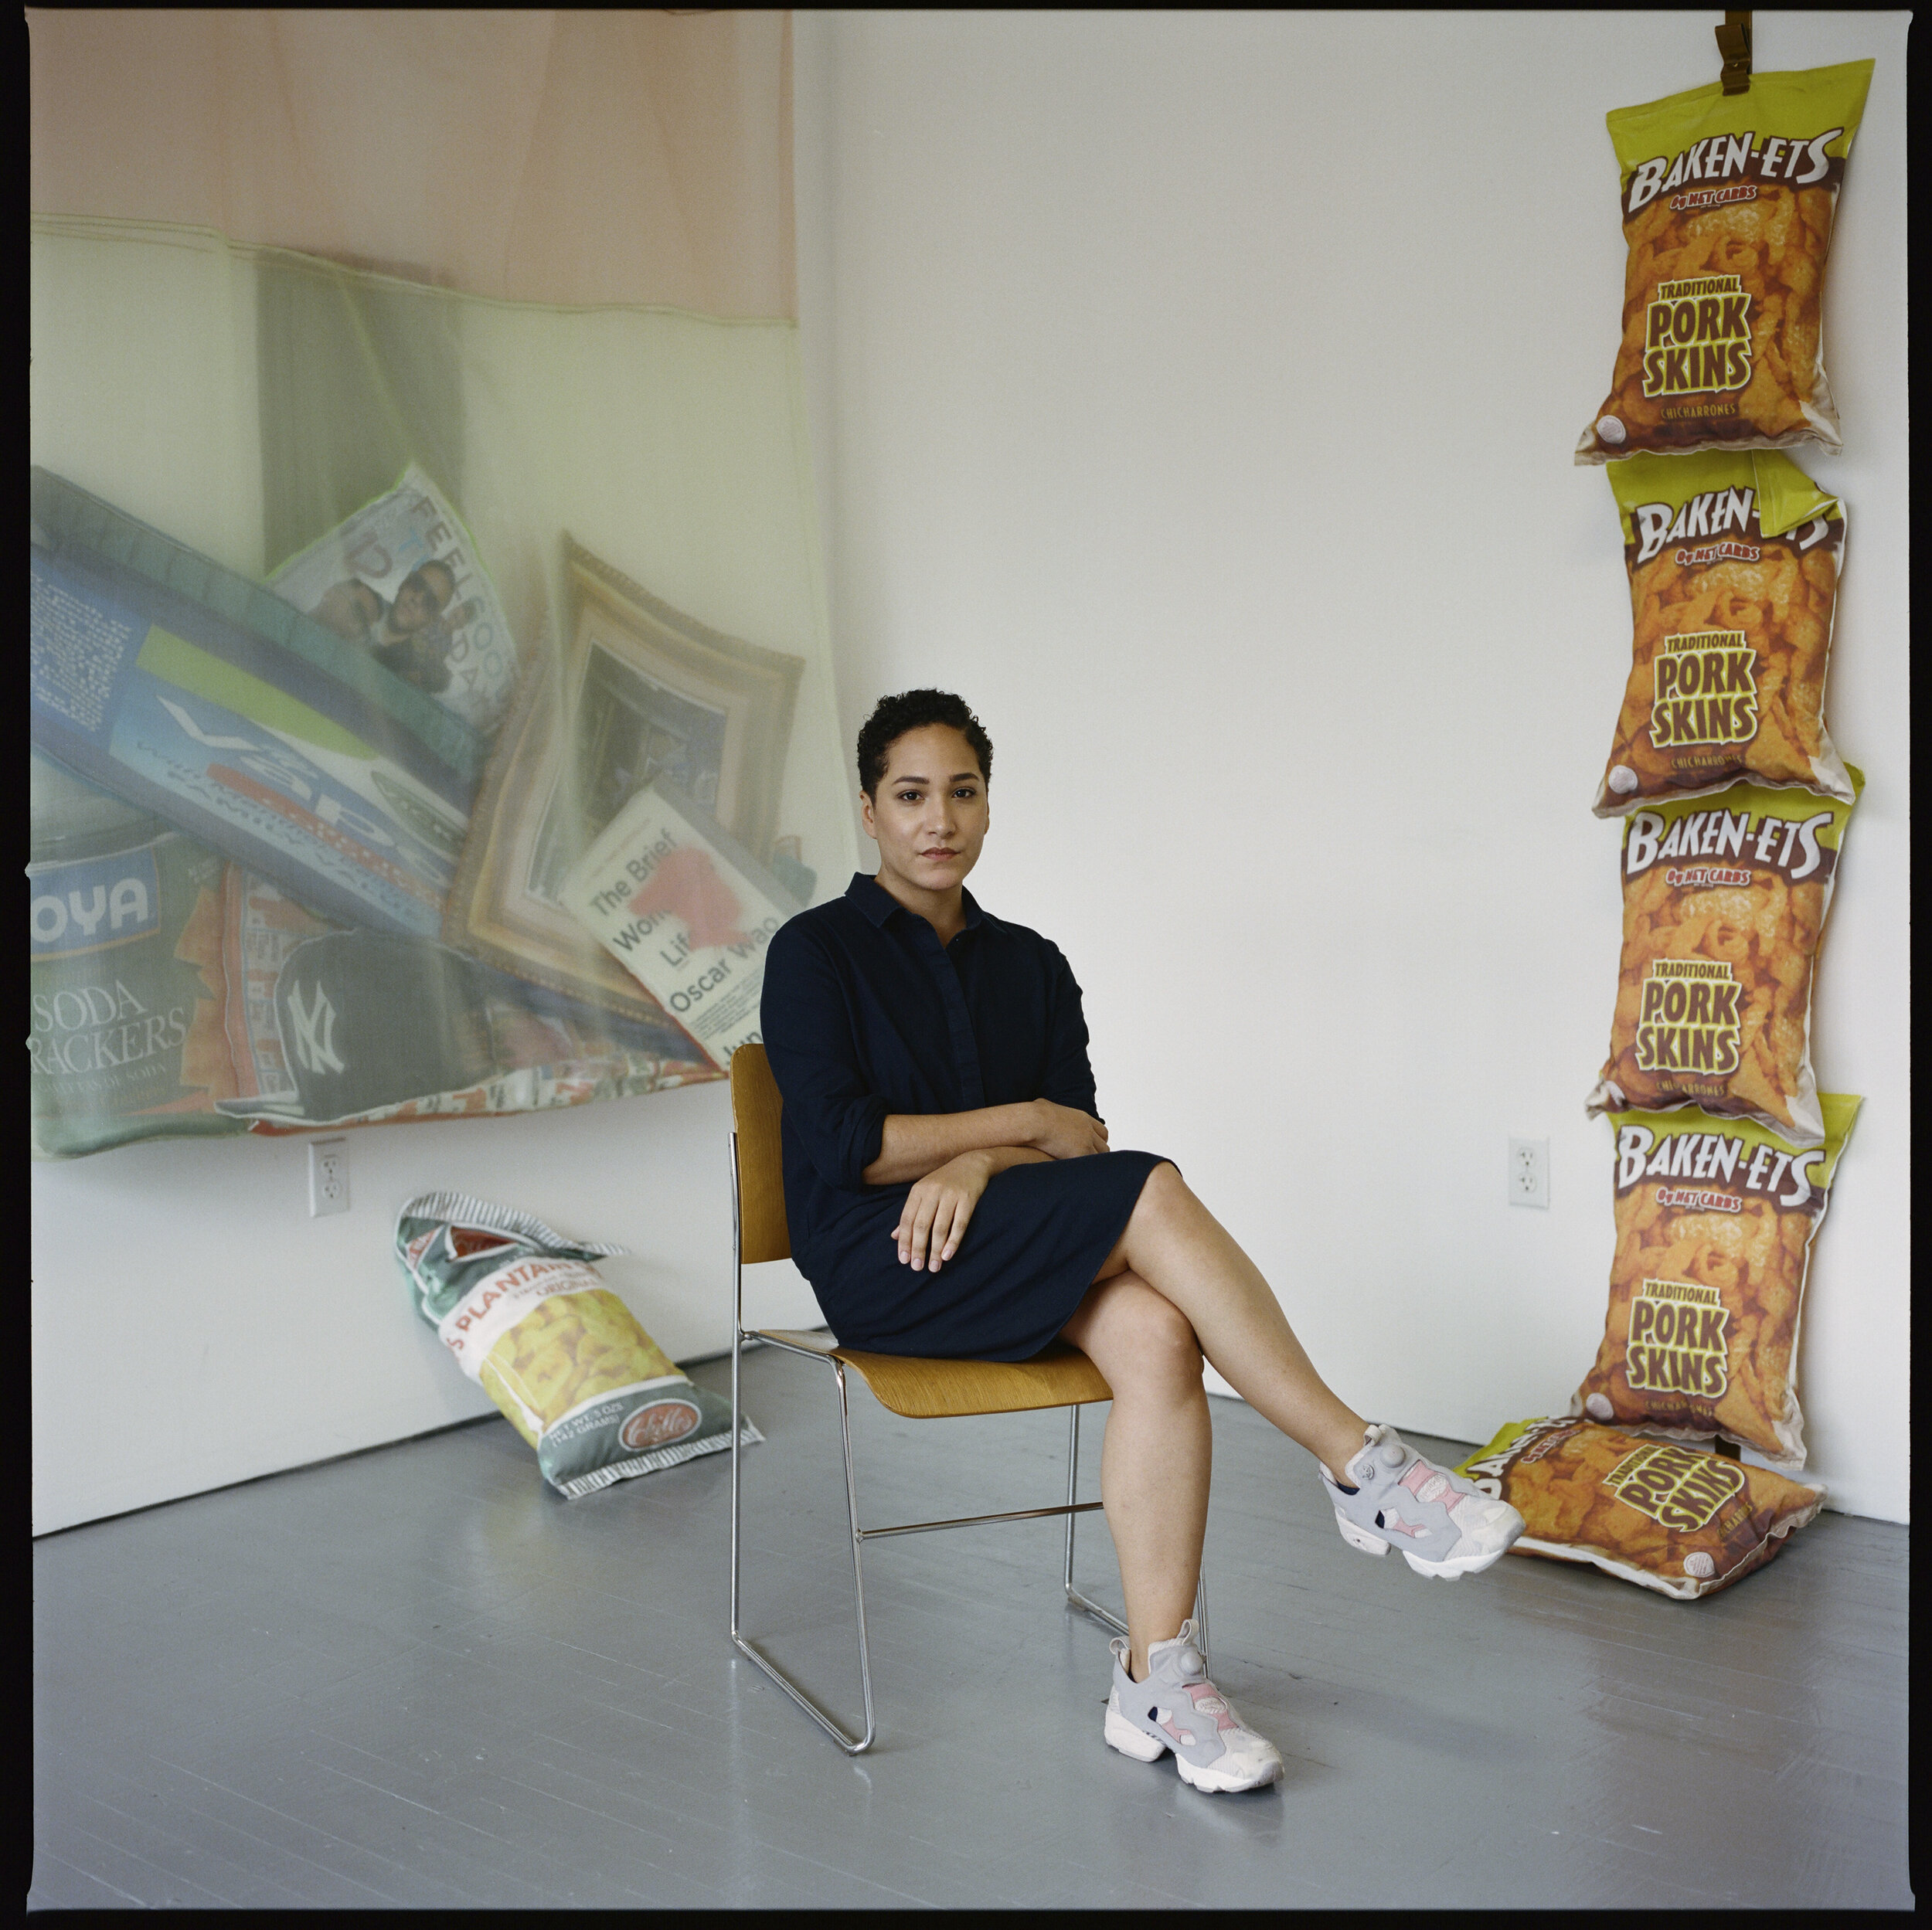
Lucia Hierro
X Factor: Latinx Artists and the Reconquest of the Everyday

Slide 2
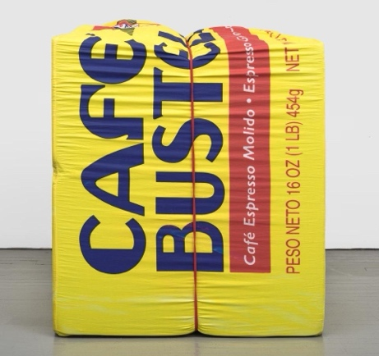
Notes:
Questions to guide viewing and facilitate discussion:
By a show of hands, does anyone recognize this object?
Look at the writing on the object: in what language are the words written?
For those of you who understand Spanish, what do the words mean?
What is the red line that runs down the middle? What is it used for?
How big do you think the object is?
Courtesy: Charlie James Gallery, Los Angeles

Slide 3
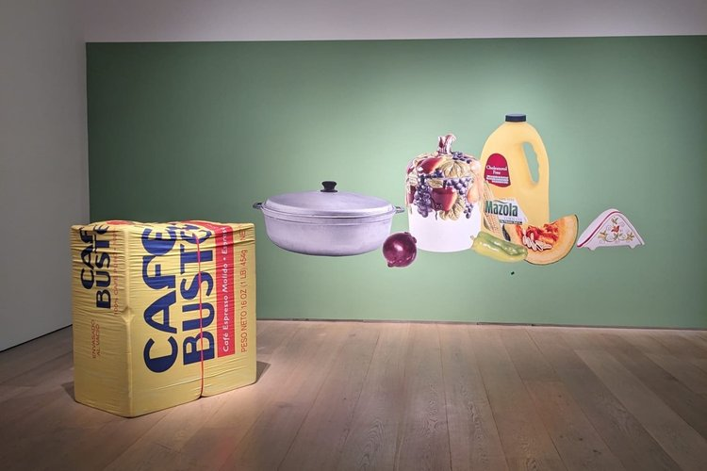
10oz. Cafe Bustelo (2022) by Lucia Hierro foam, digital print on cotton sateen, rubber band
53 x 43 x 25 inches
Notes:
53 x 43 x 25 inches = 4.4 feet X 3.5 feet X 2 feet
Point out the dimensions of the sculpture. Ask:
Are you surprised by its size?
Why do you think the artist made it so large?
What might she be conveying with this work?
Image source: https://www.luciahierro.com/

Slide 4
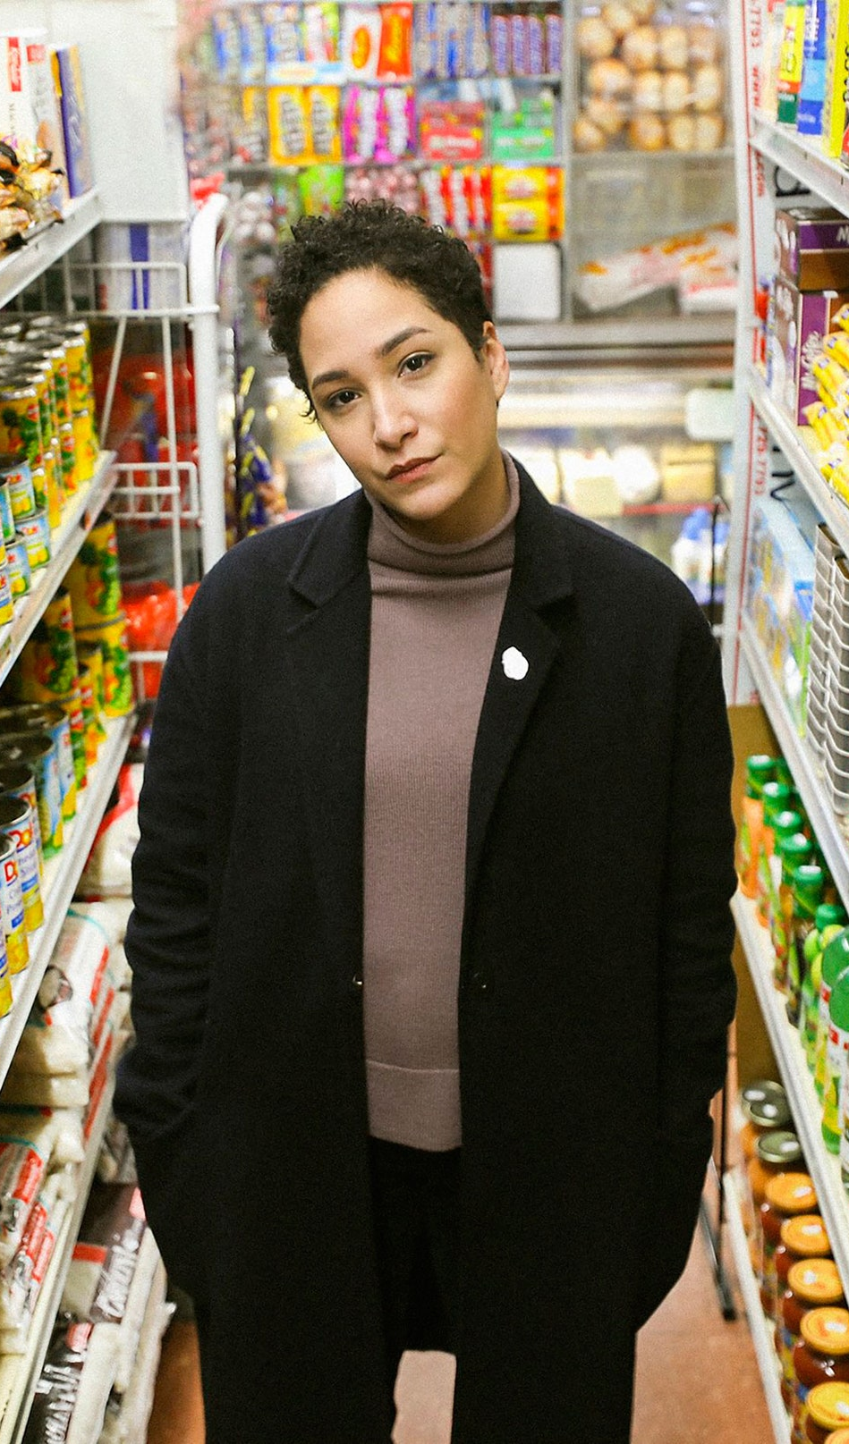
Lucia Hierro
b. 1987
Dominican American conceptual artist
Born and raised in New York City
Education:
  FA from SUNY Purchase (2010)
  MFA from Yale School of Art (2013)
Examines everyday objects and popular culture
Notes:
Image: https://www.vogue.com/article/lucia-hierro-red-bull-house-of-art-detroit-mercado-interview

Slide 5

Family Background
Dominican immigrant family in NY
Artistic, creative family
Grandmother came to NY to work in a garment factory
Initially, Hierro resisted working with fabric
When Hierro learned of her grandmother’s dream to be a fashion designer, she embraced fabric as an artistic medium
Notes:
Detailed notes:
Dominican immigrant family in NY
Artistic, creative family (parents: musicians) --- father played music, mother was a vocalist
Grandmother came to NY to work in a garment factory
Hierro resisted working with fabric because she associated it with her grandmother’s struggle as a garment worker
When Hierro learned of her grandmother’s dream to be a fashion designer, she embraced fabric as an artistic medium
Image source: https://www.culturedmag.com/article/2020/08/21/artist-lucia-hierro-interrogates-everyday-aesthetics
Photo by: Kevin Claiborne.

Slide 6
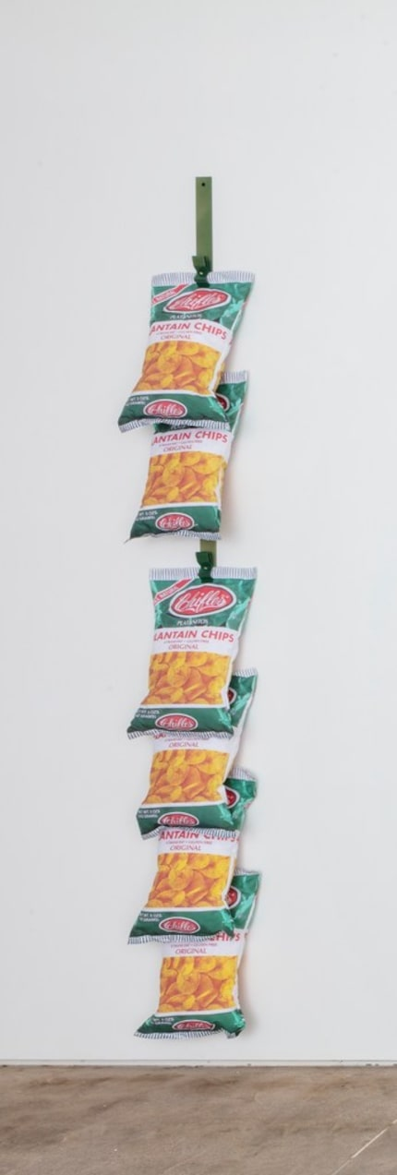
Approach and Media
Rack: Platanitos
(2019)
by Lucia Hierro
Digital print on brushed nylon, foam, and powder-coated
aluminum
96 x 12 x 7 inches
conceptual artist
soft assemblage
sculpture
digital media
installation
Notes:
Image source: https://www.dallasnews.com/arts-entertainment/visual-arts/2019/09/23/pop-art-and-identity-politics-spark-lucia-hierro-s-dallas-show-of-uncommon-depth
Working definitions:
conceptual artist: an art form in which the artist’s primary intent is to convey a concept/idea/message
soft assemblage: an artistic composition made from soft materials and textiles
sculpture: an artistic form in which hard, soft, and plastic materials are worked into three-dimensional objects
digital media: content that is digitized and is transmitted through computer technology
installation: a work of art that usually consists of multiple components that is usually exhibited in a large space in an arrangement specified by the artist
Point out the work, Rack: Platanitos (2019), a depiction of a common sight in a bodega (neighborhood Hispanic grocery store) of a popular snack food (fried plantain chips).
Ask: If you were to create a similar artwork, what product would you include that reflects your experience?

Slide 7
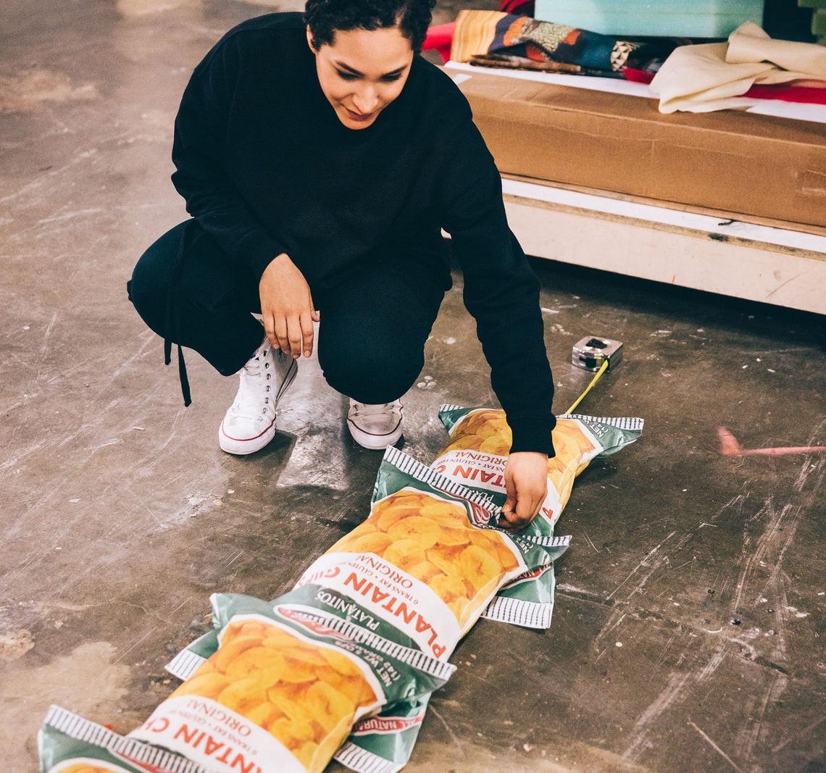
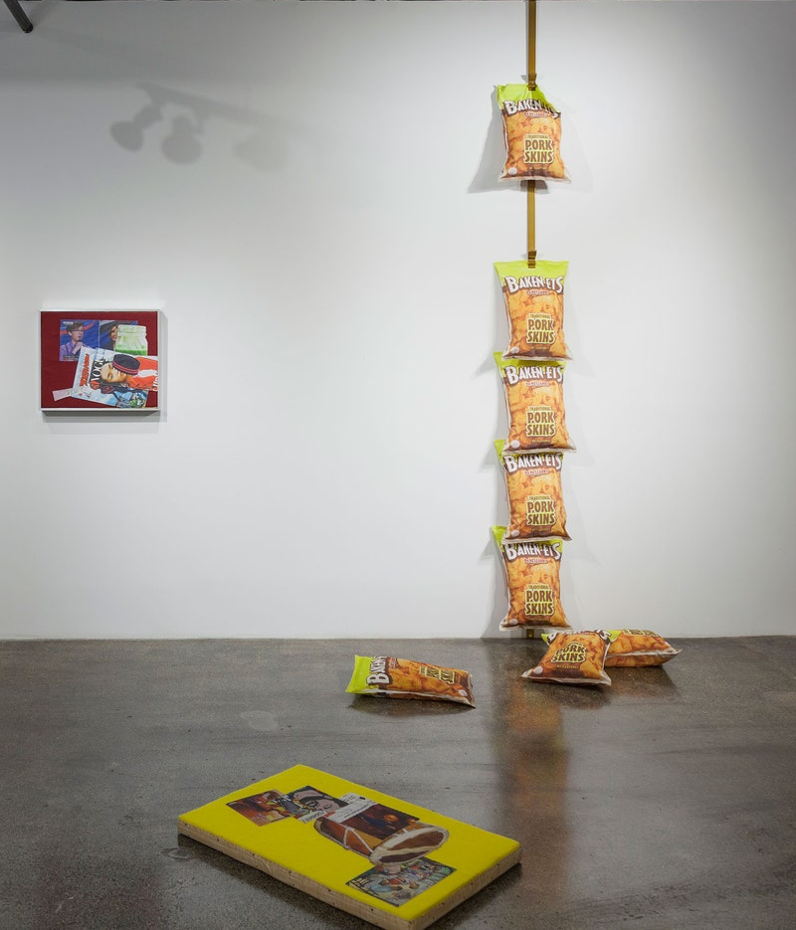
Notes:
Images source: https://www.vogue.com/article/lucia-hierro-red-bull-house-of-art-detroit-mercado-interview
Left: Installation view at Red Bull House of Art, Detroit. Photo by: Claire Gatto
Right: The artist with her Rack: Platanitos (2018). Photo by: Joe Gall

Slide 8
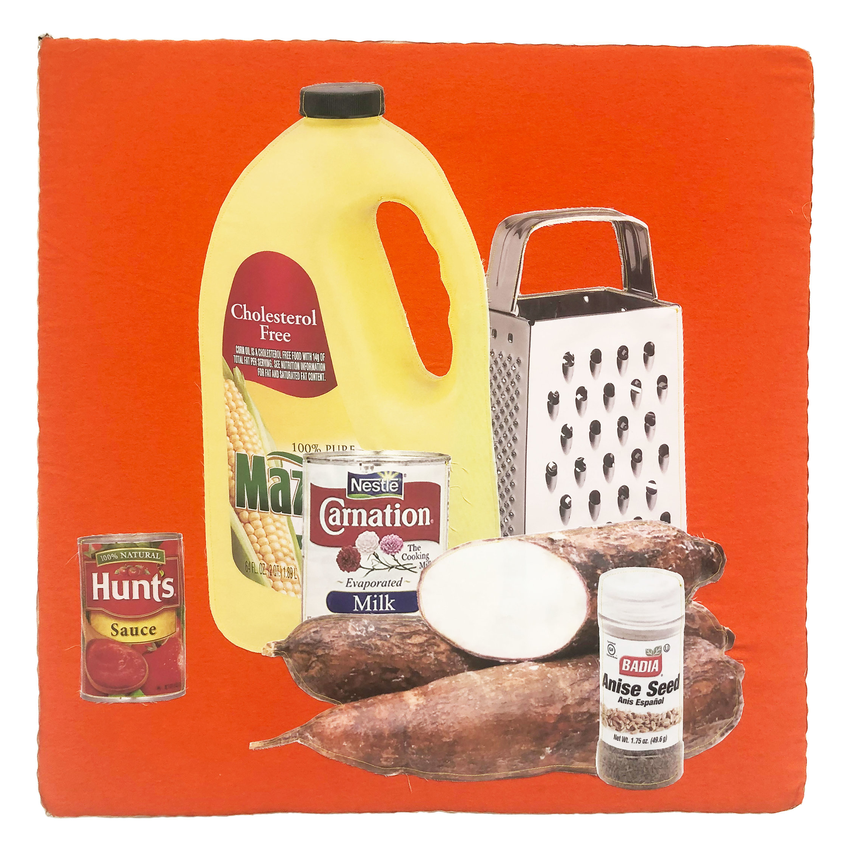
Torrejitas de Yuca
(2019)
by Lucia Hierro
Digital Print on Brush Suede, Cotton, Fleece, Foam
22 x 22 x 2 inches
Notes:
Torrejitas de yuca is a Dominican dish of yuca fritters. They feature shredded yuca tuber, forming a dough which is then fried.
Image source: https://www.flaunt.com/blog/lucia-hierro
Photo by: Freddie L. Rankin II

Slide 9
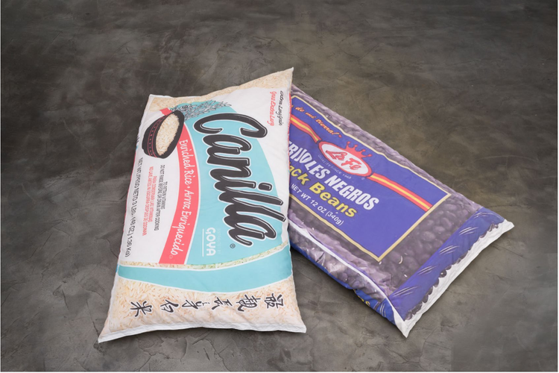
Arroz Blanco (2020)
and
Frijoles Negro
(2020)
by Lucia Hierro
Digital Print on Brush Suede, Packing Peanuts
68 x 33 x 5 inches
Notes:
Arroz blanco = white rice
Frijoles negros = black beans
Arroz Blanco & Frijoles Negros (2020)
Digital Print On Brushed Suede,
Packing Peanuts 68 x 33 x 5 Inches
Image source: https://www.luciahierro.com/objetos

Slide 10
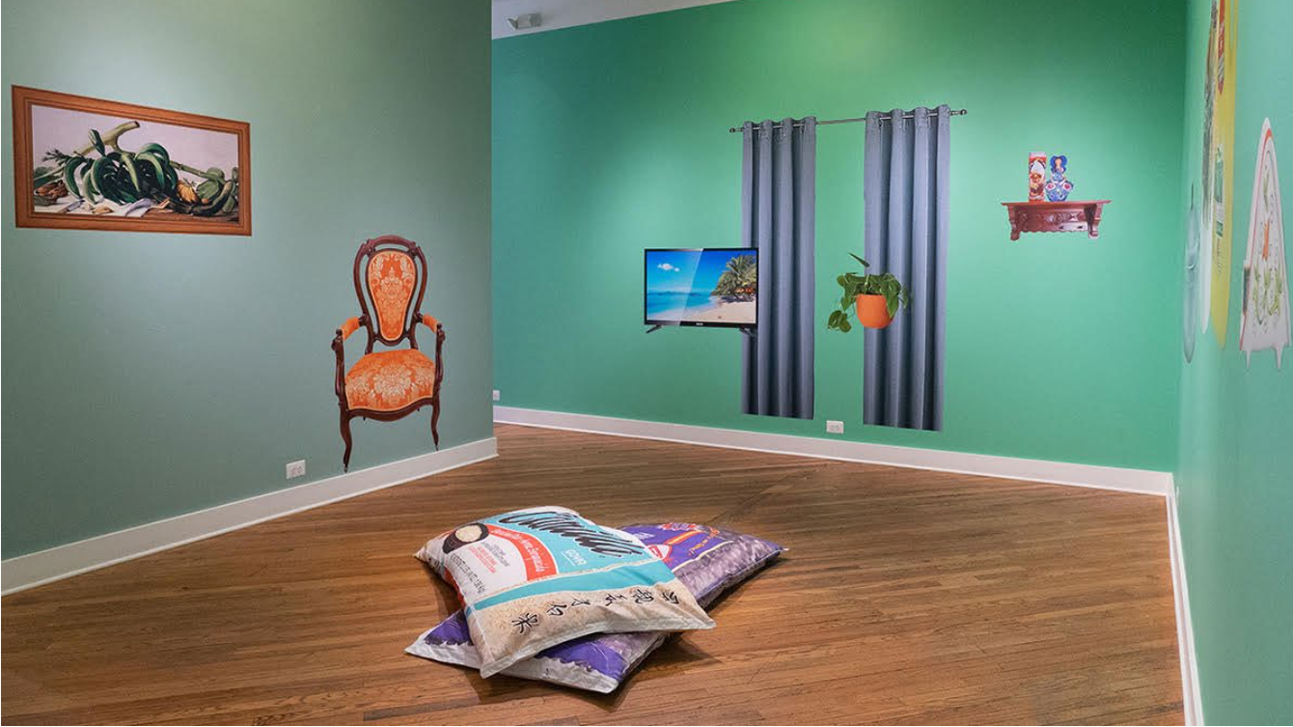
Notes:
Gallery view of Arroz Blanco (2020) and Frijoles Negros (2020).
Image source: https://www.luciahierro.com/objetos

Slide 11
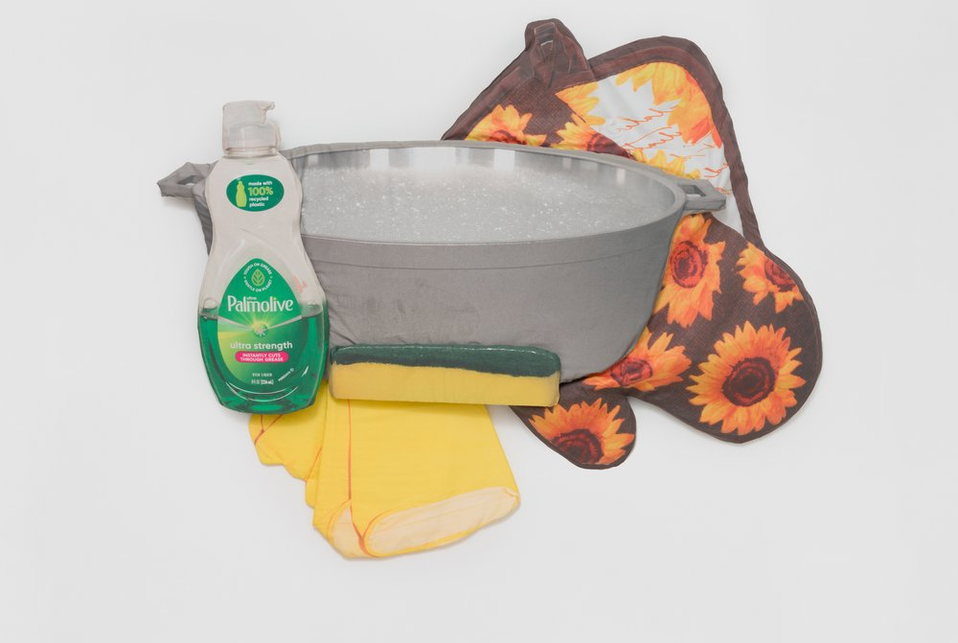
Remojo (2023)
Notes:
Lucia Hierro
Remojo, 2023 [pronounced: reh-MOH-ho]
cotton, digital print, cotton sateen, foam
74-1/2 x 61 x 4 inches
In Spanish, “remojo” means to soak or immerse.
Ask: How might these objects be used to soak something? For what purpose?
Image source: https://www.luciahierro.com/objetos
Courtesy: Charlie James Gallery, Los Angeles

Slide 12
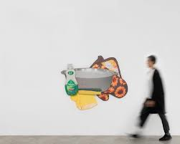
Notes:
Gallery view of Remojo (2023).

Slide 13
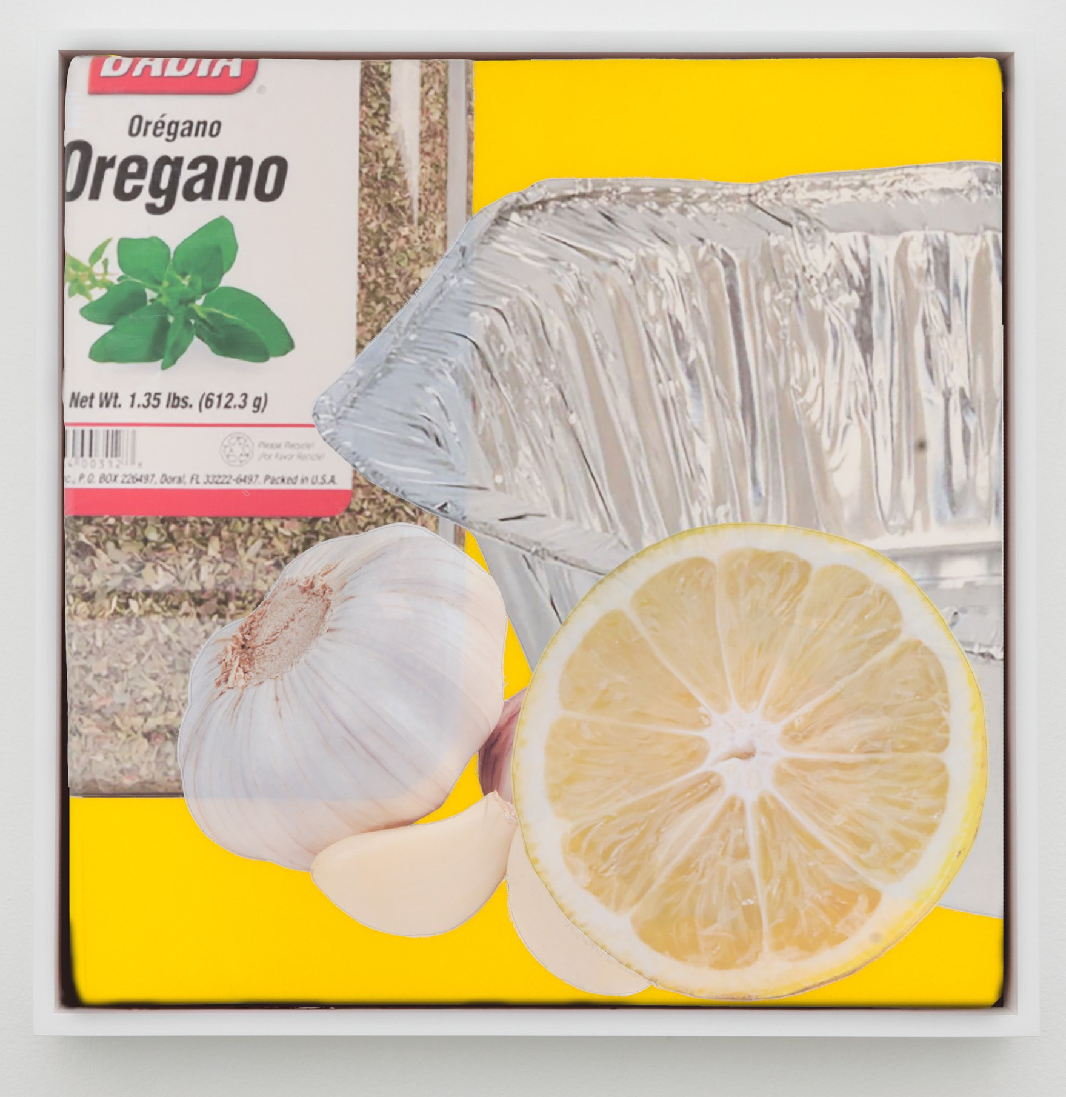
Preparando un Pernil
(2021)
by Lucia Hierro
felt, foam, digital print on brushed suede
36 x 36 x 2 inches
Notes:
Preparando un Pernil
Felt, foam, digital print on brushed suede
36 x 36 x 2 inches
2021
“Pernil” refers to a large pork roast that is often made for celebratory occasions in many Latin American cultures.
Ask: What are 3 ingredients that are used to prepare the pernil, according to this image?
Answer: garlic, oregano, and citrus juice (often, sour orange in many Caribbean Latinx homes).
Image source: https://www.cjamesgallery.com/artists/lucia-hierro
Courtesy: Charlie James Gallery

Slide 14
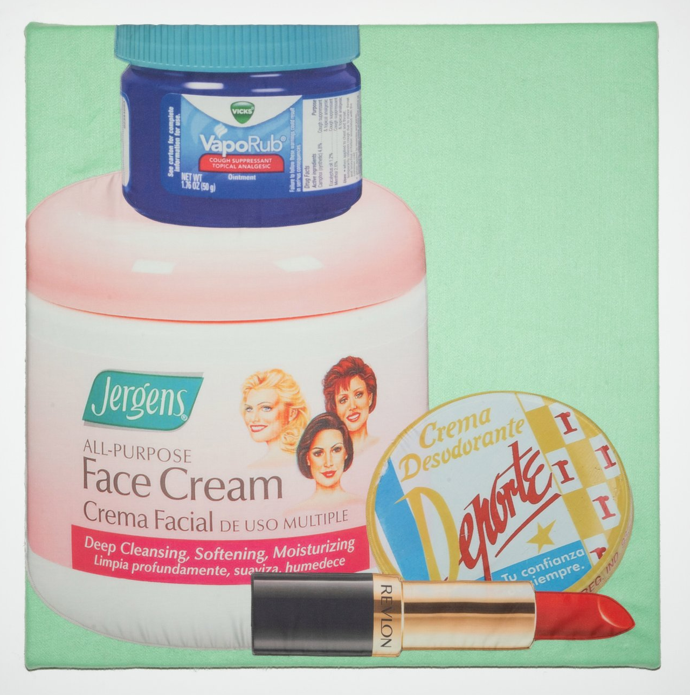
Mama’s Nightstand (Redux)
(2022)
by Lucia Hierro
felt, digital print on cotton sateen, foam
36 x 36 x 2 inches
Notes:
Ask: What feelings/emotions does this work invoke?
Mama’s Nightstand (Redux) (2022)
Felt, Digital Print on Cotton Sateen, Foam
36 x 36 x 2”

Slide 15
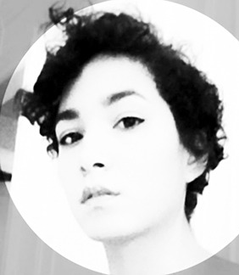
“If I’m going to talk about home, or a concept of home in a neighborhood kind of setting, what’s more personal than a material that one wears, or sleeps in, or sits on? There’s an intimacy with that.”
Lucia Hierro
When you think about the concepts of home and neighborhood, what images come to mind?
Notes:
Image source: https://artartartthemodernwoman.tumblr.com/post/79344858221/lucia-hierro-is-a-dominican-american-artist-born
After reading the quote by the artist, ask students to consider:
When you think about the concepts of home and neighborhood, what images come to mind?

