Slide 1
Caio Reisewitz
Progress & Preservation

Slide 2
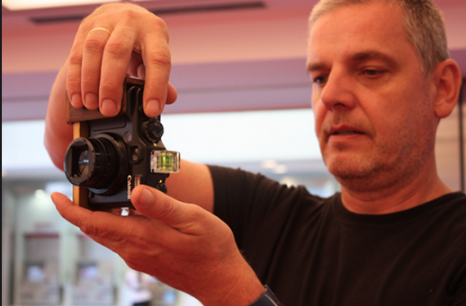
Artist Biography
Caio Reisewitz
Notes:
http://www.pipaprize.com/pag/caio-reisewitz/
Video Clip: https://www.youtube.com/watch?v=2iorP_yla40
Ask:
What did the artist say influences his work?
Based on the video, what sort of photographs might we see today?

Slide 3
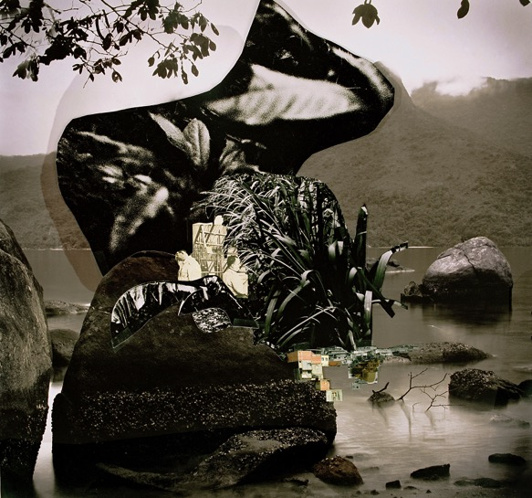
Tababuia, 2009
Caio Reisewitz
Notes:
Think-Write-Pair-Share:
On your paper, list everything that you see in this image.
Where do you think the backdrop of this image is located?
What is the form in the foreground?
Why do you think the artist has arranged the image in this way?

Slide 4
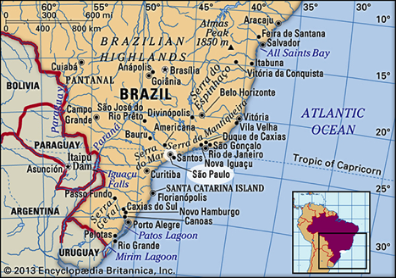
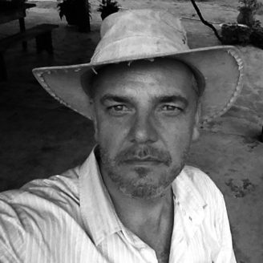
Caio Reisewitz
(São Paulo, Brazil)
Notes:
Caio Reisewitz creates large-scale color photographs that explore the dynamic relationship between rural and urban areas.
He was born in São Paulo and continues to live there to this day. Much of his work includes photographs taken in Såo Paulo or within a few hundred miles of the city.

Slide 5
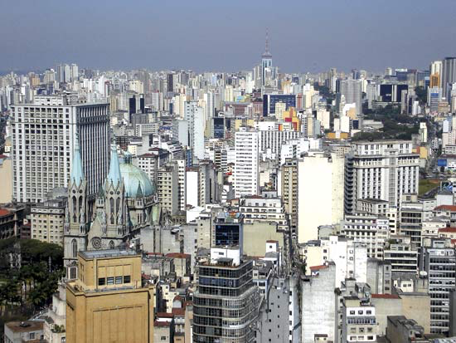
São Paulo
Notes:
In the past century, São Paulo has become the largest city in the Southern Hemisphere. The growth of the coffee industry and migrations from Europe have led to large scale urban expansion in the city. The city is now an international leader in industry and is now referred to as a megametropolis due to its fast growing populatio.n population

Slide 6
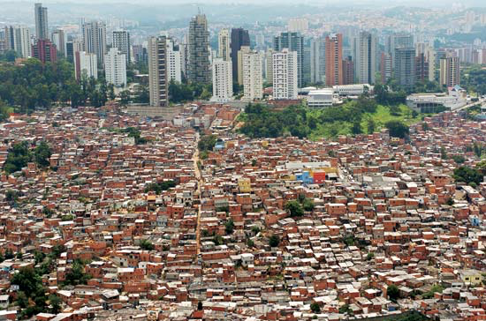
Urban Expansion in São Paulo
Notes:
Picture: Favela Morumbi, bordered by one of the city’s riches neighborhoods in São Paulo. The economic growth of the city has brought people from all walks of life. Several million of the cities residents live in favelas, or shantytowns, expanding the city even further. While government leader have worked in to provide city services for these low income families, many favelas are without basic utilities.

Slide 7
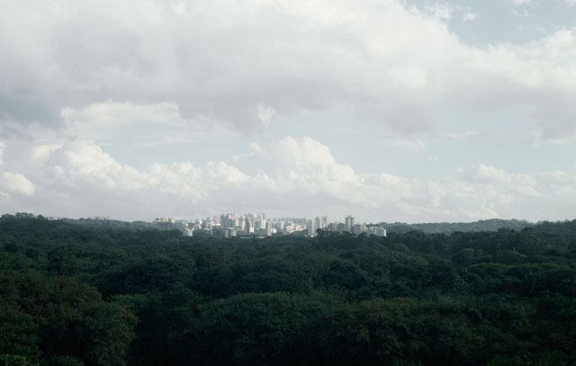
Butantã, 2003
Caio Reisewitz
Notes:
Show Butantã, and ask students:
What do you see in this picture?
How is this picture different than the other pictures we saw of São Paulo?
Is this picture real? Or did Caio manipulate it? Explain your reasoning.
Why do you think he chose to portray the city in this way?
Inform students that São Paulo is located within the Mata Atlantica (Atlantic Forest) that spans over half a million square miles in southeastern Brazil. Much of Caio Reisewitz’s work explores the relationship between natural and human made environments in São Paulo.
Butantã is one of Caio’s older works. We are now going to look to his more current photographs examining this line between reality and artificiality.
Ask: What does this photograph say about the relationship between the forest and the city?

Slide 8
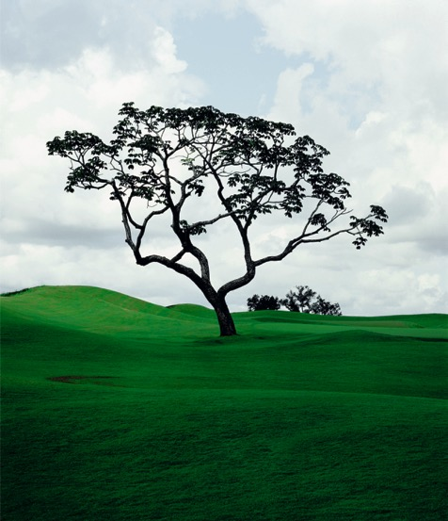
Goiânia Golf Club II, 2004
Caio Reisewitz
Notes:
The tension between the country’s economic development and the degradation of the environment is a consistent theme in Reisewitz’s work.
Visual Analysis:
What do you see in this photograph?
What is real and what is artificial in this photograph? What makes you think that?
What does this photograph say about the relationship between natural and human made environments?

Slide 9
Tababuia, 2009
Caio Reisewitz
Notes:
We are now going to look to his more recent works examining this line between reality and artificiality. These photographic collages, like we saw in Tababuia, include digitally overlaid cutout images – of people, favelas or slums, and vegetation- onto scenes of forests, rivers, and grasslands.
Considering the background information we have learned about the artist:
What is real and what is artificial in this photograph? What makes you think that?
What does this photograph say about the relationship between natural and human made environments?

Slide 10
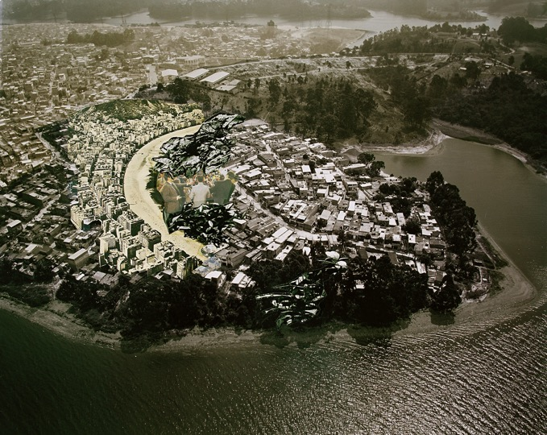
Copacadema, 2009
Caio Reisewitz
Notes:
Visual Analysis:
What do you see in this photograph?
What is real and artificial in the photograph? What makes you think that?
What does this photograph say about the relationship between natural and human made environments?

Slide 11
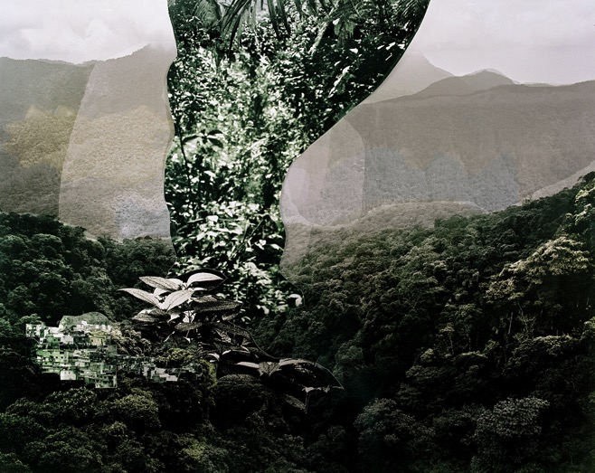
Curahy, 2009
Caio Reisewitz
Notes:
Visual Analysis:
What do you see in this photograph?
What is real and artificial in the photograph? What makes you think that?
What does this photograph say about the relationship between natural and human made environments?

Slide 12
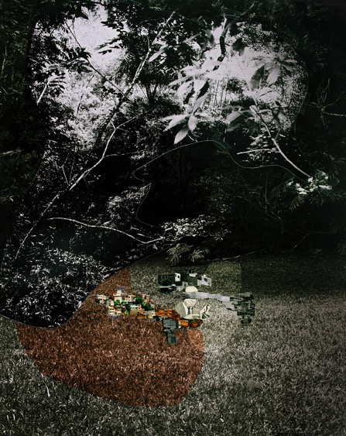
Sapetuba, 2014
Caio Reisewitz
Notes:
Visual Analysis:
What do you see in this photograph?
What is real and artificial in the photograph? What makes you think that?
What does this photograph say about the relationship between natural and human made environments?

Slide 13
Piaçabuçu, 2012
Notes:
Guide discussion by posing the following:
1.The artist decided to add images to the photographs. In what ways does this disrupt reality? In what ways does this process reflect environmental issues facing humanity?
2.How does the artist portray water in his works? How do you think the relationship between urban centers and natural environments impacts the water supply?
3.Much of the artist’s work explores the line between reality and artificiality. Which work do you feel best reflects this artistic interest? Explain your response.

Slide 14
Progress and Preservation
“Reisewitz’s images offer a sustained reflection on the struggle between primeval nature and the voracious human appetite to exploit it that has marked Brazil’s history since colonial times.”
– Christopher Phillips
Guarituba, 2014
Notes:
Ask students: Consider the conflict between the preservation of natural environments and the desire for human progress through economic development. Is it possible to have both progress and preservation? Have students write a one-page reflection paper expressing their thoughts.

