Slide 1
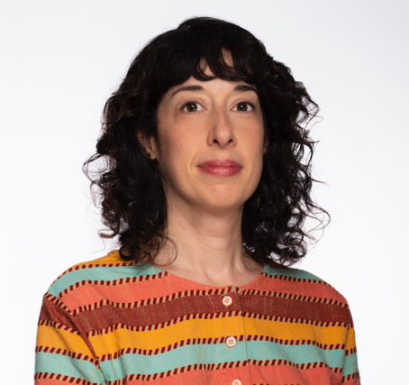
Hope Ginsburg
Building Community through
Learning and Art
Notes:
Image source: https://www.cltampa.com/arts-entertainment/a-e-events/article/21084624/find-hope-ginsburg-talking-environmental-art-at-usf-tampa

Slide 2
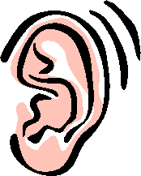
Close your eyes & Listen
What do you hear?
What sounds can you make out?
What/Who is making the sounds?
Where do you think this is taking place?
Open your eyes & Write
Jot down your responses to the questions above
Notes:
Dim the lights, ask students to get comfortable in their seats, and direct them to listen to the following clip, keeping in mind the 4 questions posed.
Ask students to close their eyes to heighten their hearing, and play the first 2 minutes of this audio clip: http://media.icompendium.com/hopegins_Land-Dive-Team-Amphibious-James-Live-Performance.mp3
Stop the audio clip at the 2-minute point, ask students to open their eyes, and jot down their responses to the 4 questions.
After giving students a couple of minutes to jot down their thoughts, ask for volunteers to share their responses to each of the questions.
Prompt a discussion by asking: What one word comes to mind as a result of listening to this audio clip?
Explain that the audio clip is from a work by Hope Ginsburg, an artist deeply concerned about environmental issues.

Slide 3
Land Dive Team: Amphibious James (2018)
Notes:
Source: https://www.hopeginsburg.com/work/land-dive-team-amphibious-james-2018
Land Dive Team: Amphibious James was a public performance at the site of the James River co-commissioned by the Institute for Contemporary Art at VCU and the Richmond Symphony. The piece was a meditation for the James with the species that live on its shores, in its waters, and in the air above. There were three movements in the score by Joshua Quarles and three main components in the project: a Land Dive Team of nine participants meditating with scuba gear during movements one and three, a wind ensemble of nine musicians, and an Amphibious Dive Team (including myself) that entered the river during the second movement to send live sound back to the mix on the shore using full face masks outfitted with telecommunications gear. The first movement focused on species who dwell on land and included field recordings from the wetlands along the James River. The second movement incorporated underwater fish recordings as well as a meditation that I recited from within the river. The third movement was the “amphibious” culmination, including field recordings of frogs and the return of the Amphibious Dive Team to join the meditating Land Dive Team. The full transcript that was spoken from the river appears at the above "more" link.

Slide 4
Stills from: Land Dive Team: Amphibious James (2018)

Slide 5
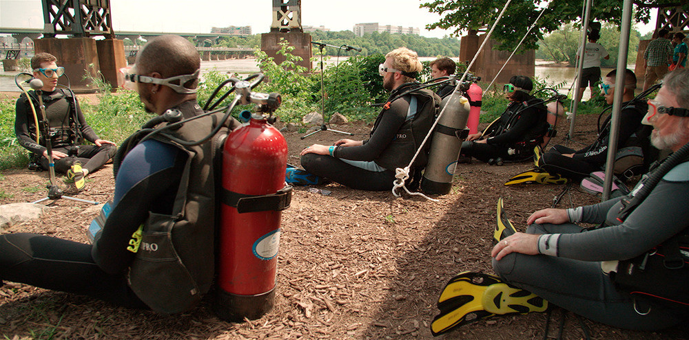
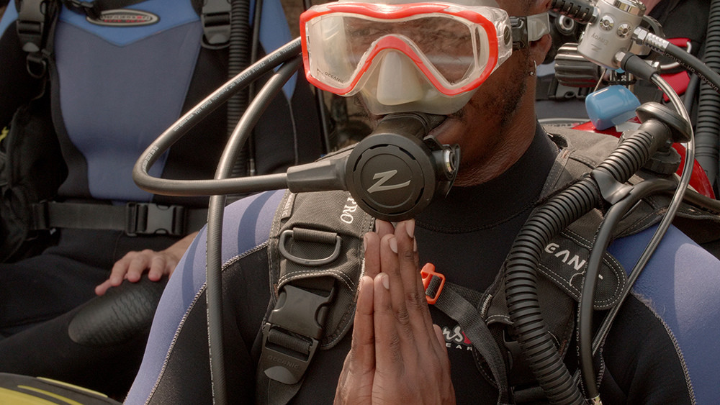
Notes:
Images: UFOclub Creative; Source: https://www.hopeginsburg.com/work/land-dive-team-amphibious-james-2018

Slide 6
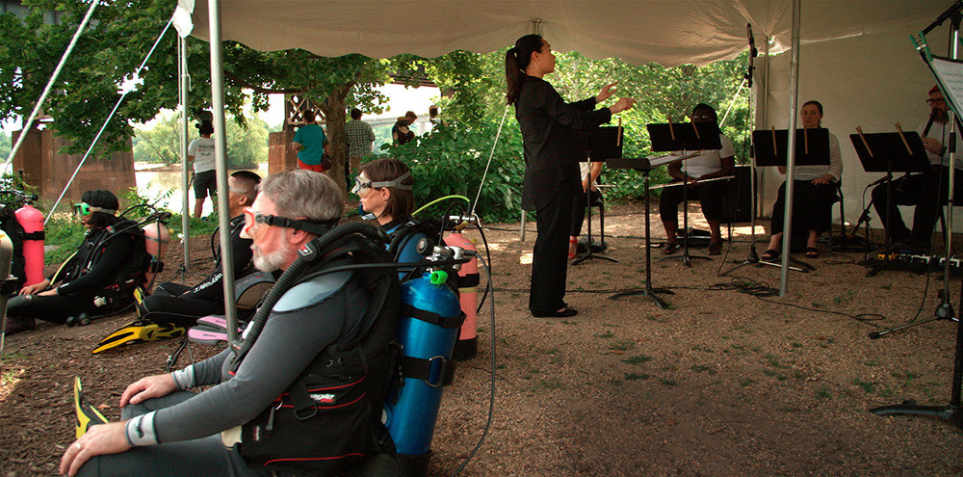
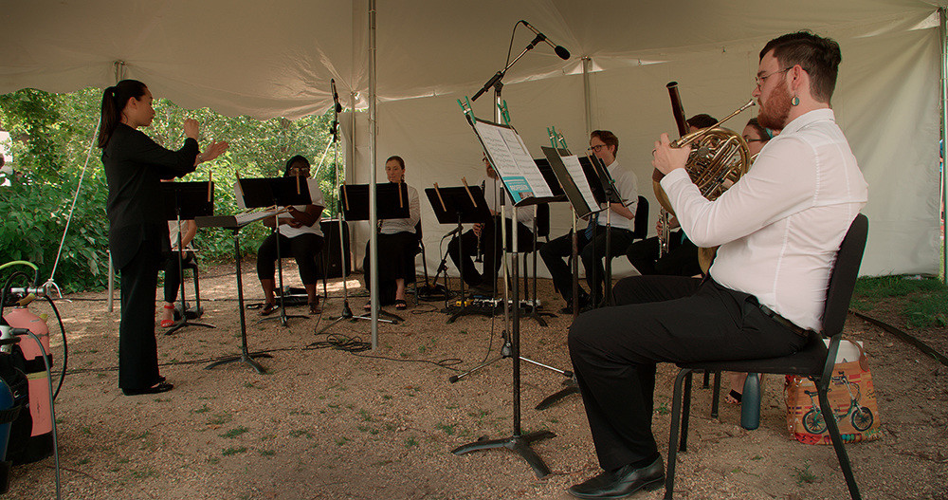
Notes:
Images: UFOclub Creative; Source: https://www.hopeginsburg.com/work/land-dive-team-amphibious-james-2018

Slide 7
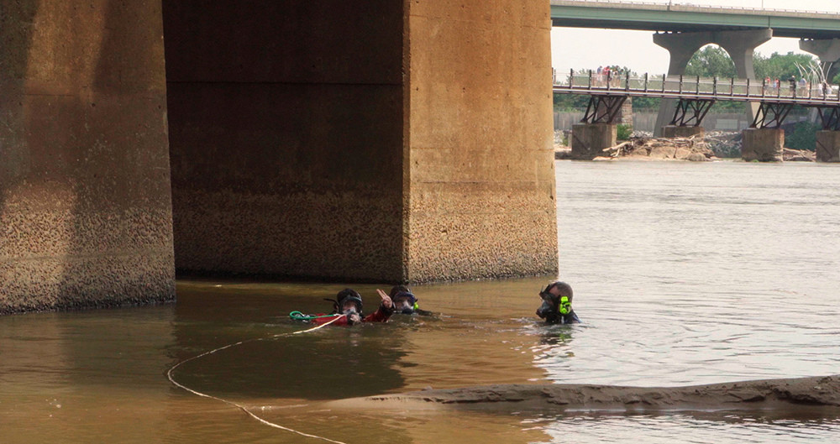
Notes:
Images: UFOclub Creative; Source: https://www.hopeginsburg.com/work/land-dive-team-amphibious-james-2018
Ask: what do you think the artist was trying to achieve with this work? What questions does viewing stills from the work prompt for you?

Slide 8
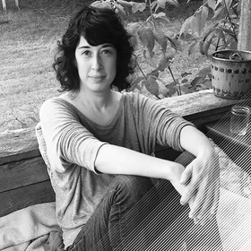
Hope Ginsburg
BFA in Sculpture, Tyler School of Art
MS in Visual Studies, Massachusetts Institute of Technology
professor at Virginia Commonwealth University’s School of the Arts
Notes:
Source: http://creativetime.org/summit/author/hope-ginsburg/
Curiosity about the natural world, “learning by doing,” and knowledge exchange inform Hope Ginsburg’s work, which takes the form of live events that explore the images, objects, and spaces that they generate. Her pedagogical project Sponge is headquartered at the Virginia Commonwealth University School of the Arts, where she is an associate professor. Ginsburg’s projects and workshops have appeared in the 9th Mercosul Biennial, Porto Alegre, Brazil; The Museum of Modern Art, New York City; Proteus Gowanus, Brooklyn, New York; and Mildred’s Lane, Beach Lake, Pennsylvania. Upcoming group exhibitions include Explode Everyday: An Inquiry into the Phenomena of Wonder, at MASS MoCA (North Adams, Massachusetts); and a Distinguished Alumni Exhibition at Tyler School of Art’s Temple Contemporary Gallery (Philadelphia). Ginsburg holds a BFA in Sculpture from Tyler School of Art and an MS in Visual Studies from MIT.

Slide 9
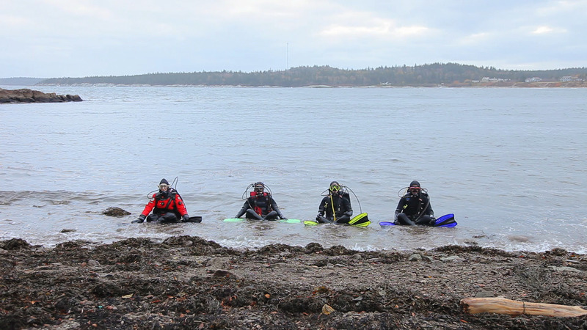
Ginsburg’s art
Central Concepts
Art Mediums
The Natural World
Community
Human-Environment interaction
Photography
Video
Performance Art
Notes:
Source: VCU’s Institute for Contemporary Art, https://icavcu.org/artist/ginsburg/ginsburg1/

Slide 10
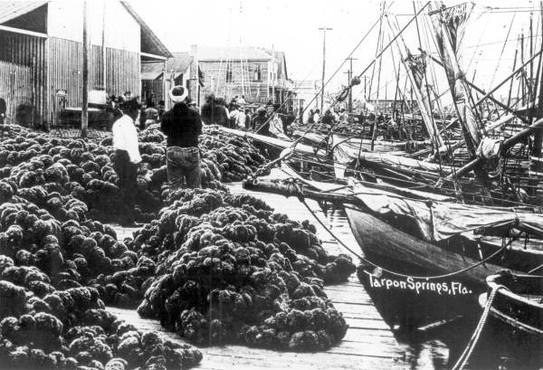
Notes:
Source: https://www.floridamemory.com/items/show/24516
Sponge fleet boats at a sponge filled dock - Tarpon Springs, Florida
Image Number: RC00341
Year: 19--?
Physical Description: 1 photoprint - b&w - 7 x 10 in.
Give students 1-2 minutes to view the black and white photograph. Ask:
When might this photograph have been taken?
Where was this photo taken?
What objects can you identify?
What are the people doing?
After discussing their guesses, tell students that this photograph was taken at the beginning of the 20th century in Tarpon Springs, Florida, a city with a long history in the sponge industry.
In the late 19th century, the first sponge business was founded in the city, continuing to grow as demand grew. Bahamian and Greek immigrants moved to the city to work in the sponge industry.

Slide 11
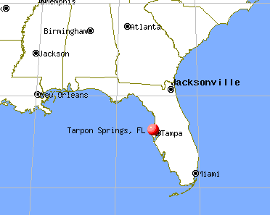
Tarpon Springs, Florida: A Brief History
First settled in late 1800s
In 1880s first sponge business began
Greek immigrants started arriving in 1890s
Today has highest percentage of Greek Americans in U.S.
Continues to have an active sponge industry
Notes:
Located on the Gulf of Mexico, Tarpon Springs.

Slide 12
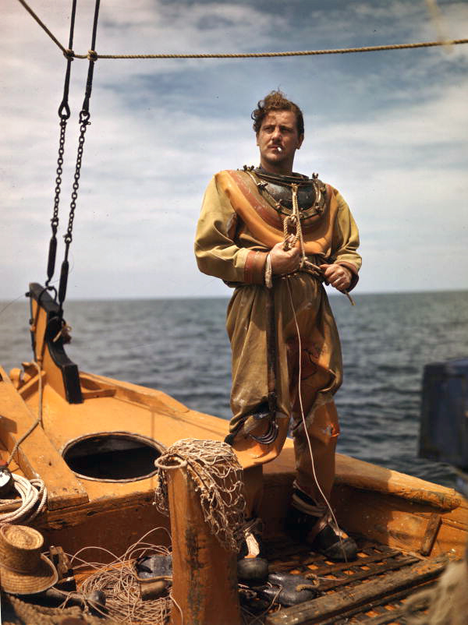
Sponge Diving
One of the earliest forms of diving
In Greece, divers using the freediving method stayed underwater for up to 5 minutes
Sponges are retrieved by divers for use by people
Natural sponges were used exclusively until the introduction of synthetic sponges
Notes:
Source: https://en.wikipedia.org/wiki/Tarpon_Springs,_Florida
In 1905, John Cocoris introduced the technique of sponge diving to Tarpon Springs by recruiting divers and crew members from Greece. The first divers came from the Saronic Gulf islands of Aegina and Hydra, but they were soon outnumbered by those from the Dodecanese islands of Kalymnos, Symi and Halki. The sponge industry soon became one of the leading maritime industries in Florida and the most important business in Tarpon Springs, generating millions of dollars a year.

Slide 13
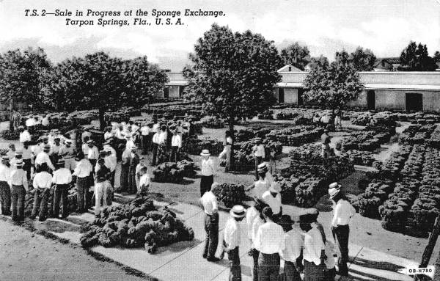
Notes:
The sponge industry was an important business in Tarpon Springs in the late 1800s/early 1900s.l
Source: https://www.floridamemory.com/items/show/149423
Sponge sale in progress at the Sponge Exchange - Tarpon Springs, Florida
Image Number: N041335
Year: 19--?
Publication Info: Saint Petersburg, Fla. : Sun News, [19--]
General Note: Photonegative of a postcard, number OB-H780.

Slide 14
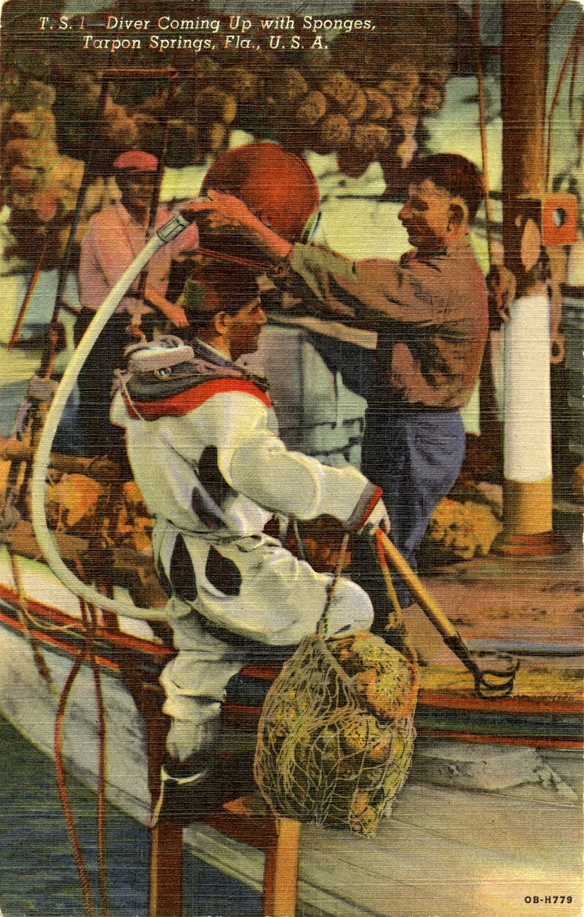
Tarpon Springs, 1940
Notes:
Source: https://www.floridamemory.com/items/show/334298
Image Number: PC15643
Year: 1940
Publication Info: St. Petersburg, Fla. : Sun News Co., 1940.
Physical Description: 1 postcard - hand-colored - 14 x 9 cm.

Slide 15
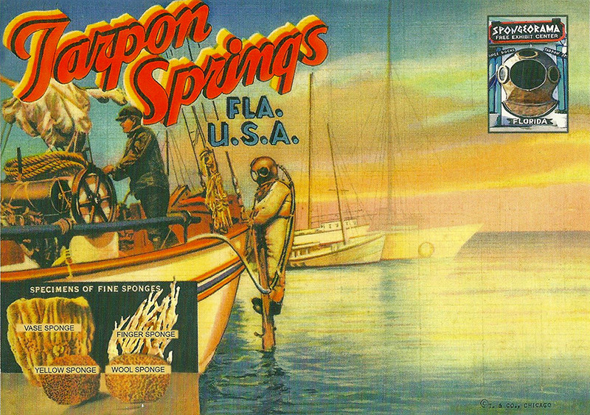
Notes:
Image source: https://www.hopeginsburg.com/
Vintage postcard from the Spongeorama.

Slide 16
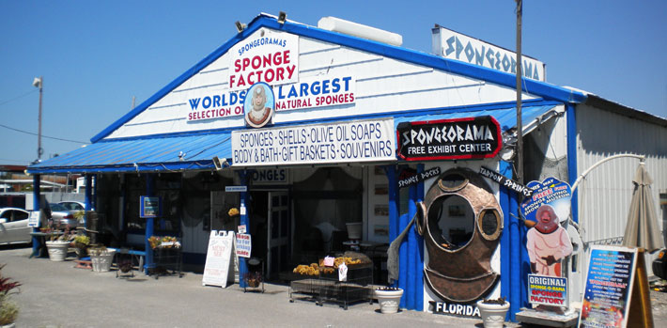
Notes:
The Spongeorama was founded in 1968 as a factory of natural sea sponges. Today it operates as a shop and museum.
Source: https://spongeorama.com/

Slide 17
Sponge Exchange (2019)
Notes:
Ginsburg’s Sponge Exchange explores past challenges to the local sponge industry, raises awareness and understanding of how the health of marine invertebrates is deeply tied to the environment and economic life of the region, and serves as a catalyst for imagining productive solutions for the future.
Source: http://ira.usf.edu/CAM/exhibitions/2020_1_Sponge_Exchange/Sponge_Exchange.html

Slide 18
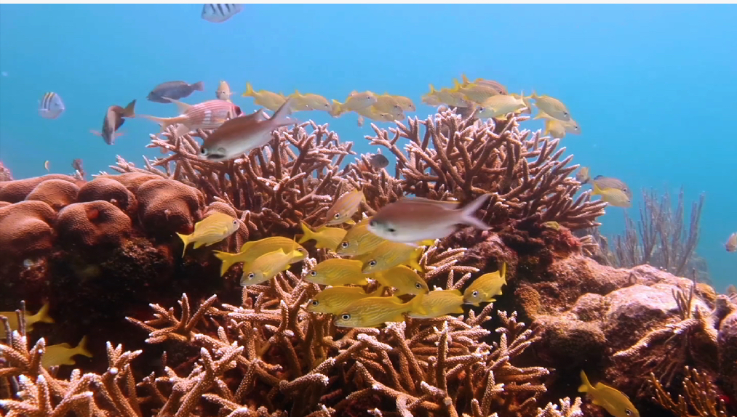
Swirling (2019)
Notes:
Sponge Exchange uses “sea sponges and hard corals as a metaphor for exchange and the ecology of learning to stimulate social transformation” — meant to cultivate resilience by addressing critical social and environmental issues.
Source: https://www.cltampa.com/arts-entertainment/a-e-events/article/21084624/find-hope-ginsburg-talking-environmental-art-at-usf-tampa

Slide 19
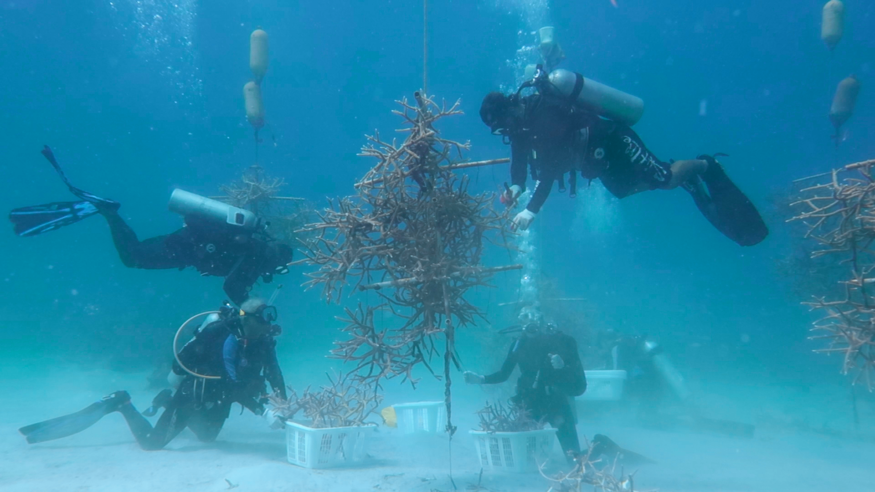
Swirling (2019)
Notes:
Source: http://ira.usf.edu/CAM/exhibitions/2020_1_Sponge_Exchange/Sponge_Exchange.html
The four-channel video submerges viewers in the underwater coral nurseries and outplant sites of St. Croix, capturing the often unseen coral farming and reef restoration work that occurs beneath the surface.

Slide 20
Hope Ginsburg
"I've always been married to the idea of preserving the visual. It's something that I feel is very important.”
Notes:
Image source: soundartsrichmond.com
Quote source: http://cueartfoundation.org/young-art-critics-essays/2013/8/8/emily-sessions-on-hope-ginsburg

