Slide 1
Anastasia Samoylova
Climate of Paradise
Notes:
Image source: http://correspondencias.fotocolectania.org/en/contributors/

Slide 2
What do you think is going on in the picture?
What in the picture creates this perception?
What else can you conclude from this picture?
Notes:
Image source: https://grist.org/cities/miami-vise-rising-seas-put-the-squeeze-on-a-sun-drenched-beach-town/

Slide 3
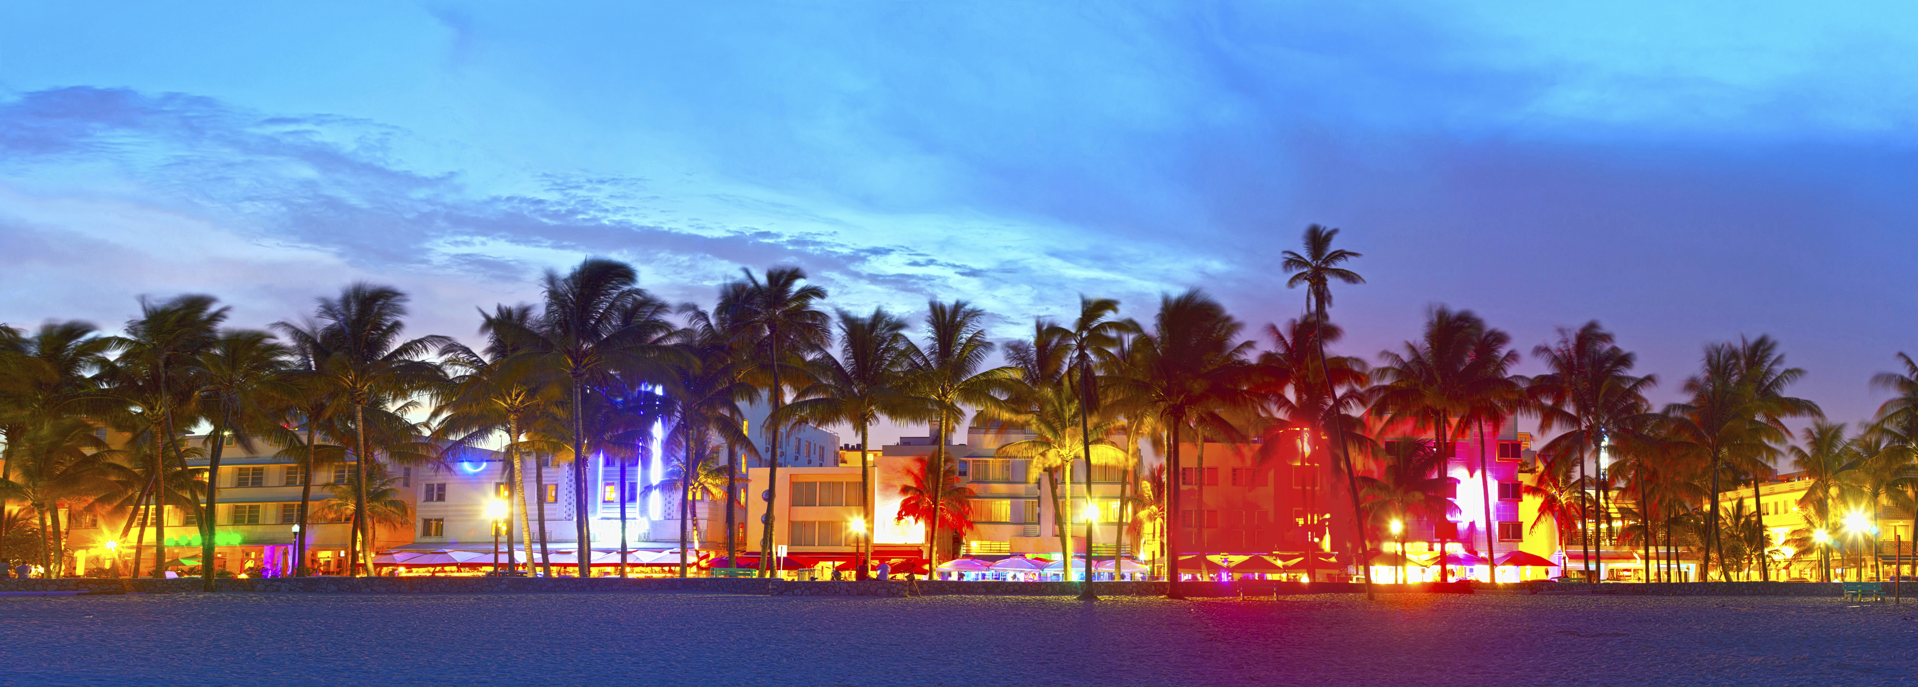
What do you see in this picture?
What do you see that makes you say that?
What else can you conclude from this image?
Notes:
Image source: https://westsidetoday.com/2014/10/24/south-beach-gems-miamis-best-kept-secrets/

Slide 4
Both pictures are of Miami Beach, FL
Notes:
Both images represent Miami Beach, FL, yet each picture communicates a different narrative of the city. The rise in sea level is threatening coastal communities. Recently, rain-induced events and tide-induced flooding have become more frequent in Miami Beach, affecting neighborhoods and wreaking severe damage in the area (Wdowinski, Bray, Kirtman, & Wu, 2016).
Reference: Wdowinski, S., Bray, R., Kirtman, B. P., & Wu, Z. (2016). Increasing flooding hazard in coastal communities due to rising sea level: Case study of Miami Beach, Florida. Ocean and Coastal Management, 126, 1–8.

Slide 5
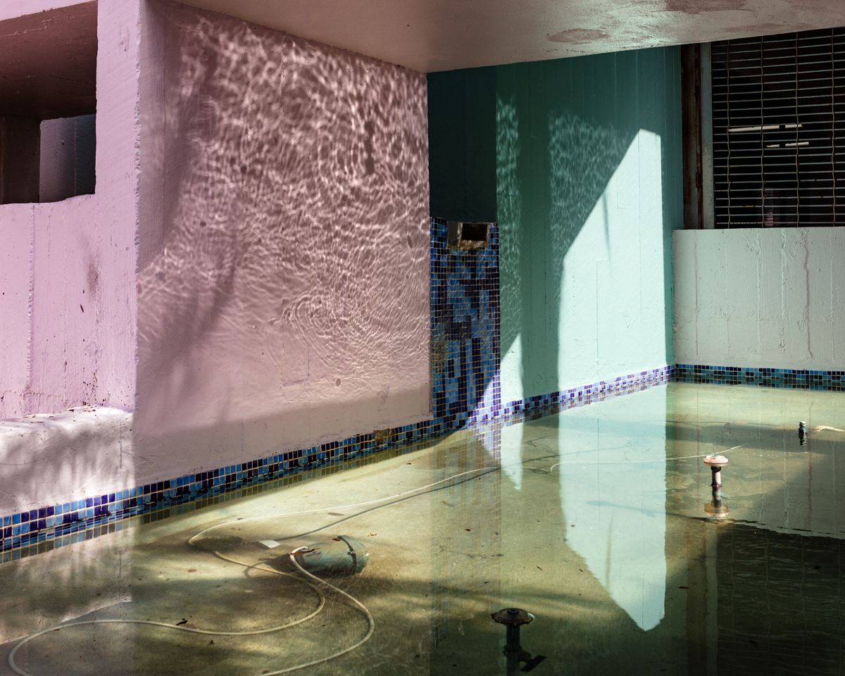
FloodZone (2016): Photographic representations of rising sea level
Notes:
Image retrieved from: https://www.anasamoylova.com/work-1#/floodzone/

Slide 6
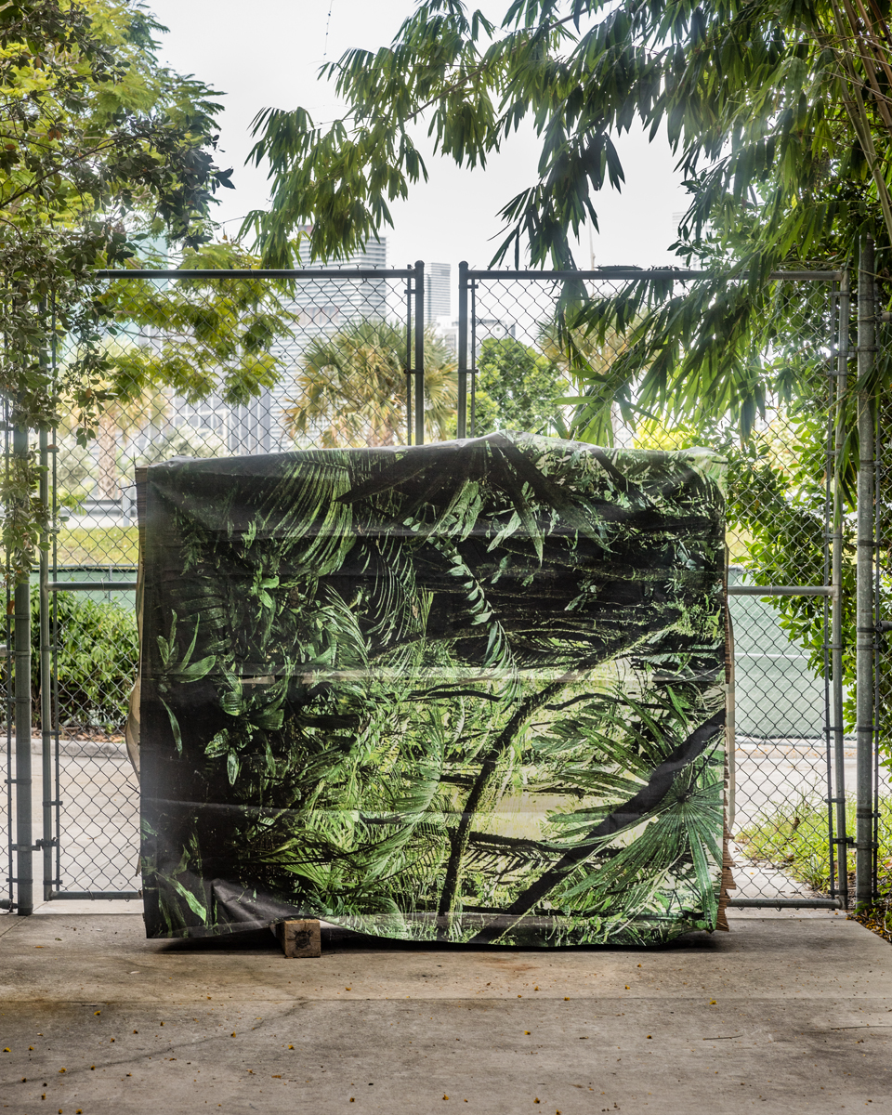
Notes:
Image retrieved from: https://www.anasamoylova.com/work-1#/floodzone/

Slide 7
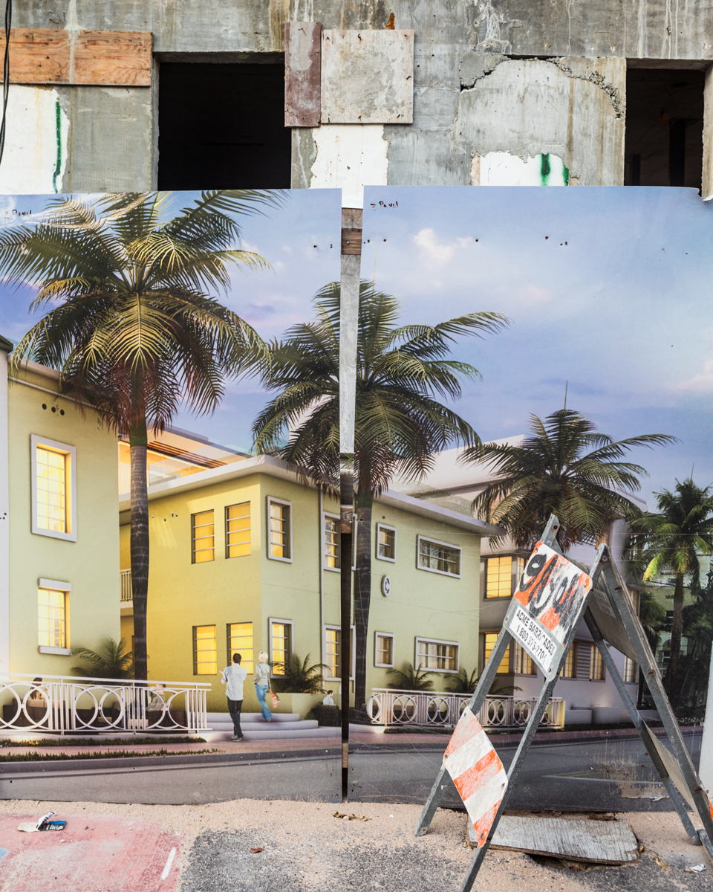
Notes:
Image retrieved from: https://www.anasamoylova.com/work-1#/floodzone/

Slide 8
Born in Moscow, Russia
MFA Bradley University, 2011
MA Russian State University for the Humanities, Moscow, 2007
Notes:
Image retrieved from: https://oolitearts.org/resident/anastasia-samoylova/
Notes retrieved from: https://www.anasamoylova.com/bio

Slide 9
Through photography and other art mediums, Samoylova explores constructed narratives of the world.
Her recent focus is on the Miami Beach tourism narrative that fuels high profits versus the reality of increased flooding due to sea level rise and rain.
Notes:
Image: Crashing Waves
Image and information retrieved from: https://www.anasamoylova.com/work-1#/sublime/

Slide 10
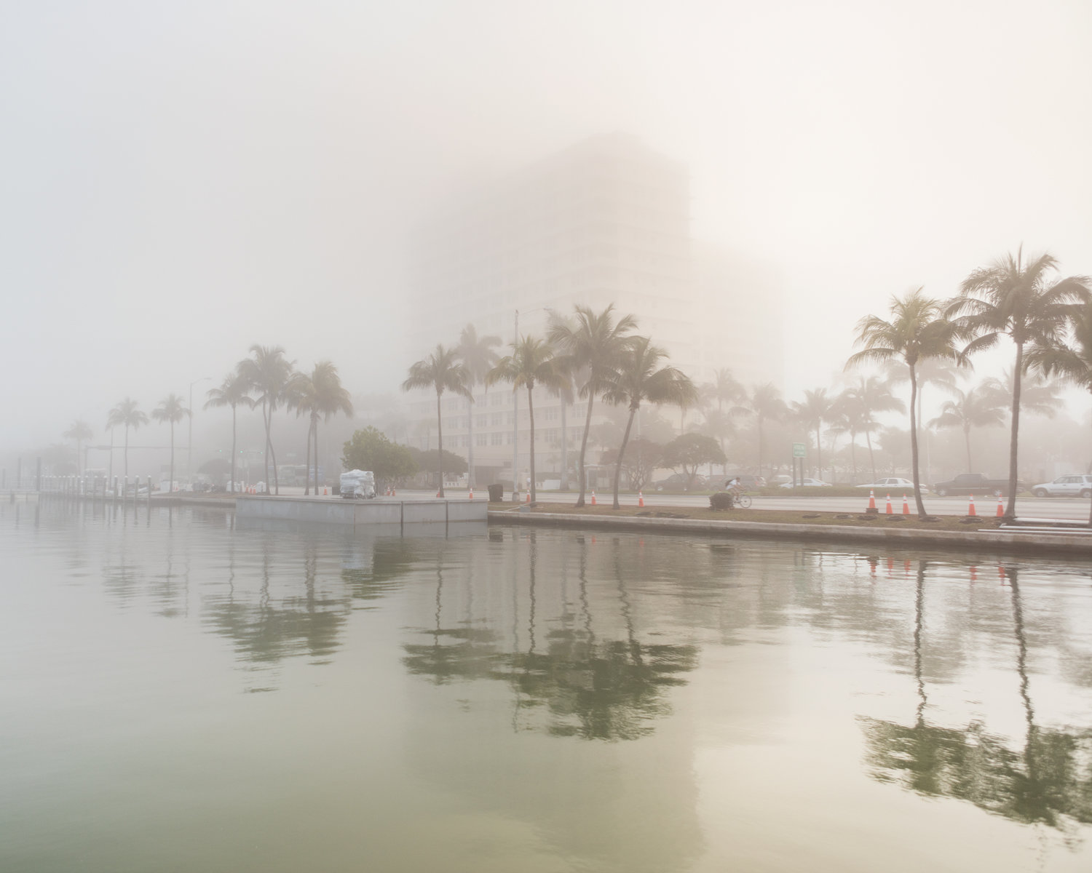
Miami Beach: A Brief and Recent Flood History
Notes:
Image retrieved from: https://www.anasamoylova.com/work-1#/floodzone/

Slide 11
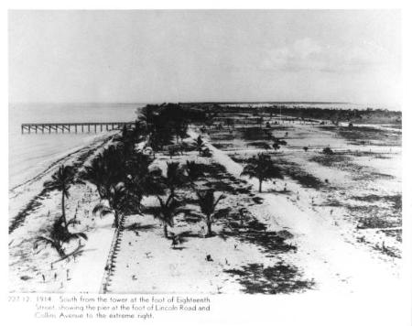
Miami Beach is an artificially built island a little over 100 years old.
It is a low-lying coastal community
Notes:
Image retrieved from: http://www.visitsouthbeachonline.com/south-of-fifth.htm
Reference: https://www.miamiherald.com/news/local/community/miami-dade/miami-beach/article15798998.html

Slide 12
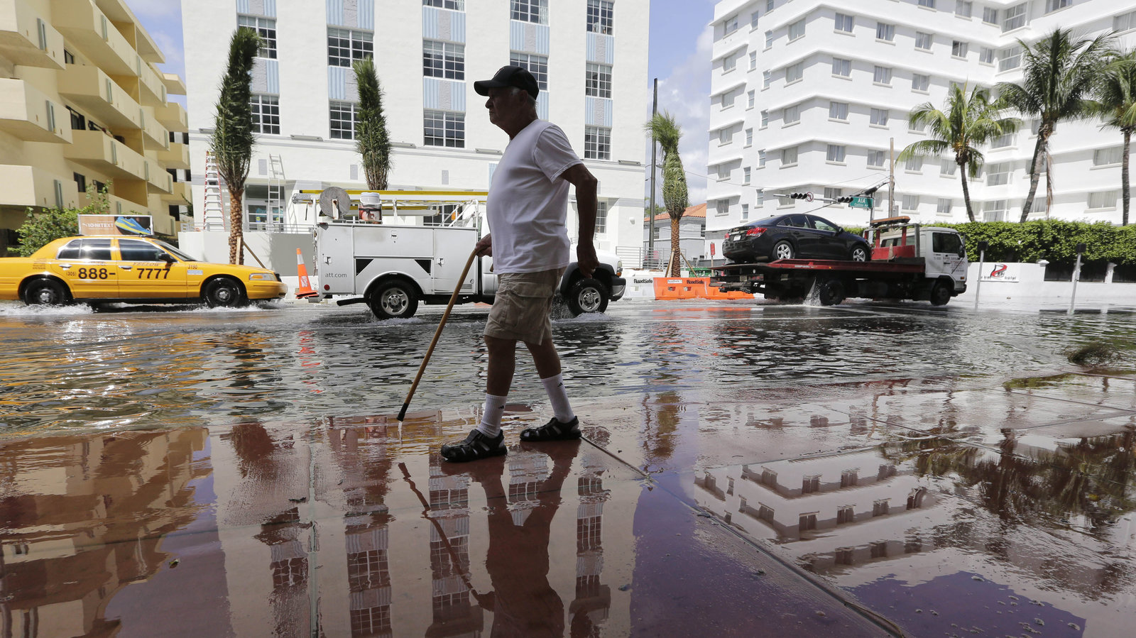
Miami Beach is highly susceptible to flooding.
Rain-induced events have increased by 33% since 2006.
Tide-induced events increased by 400% since 2006.
Notes:
Image retrieved from: https://www.npr.org/2016/05/10/476071206/as-waters-rise-miami-beach-builds-higher-streets-and-political-willpower
Reference: Wdowinski, S., Bray, R., Kirtman, B. P., & Wu, Z. (2016). Increasing flooding hazard in coastal communities due to rising sea level: Case study of Miami Beach, Florida. Ocean and Coastal Management, 126, 1–8.

Slide 13
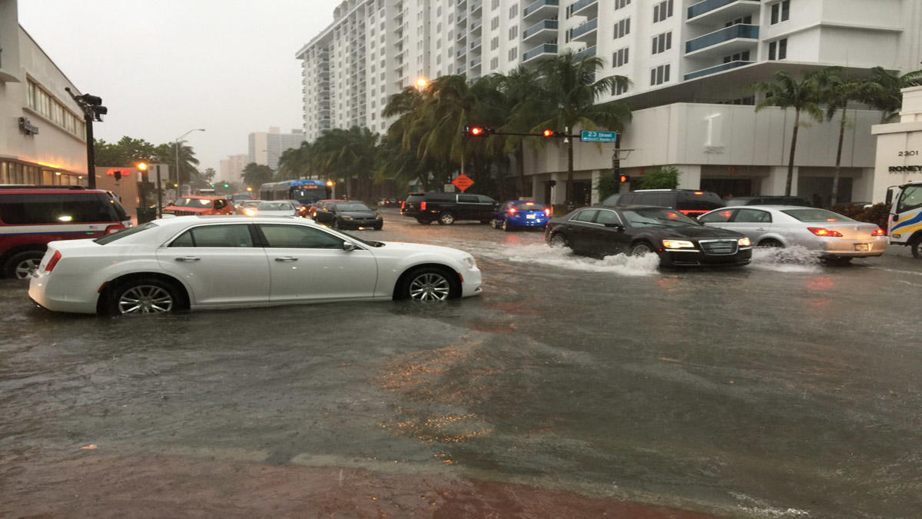
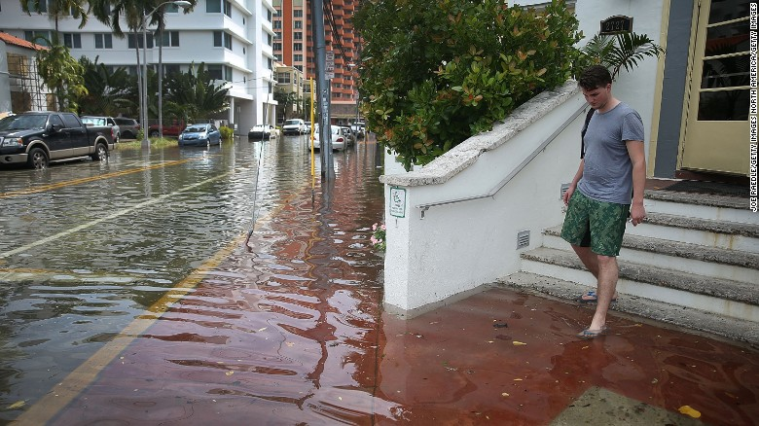
Notes:
Image (left) from: https://www.nbcmiami.com/news/local/Heavy-Showers-Cause-Flooding-in-Miami-Beach-437926953.html
Image (right) from: https://www.cnn.com/2017/07/16/app-news-section/weekend-survey-results-july-16-mobile/index.html

Slide 14
“What is it like, mentally, to live at the forefront of climate change? The dread, the anxiety, the worry, the disavowal.”
- Anastasia Samoylova

