Slide 1
Borderlands
Time, Space, and Cognition

Slide 2
Notes:
Teacher: What do you think is the content of the photo? (Topic of photo) What do you think is the subject of the photo? (Main person/people in the photo) What is the landscape of the photo? (Environment) What do you think the photo journalist expresses in this image?
Visual literacy strategies

Slide 3
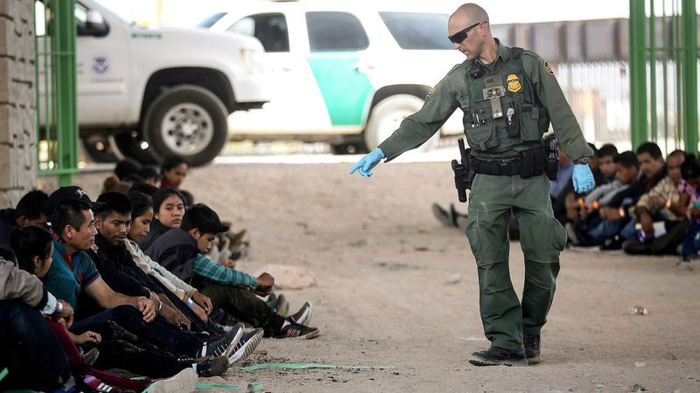
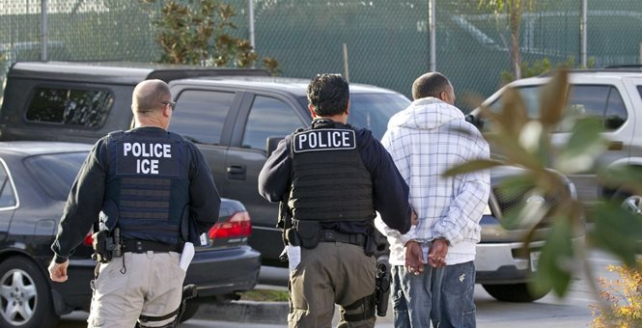
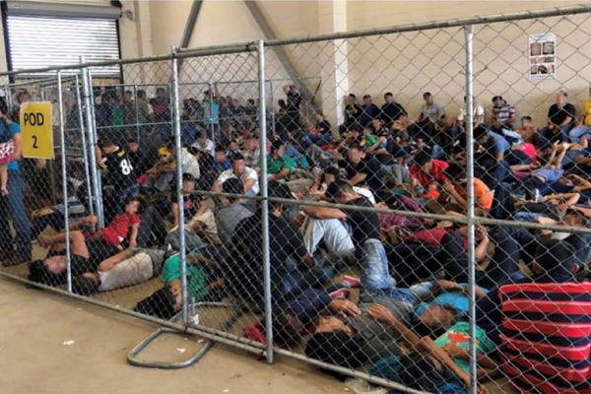
What do we see, hear, and read about immigration today?: Snapshots
Notes:
Teacher: This slide contains snapshots from a recent google news search on immigration in the U.S. section. Pay close attention to the language in the headlines and the content and subject in the images.
Write down one word of interest from each headline. [4 in total] Why did you select these words? What do these words mean to you? Do these words affect your perception on immigrants? If so, how?
Write your perception of the content and subject of each photograph. How does the presentation of content and subject in these images affect your perception on immigration?

Slide 4
What is a narrative?
Merriam-Webster Online Dictionary Definition:
“…a way of presenting or understanding a situation or series of events that reflect and promote a particular point of view or set of values…”
Notes:
Teacher: Discuss with students the definition of a narrative and how this applies to headlines and images. Review your writings from the previous slide. What do you perceive is the narrative being told in the headlines and images?
Source: https://www.merriam-webster.com/dictionary/narrative

Slide 5
Rodrigo Valenzuela’s Diamond Box (2013)
Notes:
Teacher: As discussed during the presentation “Rodrigo Valenzuela: Shedding Light on the Human Experience,” the artist sheds a different light on the immigrant experience. The following is his video titled Diamond Box.
“As discussed during the presentation ‘Rodrigo Valenzuela: Shedding Light on the Human Experience,’ the artist sheds a different light, or a different narrative, on the immigrant experience. The following is his video titled Diamond Box. As we watch the video, write down words of interest and description of the images.”
Play Rodrigo Valenzuela’s Diamond Box.
After the video ends, inform students they have a couple of minutes to write down any further thoughts on the video.
Ask students:
• What are words from Diamond Box that interest you?
• What are your perceptions of the images?
• What is the immigration narrative Valenzuela reveals?
The artist intends to humanize the immigrants. The video reveals stories of crossing the border. How does this narrative conflict with the narrative found in the headlines and images discussed?
Source: https://vimeo.com/35288013

Slide 6
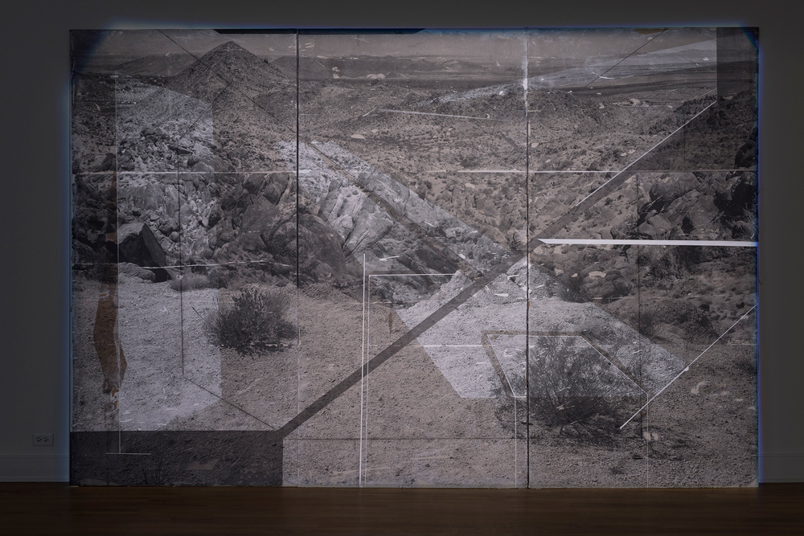
Rodrigo Valenzuela’s Frontiers (Installation)
Notes:
Teacher: This is an image from Valenzuela’s Frontiers. It is an image of the terrain found along the U.S.-Mexico border.

Slide 7
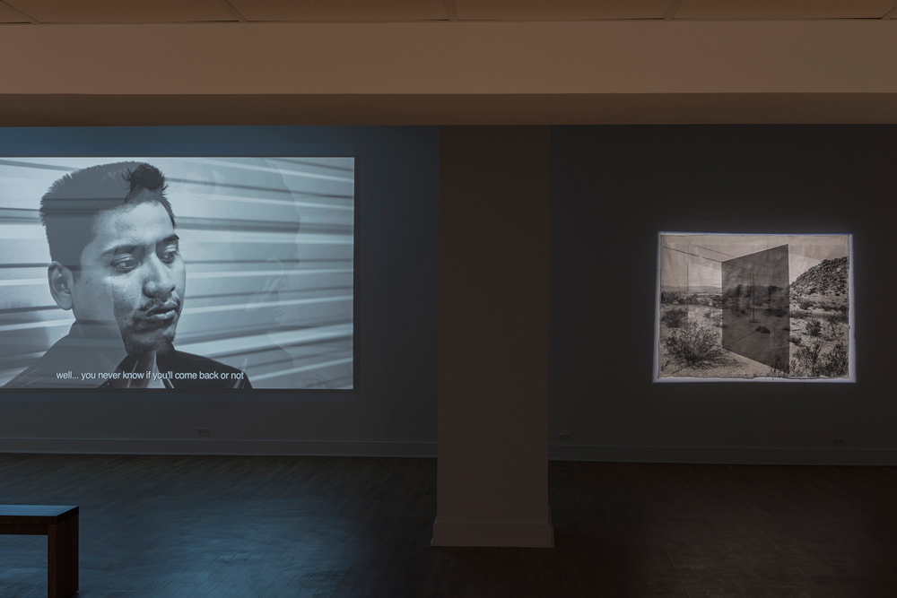
Notes:
Teacher: What is the content within this image? What is the subject? What is the landscape? How do these come together to create a narrative?
Source: http://www.rodrigovalenzuela.com/frontiers/erwwmr3kthxx17zcg6we48lakncoqh

Slide 8
Activity
Select a contemporary issue/movement important to you
Examples: climate change, Black lives matter, women’s rights, LGBTQ+ rights, 1st Amendment (gun rights), etc.
Conduct a news search on the issue
Select and copy four headlines
Write a paragraph on your perception of the narrative found in the media
Create an image
Write and prepare to discuss:
What is your personal narrative of the issue?
How did you come to this narrative?

